Slide 1
The Grand Convergence and Country Graduation from International Funding Mechanisms: fiscal implications for health in Africa with a focus on Ghana and Kenya
Helen Saxenian
September 27, 2016
4th AfHEA International Conference
Rabat Morocco

Slide 2
Agenda
Sources of financing for convergence: Commission on Investing in Health perspectives on resource mobilization
World Bank income classification system and external assistance
Health finance implications for Ghana and Kenya

Slide 3
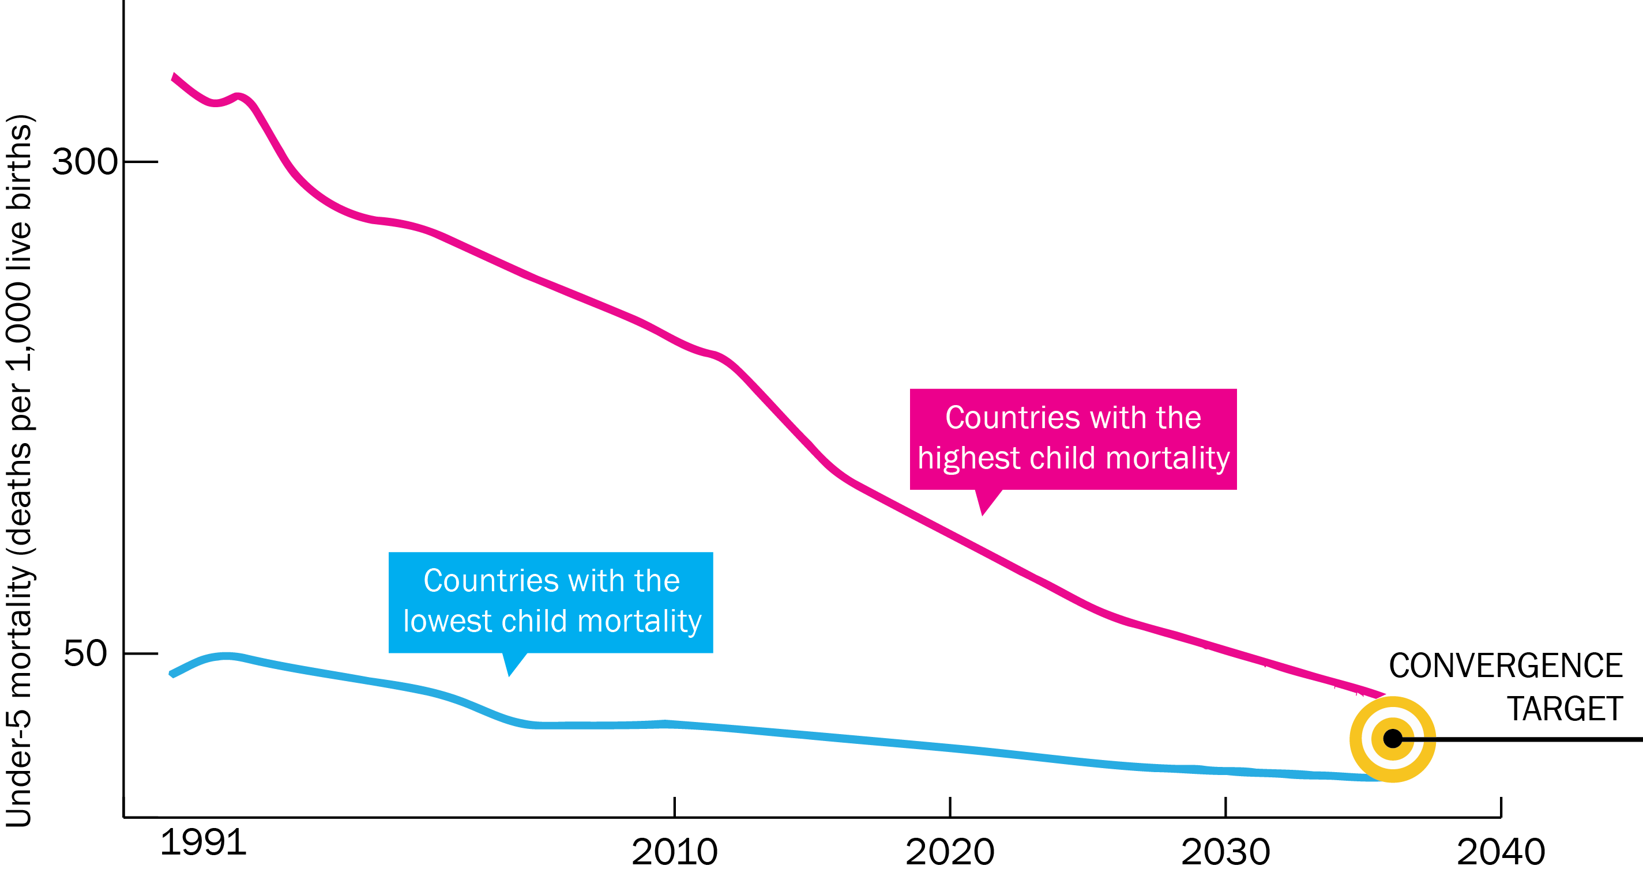
Global Health 2035: With Sufficient Investments in Health Nearly All Countries Could Converge by 2035

Slide 4
Financing Convergence
Economic growth
Cost of convergence ($70 billion/y) is less than 1% of anticipated growth in low- and lower-middle income countries from 2015 - 2035
Mobilization of domestic resources
Taxation of tobacco, alcohol, sugar (win-wins)
Inter-sectoral reallocations and efficiency gains
Development assistance for health
E.g. Removal of fossil fuel subsidies and other reallocations
Will still be crucial for achieving convergence
Health sector efficiency
Broadening of tax base, strengthened administration

Slide 5
Economic Growth
Economic growth can create additional fiscal space for health spending
Sub-Saharan Africa real growth in income 2010 – 2015 (actual), 2016 – 2021 (projected)
2010 | 2011 | 2012 | 2013 | 2014 | 2015 | 2016 | 2017 | 2018 | 2019 | 2020 | 2021
6.6 % | 5.0 % | 4.3 % | 5.2 % | 5.1 % | 3.4 % | 3.0 % | 4.0 % | 4.4 % | 4.5 % | 4.5 % | 5.0 %
Source: IMF World Economic Outlook, April 2016

Slide 6
Economic Growth
Tax base broadens and tax administration improves as economies grow
Low Income
Lower-middle Income
Upper-middle Income

Slide 7
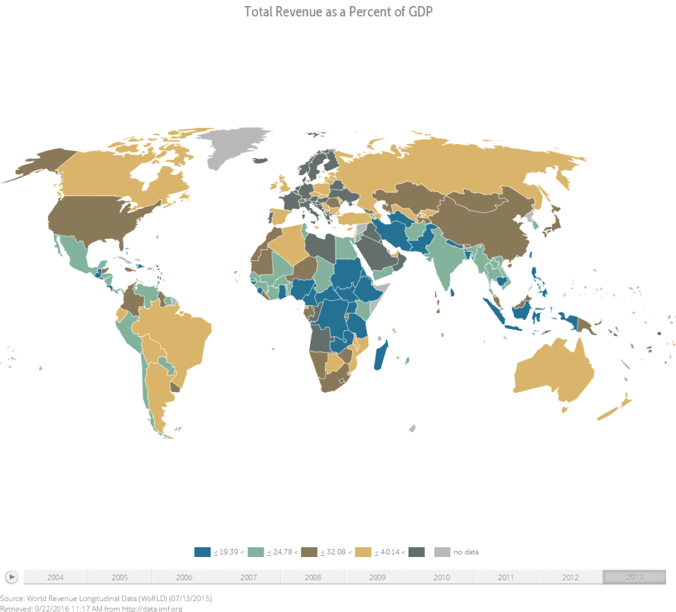
Economic Growth
Total revenue as a percent of GDP, 2013
Source: IMF World Revenue Longitudinal Data

Slide 8
Domestic Resource Mobilization
Taxes on tobacco, alcohol, and sugar (emerging experience) can improve health and raise revenue
Note numbers for Ghana may need updating (increase in tobacco tax in 2015)
WHO recommends that tobacco tax be at least 70% of consumer price
Tobacco use and taxation in Ghana and Kenya (source: WHO)
 | Age-standardized prevalence of smoking, 2013 (any smoked tobacco, both sexes, 15+ yrs) | Price of cigarette pack (USD at official exchange rate) | Taxes as % of cigarette pack price | Tobacco taxes as % of GDP (2013)
Kenya | 13.6 | $1.14 | 49% | 0.24 %
Ghana | 6.3 | $0.82 | 28% | 0.03 %
Notes:
WHO recommends that tobacco tax be at least 70% of consumer price.

Slide 9
Budgetary reallocations and efficiency gains
Reallocate fiscal resources from unproductive to productive/high-priority spending, including health
  Large energy subsidies on air-polluting fuels (e.g., 3.5% of GDP in sub-Saharan Africa; larger expenditure on subsidies than on health)¹
  IMF estimates: revenue gain from eliminating energy subsidies US$2.9 trillion (3.6 percent of global GDP), 2015
Scope for efficiency gains within the health sector
  Could free up resources for expanding critical health services, thus improving health outcomes
¹ In most countries, the largest share stems from undercharging for domestic environmental damage (air pollution, and broader externalities from vehicle use like traffic congestion and accidents.

Slide 10
Development Assistance for Health (DAH)
Significant DAH will be needed to achieve Grand Convergence in low-income, and many lower-middle income, countries
After rapid growth, DAH, though, fairly flat in recent years
Source: Institute for Health Metrics and Evaluation

Slide 11
SSA receives largest share of development assistance for health
34% in 2013 ; rose 12% from 2012 to 2013 (Source: IHME)
Major channels of DAH: NGOs & foundations, Bilateral donors, Global Fund, Development Banks, WHO, Gavi, and others
Some external donors have clear eligibility thresholds and transition arrangements, others more based on donor-country relationships and aid objectives

Slide 12
Country Income Classifications and Impact on DAH
History of World Bank Analytical Income Classification:
  In use since 1989
  Sets classification using GNI per capita valued annually, and 3 year average exchange rate
  Significant change in the number of countries in each of four income categories since the system was established:
The main purpose, for the World Bank, is analytical
GNI per capita correlates well with many development outcomes, but it is not a perfect measure
 | Low Income | Lower-middle Income | Upper-middle Income | High Income
1989 | 49 | 46 | 27 | 41
2016 | 31 | 51 | 53 | 80

Slide 13
Country Income Classifications
Income classification often confused with Bank’s operational guidelines that establish lending terms → these are not the same
  IDA only (highly concessional credits): LIC and some LMIC
  Blend (eligible for blend of IDA credits & IBRD loans): LIC and LMIC
  IBRD loans (after successful IDA graduation): some LMIC and many UMIC countries
Few donors use exclusively World Bank Income Classification to guide resource allocation
  Global Fund: Income in conjunction with disease burden
  Gavi: uses low income category as part of its co-financing categories, and 3-year moving average of GNI per capita for eligibility threshold (currently $1580)

Slide 14
Main Critiques of GNI p.c. Income Classification
Purchasing power parity GNI p.c. estimates better for comparing countries, but these are not updated every year
Thresholds seem arbitrary
GNI p.c. well correlated with poverty headcount, but doesn’t explicitly take into account how well income is shared within a country
Issues with data quality
Rebasing can cause large jumps (and abrupt changes)
Some volatility (countries can move in and out of income classifications)
SDR deflator not representative of international inflation

Slide 15
Ghana and Kenya Income Classification¹ (current USD)
 | Ghana GNI p.c. | Kenya GNI p.c. | Low-Income Category | Lower-middle income Category
2009 | $700 | $770 | ≤$995 | $996-$3945
2010 | $1240* | $780 | ≤$1005 | $1006-$3975
2011 | $1410 | $820 | ≤$1025 | $1026-$4035
2012 | $1550 | $840 | ≤$1035 | $1036-$4085
2013 | $1760 | $930 | ≤$1045 | $1046-$4125
2014 | $1620 | $1280* | ≤$1045 | $1046-$4125
2015 | $1480 | $1340 | ≤$1025 | $1026-$4035
*Rebasing of national income
¹ Based on release the following July by the World Bank. For example, GNI p.c. estimate for 2015 is released on July 1, 2016.

Slide 16
What does all of this mean for Ghana and Kenya?
Economic growth in and of itself will raise health budget, all things equal
Broaden and strengthen tax base and consider new/larger taxes that are “win-win” in improving health and raising revenue
Need to continue to make the case for investing health in government budget processes (and with counties, in Kenya)
External assistance is likely to decline over medium/long term: need to make strategic use of external assistance and plan for sustainability

Slide 17
Thank you
GlobalHealth2035.org

