Slide 1
Benjamin Nyakutsey
Head, Policy Unit PPMED, Ghana Ministry of Health
Implications for Health Financing Policy in Ghana
Policy Options for Ghana to Achieve Grand Convergence

Slide 2
Introduction
Recent rebasing of Ghana’s GDP led to an overnight US$500 per capita jump (from $1,140 to $1,620)
Ghana faces reduced access to external development assistance for health (DAH) due to new income classification
Policy Implications for Ghana
  Health systems strengthening to achieve efficiency gains
  Ignite political commitment and attitudinal shifts
  Collaborate across sectors to reduce health costs and control risks
Notes:
Outline:
Reflections on the LMIC Status
Policy Highlights/Shifts
Critical Success Factors

Slide 3
Policy Thrust
Achieve Universal Health Coverage (UHC)
  Financial risk protection
  Access to safe, effective, quality services and affordable essential medicines and vaccines for all
Health Systems Strengthening and Realignment
  Ouagadougou Declaration Framework
Provide Leadership for Inter-Sectoral Linkages to Limit Future Risks
  Infrastructure
  Environment
  Nutrition
  Focus on High Impact Interventions
    CHPS (Community- Based Health Planning and Services)
    MAF (Millennium Accelerated Framework)

Slide 4
Health Sector Response
Bridge equity gaps in geographical access to health services
  Accelerate the implementation of the revised CHPS strategy
Ensure sustainable financing for health care delivery and financial protection for the poor
  Review of the NHIS and implement recommendations
  Improve efficiency in the provider-payment mechanisms
Improve efficiency in governance and management of the health system
  Strengthen inter-agency strategic and operational coordination
  Develop and implement health research agenda, and monitoring and evaluation systems
Notes:
National psyching of ownership, integrity and service to mankind

Slide 5
Health Sector Response
Improve quality of health services delivery, including mental health services
  Strengthen the continuum of care practices at all levels within health service delivery system
Enhance national capacity to attain health-related SDGs and sustain the MDG gains
  MAF strategy
  Newborn care
Intensify prevention and control of NCDs and infectious diseases
  Alcohol policy to be backed by a Legislative Instrument (LI)
  Optimize emergency preparedness and response plan
  Regenerative Health Policy

Slide 6
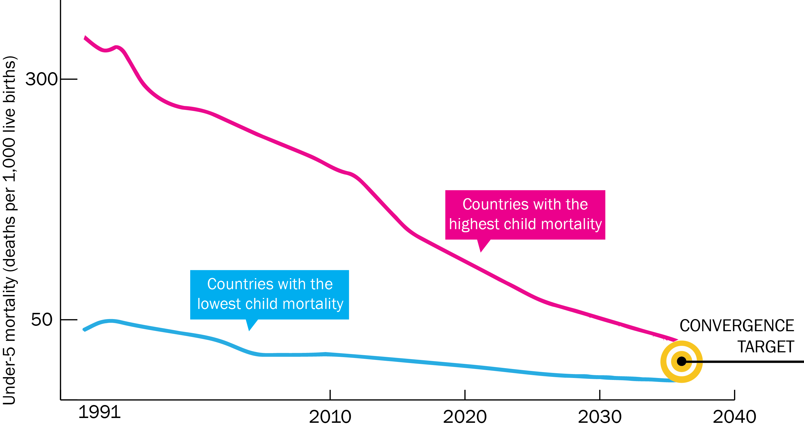
Final Destination (2035)

