Slide 1
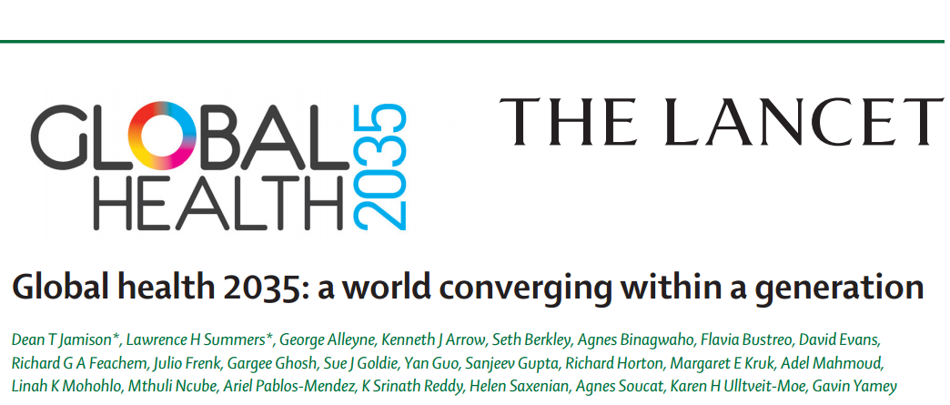
Gavin Yamey MD MPH
Associate Professor of Epidemiology & Biostatistics, UCSF School of Medicine
Lead, Evidence to Policy Initiative, Global Health Group, UCSF
Wednesday, March 18th, 09.30 – 11:00 am
Litteraturhuset, Wergelandsveien 29, 0167 Oslo

Slide 2
Health challenges of SDGs era
1. Key messages of report
2. Current program of work
3. Case studies of impact
High rates of avertable infectious, child, and maternal deaths
Unfinished agenda
Demographic change and shift in GBD towards NCDs and injuries
Emerging agenda
Impoverishing medical expenses, unproductive cost increases
Cost agenda

Slide 3
1. Key messages of report
2. Current program of work
3. Case studies of impact
The returns from investing in health are extremely impressive
A grand convergence in health is achievable within our lifetime
Fiscal policies are a powerful, underused lever for curbing non-communicable diseases and injuries
Pro-poor pathways to universal health coverage are an efficient way to achieve health and financial protection

Slide 4
1. Key messages of report
2. Current program of work
3. Case studies of impact

Slide 5
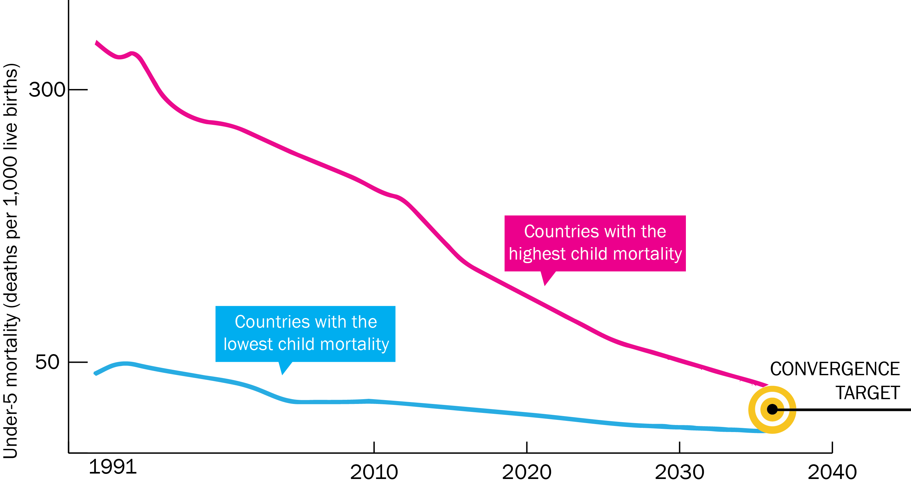
On cusp of historical achievement: nearly all countries could converge by 2035
C
1. Key messages of report
2. Current program of work
3. Case studies of impact

Slide 6
C
1. Key messages of report
2. Current program of work
3. Case studies of impact
Low-income countries | Lower middle-income countries
Annual deaths averted from 2035 onwards
4.5 million | 5.8 million
Approximate incremental cost per year, 2016-2035
$25 billion | $45 billion
Proportion of costs devoted to structural investments in health system
60-70% | 30-40%
Proportion of health gap closed by existing tools (rest closed by new tools)
2/3 | 4/5

Slide 7
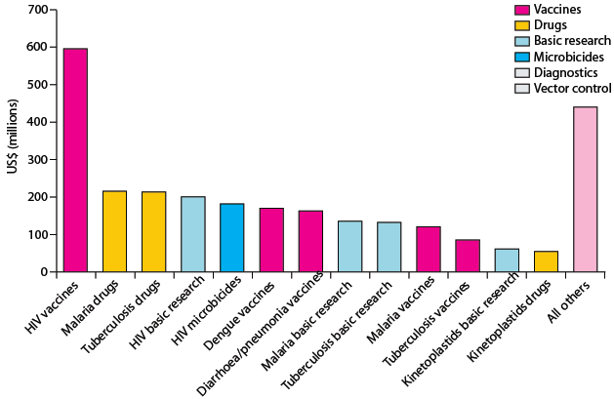
C
1. Key messages of report
2. Current program of work
3. Case studies of impact
Best way to support convergence is funding
R&D for diseases disproportionately affecting LICs and LMICs
and managing externalities e.g. flu pandemic
Current R&D ($3B/y) should be doubled, with half the increment funded by MICs
Current global spending on R&D for ‘convergence conditions’ Total: $3B/y

Slide 8
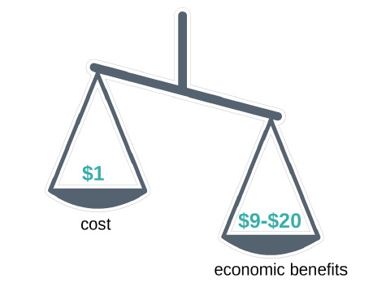
Convergence has impressive benefit: cost ratio
C
1. Key messages of report
2. Current program of work
3. Case studies of impact

Slide 9

Single greatest opportunity to curb NCDs is tobacco taxation
C
1. Key messages of report
2. Current program of work
3. Case studies of impact
50% rise in tobacco price from tax increases in China
  prevents 20 million deaths + generates extra $20 billion/y in next 50 y
  additional tax revenue would fall over time but would be higher than current levels even after 50 y
  largest share of life-years gained is in bottom income quintile

Slide 10
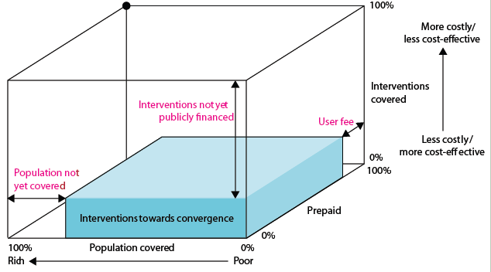
We recommend pro-poor pathway to UHC (blue shading)
C
1. Key messages of report
2. Current program of work
3. Case studies of impact
+ essential package for NCDIs

Slide 11
C
1. Key messages of report
2. Current program of work
3. Case studies of impact
Inform donor investments in health and influence G7 process
Help to ensure that SDG3 and its targets have a sound technical basis
Inform the future health investment decisions of LICs and MICs

Slide 12
C
1. Key messages of report
2. Current program of work
3. Case studies of impact
SDG 3
Donors
▪ Deep dive analysis of Swedish DAH + SIDA/MFA event March 19, 2015
▪ China engagement
▪ G7 sherpa team briefings
▪ EU briefings April 2015
▪ In-person presentations: UN, OWG members, UNSG team
▪ Briefing notes on quantifying SDG3
▪ New research that helps estimate SDG3 targets
▪ Mexico, India: briefing events and ongoing engagement
▪ Ethiopia health financing planning
▪ Bellagio conference on pro-poor UHC in 2015
▪ Ghana, Myanmar
LICs/MICs

Slide 13
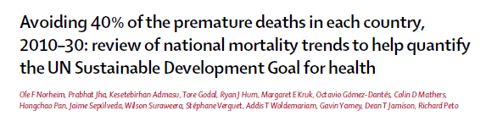
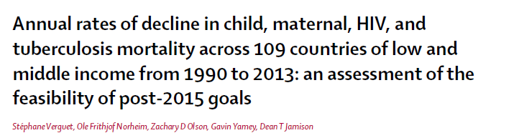
New research and analysis on quantifying SDG3
C
1. Key messages of report
2. Current program of work
3. Case studies of impact

Slide 14
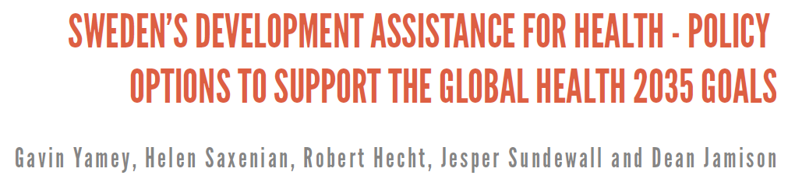

C
1. Key messages of report
2. Current program of work
3. Case studies of impact

Slide 15

Thank You
@gyamey
@globlhealth2035
GlobalHealth2035.org
#GH2035

