Slide 2
Global Health 2035: WDR 1993 @20 Years
The World Bank’s World Development Report 1993
Evidence-based health expenditures are an investment not only in health, but in economic prosperity
The Lancet Commission on Investing in Health
Re-examines the case for investing in health
Additional resources should be spent on cost-effective interventions to address high-burden diseases
Provides a roadmap to achieving gains in global health through a ‘grand convergence’
Proposes a health investment framework for low- and middle-income countries

Slide 3
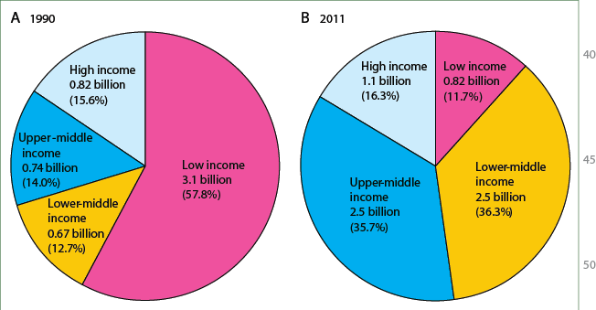
1993-2013: Extraordinary Health & Economic Progress
Movement of populations from low income to higher income between 1990 and 2011

Slide 4
2015-2035: Three Domains of Health Challenges
High rates of avertable infectious, child, and maternal deaths
Unfinished agenda
Demographic change and shift in GBD towards NCDs and injuries
Emerging agenda
Impoverishing medical expenses, unproductive cost increases
Cost agenda

Slide 5
Global Health 2035: 4 Key Messages
The returns from investing in health are extremely impressive
A grand convergence in health is achievable within our lifetime
Fiscal policies are a powerful, underused lever for curbing non-communicable diseases and injuries
Progressive pathways to universal health coverage are an efficient way to achieve health and financial protection

Slide 6
Global Health 2035: 4 Key Messages
The returns from investing in health are extremely impressive
A grand convergence in health is achievable within our lifetime
Progressive pathways to universal health coverage are an efficient way to achieve health and financial protection
Fiscal policies are a powerful, underused lever for curbing non-communicable diseases and injuries

Slide 7
Two Centuries of Divergence; ‘4C Countries’ Then Converged

Slide 8
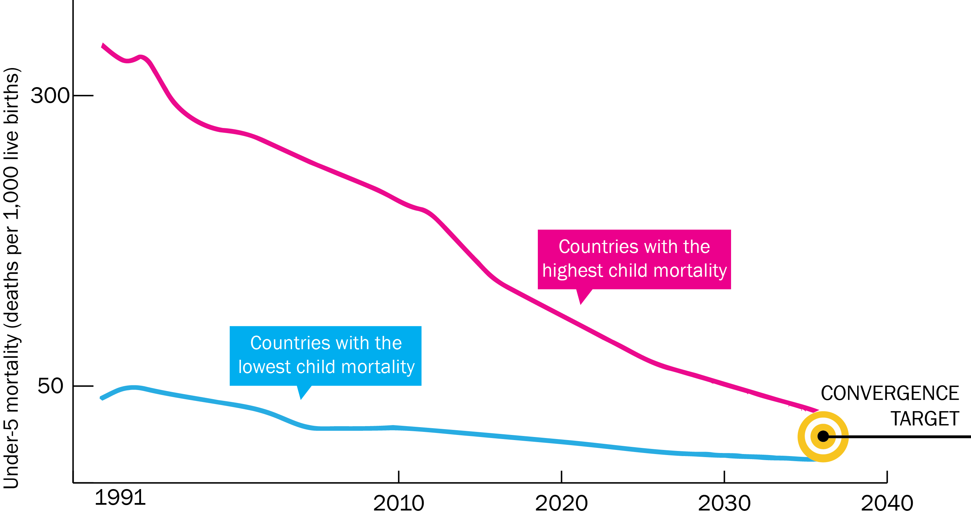
Now on Cusp of a Historical Achievement:
Nearly All Countries Could Converge by 2035

Slide 9
Rwanda: Steepest Fall in Child Mortality Ever Recorded
Investment ($70B/year) is Not a High Risk Venture: Rapid Mortality Decline Is Possible
Farmer P, et al. BMJ 2013; 346: f65

Slide 10
2035 Grand Convergence Targets are Achievable: “16-8-4”
Under-5 death rate per 1,000 live births
16
Annual AIDS deaths per 100,000 population
8
Annual TB deaths per 100,000 population
4
In line with US/UK in 1980

Slide 11
Death Rates Today in Poorest Countries
 | Low-Income Countries | Lower Middle-Income Countries | 2035 Target
Under-5 death rate per 1,000 live births | 104 | 63 | 16
Annual AIDS death rate per 100,000 population | 77 | 23 | 8
Annual TB death rate per100,000 population | 55 | 28 | 4

Slide 12
Convergence: Which Countries?
Diverse group of middle-income countries showed the way
Previously had high death rates
Low- or lower middle-income in 1991
Achieved high level of health status by 2011 largely because of scale-up of health sector interventions
“4C Countries”
Costa Rica, Cuba, Chile, China
We show that nearly all countries could reach the same health status by 2035

Slide 13
Convergence Targets are Close to Death Rates Today in 4C Countries
Indicator | Low-Income Countries | Lower Middle-Income Countries | 4C Countries (Range) | 2035 Convergence Targets
Under-5 death rate per 1,000 live births | 104 | 63 | 6 - 14 | 16
Annual AIDS deaths per 100,000 population | 77 | 23 | 1.4 - 8.7 | 8
Annual TB deaths per 100,000 population | 55 | 28 | 0.3 - 3.5 | 4

Slide 14
Modeling Convergence Investment Case¹
Compares scale-up versus constant coverage
HIV
UN One Health tool
Country-level cost and impact model to 2035
Malaria
Burden reduction
Intervention costs
“Service delivery” costs
RMNCH
Burden, interventions, coverage, efficacy

Slide 15

Modeling Convergence Investment Case²
LICs and Lower MICs
HIV
One Health
Country-level cost and impact model to 2035
One Health
Country-level cost and impact model to 2035
One Health
Country-level cost and impact model to 2035
+
Malaria
One Health
Country-level cost and impact model to 2035
TB
NTDs
HSS (HLTF)
New tools (extra 2%/year decline)
One Health
Country-level cost and impact model to 2035
One Health
Country-level cost and impact model to 2035
One Health
Country-level cost and impact model to 2035
RMNCH
One Health
Country-level cost and impact model to 2035
UN One Health
Tool
Country-level cost and impact model to 2035

Slide 16
Impact and Cost of Convergence
Low-income countries | Lower middle-income countries
Annual deaths averted from 2035 onwards
4.5 million | 5.8 million
Approximate incremental cost per year, 2016-2035
$25 billion | $45 billion
Proportion of costs devoted to structural investments in health system
60-70% | 30-40%
Proportion of health gap closed by existing tools (rest closed by R&D)
2/3 | 4/5

Slide 17
Global Health 2035: 4 Key Messages
The returns from investing in health are extremely impressive
A grand convergence in health is achievable within our lifetime
Fiscal policies are a powerful, underused lever for curbing non-communicable diseases and injuries
Progressive pathways to universal health coverage are an efficient way to achieve health and financial protection

Slide 18
Global Health 2035: 4 Key Messages
The returns from investing in health are extremely impressive
A grand convergence in health is achievable within our lifetime
Fiscal policies are a powerful, underused lever for curbing non-communicable diseases and injuries
Progressive pathways to universal health coverage are an efficient way to achieve health and financial protection

Slide 19
Full Income: A Better Way to Measure the Returns from Investing in Health
income growth
value life years gained (VLYs) in that period
change in country's full income over a time period
Between 2000 and 2011, about a quarter of the growth in full income in low-income and middle-income countries resulted from VLYs gained

Slide 20
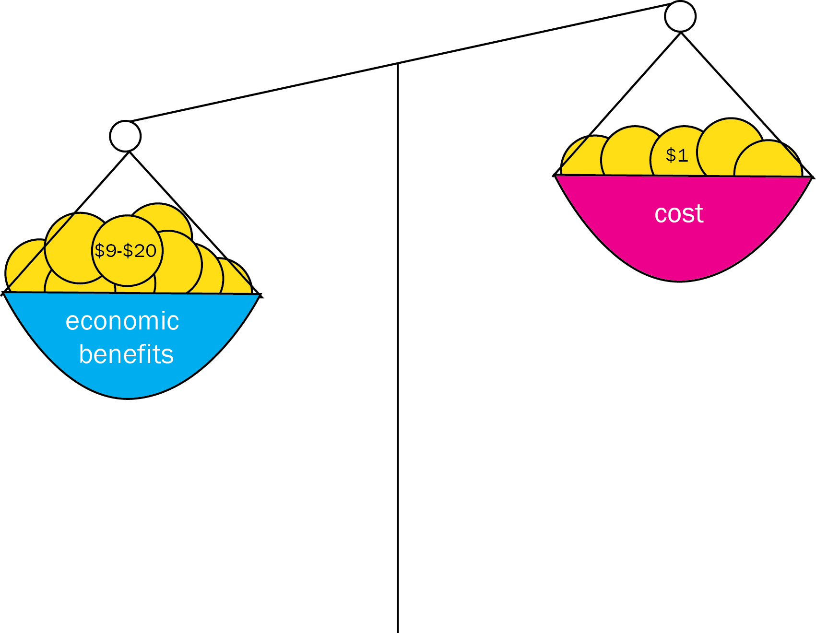
With Full Income Approach, Convergence Has Impressive Benefit: Cost Ratio

Slide 21
Sources of Income to Fund Convergence
Economic growth
IMF estimates $9.6 trillion/y from 2015-2035 in low- and lower middle-income countries
Mobilization of domestic resources
Taxation of tobacco, alcohol, sugar, extractive industries
Inter-sectoral reallocations and efficiency gains
Development assistance for health
Cost of convergence ($70 billion/y) is less than 1% of anticipated growth
Removal of fossil fuel subsidies, health sector efficiency
Subsidies account for an 3.5% of GDP on a post-tax basis
Will still be crucial for achieving convergence

Slide 22
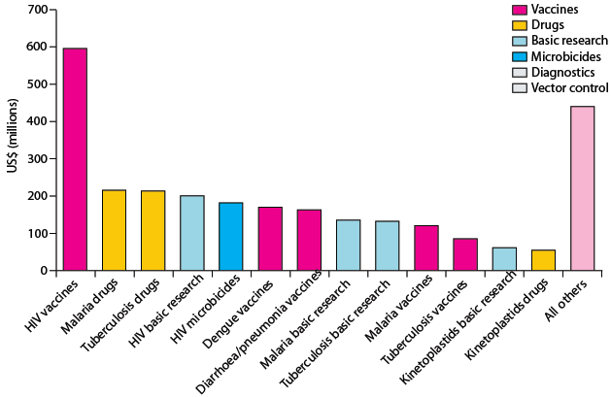
Crucial Role for International Collective Action:
Global Public Goods & Managing Externalities
Best way to support convergence is funding
R&D for diseases disproportionately affecting LICs and LMICs
and managing externalities e.g. flu pandemic
Current R&D ($3B/y) should be doubled, with half the increment funded by MICs
Current global spending on R&D for ‘convergence conditions’ Total: $3B/y

Slide 23
Global Public Goods: Important or Game-Changing Products
Likely to be available before 2020:
 | Diagnostics | Drugs | Vaccines | Devices
Important | Point-of-care diagnostics for HIV, TB, malaria | New malaria and TB co-formulations; long-acting contraceptives; new influenza drugs | Efficacious malaria vaccine; heat-stable vaccines | Self-injected vaccines
Game-changing |  | Single dose cure for vivax and falciparum malaria
Likely to be available before 2030:
 | Diagnostics | Drugs | Vaccines | Devices
Important |  | Antibiotics based on new mechanism of action | Combined diarrhea vaccine (rotavirus, E.coli, typhoid, shigella)
Game-changing |  | New classes of antiviral drugs | HIV vaccine, TB vaccine, universal flu vaccine

Slide 24
Progress on Maternal Mortality Ratio by 2035
 | Today | 2035
Low-income countries | 412 | 102
Middle-income countries | 260 | 64
4C countries (range) | 25-73
Number of deaths in pregnancy and childbirth per 100,000 live births

Slide 25
2030 Outcomes
 | 4C Countries Today (range) | Low-Income Countries 2030 | Lower Middle-Income Countries, 2030
Maternal mortality ratio per 100,000 live births | 25 - 73 | 119 | 69
Under-5 death rate per 1,000 live births | 6 - 14 | 27 | 13
Annual AIDS deaths Per 100,000 population | 1.4 - 8.7 | 5 | 1
Annual TB deaths per 100,000 population | 6 - 14 | 5 | 3

Slide 26
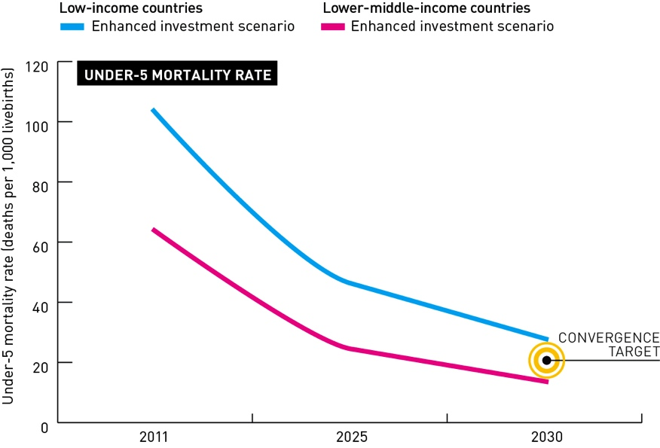
2030 Convergence with the “3P Countries”
Panama, Peru, Paraguay

Slide 27
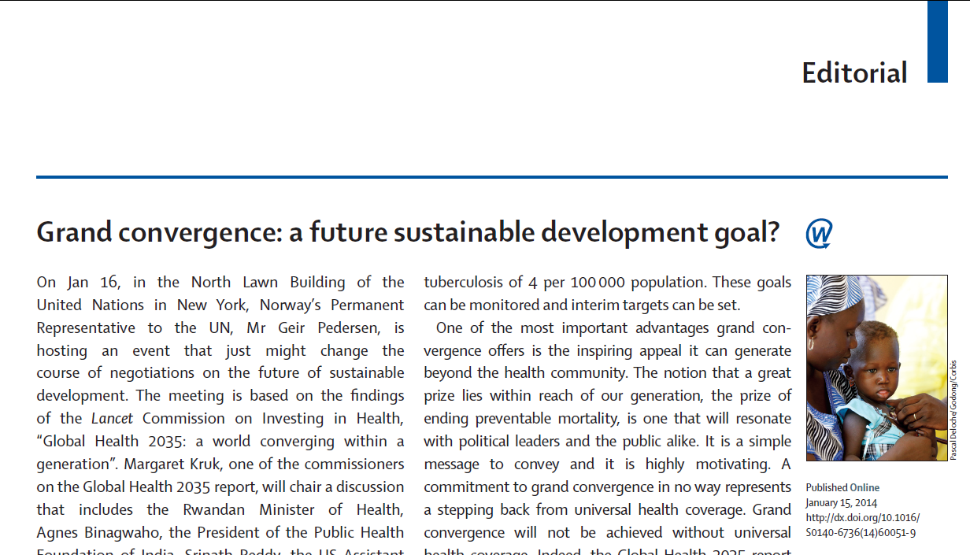

Slide 28
Grand Convergence in Post-2015 Framework
Encapsulates multiple conditions—could serve to unite global health community
Preventing avertable mortality is a “prize within reach”
Easy to understand, operationalize, and monitor
Once in a generation opportunity
Feasible targets, backed by robust evidence on health impacts, costs, and financing sources—these are not overly optimistic “advocacy aspirations”
Simple, single overarching goal

Slide 29
Grand Convergence in Post-2015 Framework (cont’d)
Based on economic calculus that measures the value of health to individuals and societies (“full income” accounting)
Grand convergence encapsulates UHC in a specific, tangible way: argues for “pro-poor” UHC that initially ensures universal coverage for tackling infections + RMNCH conditions + essential interventions for NCDs/injury
Program investments are accompanied by structural investments in health system→ would coalesce over time into a functional delivery system, prepared to address NCDs/injury
Not special pleading by health community—it is an investment with real economic returns

Slide 30
Caveats & Challenges
Inherent uncertainties in any modeling exercise
Assumes aggressive coverage levels (typically 90-95% by 2035)—would all countries have the institutional capacity?
Model does not account for role of other development sectors (e.g. climate, water ) or social determinants of health
May over-play or under-play role of R&D

Slide 31
Further Research on Convergence
Further validation of 2030 modeling results
Map out implementation steps
Historical analysis of rates of decline of U5MR, MMR, AIDS deaths, and TB deaths
show that rapid declines have occurred
learn lessons from best performers

Slide 32
Global Health 2035: 4 Key Messages
The returns from investing in health are extremely impressive
A grand convergence in health is achievable within our lifetime
Fiscal policies are a powerful, underused lever for curbing non-communicable diseases and injuries
Progressive pathways to universal health coverage are an efficient way to achieve health and financial protection

Slide 33
Global Health 2035: 4 Key Messages
The returns from investing in health are extremely impressive
A grand convergence in health is achievable within our lifetime
Fiscal policies are a powerful, underused lever for curbing non-communicable diseases and injuries
Progressive pathways to universal health coverage are an efficient way to achieve health and financial protection

Slide 34

Single Greatest Opportunity To Curb NCDs is Tobacco Taxation
50% rise in tobacco price from tax increases in China
  prevents 20 million deaths + generates extra $20 billion/y in next 50 y
  additional tax revenue would fall over time but would be higher than current levels even after 50 y
  largest share of life-years gained is in bottom income quintile

Slide 35

We Also Argue for Taxes on Sugar and Sugar-Sweetened Sodas
  Taxing empty calories, e.g. sugary sodas, can reduce prevalence of obesity and raise significant public revenue
  These taxes do not hurt the poor: main dietary problem in low-income groups is poor dietary quality and not energy insufficiency

Slide 36

Lessons from Taxing Tobacco and Alcohol
Taxes must be large to change consumption
Must prevent tax avoidance (loopholes) and tax evasion (smuggling, bootlegging)
Design taxes to avoid substitution
Young/low-income groups respond most

Slide 37
Essential Package of Clinical Interventions
WHO “best buys”
NCD | Intervention
Liver cancer | Hepatitis B vaccine
Cervical cancer | VIA and treatment of pre-cancerous lesions
CVD and diabetes | Counselling and multi-drug therapy for high-risk patients
Heart attack | Aspirin

Slide 38
We Recommend Scale-up in All Countries
Cost-effective
80% coverage by 2020 would avert 37% of global burden of cardiovascular disease
Low coverage
Except for hepatitis B vaccine, very low coverage across LICs/MICs
Feasible
1st step for all countries; costs $9bn/y; we argue that HPV vaccine should be included

Slide 39
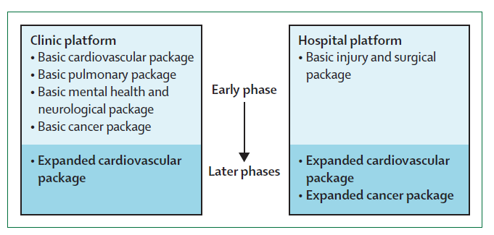
Phased Expansion Pathways
Choice of packages and expansion pathway will vary with pattern of disease, delivery capacity, domestic health spending

Slide 40
Sudden Price Drops Affect Expansion Pathway
For drugs, diagnostics, and vaccines, which can usually be delivered without complex infrastructure, price reductions can sometimes occur very rapidly
Price drop might be large enough for intervention to be used earlier in expansion pathway
Price

Slide 41
“Interventions Don’t Deliver Themselves”
 | Community outreach | Clinics | District hospitals | Referral hospitals
CVD, diabetes | Diabetes prevention programmes | Drugs for primary & secondary prevention of CVD | Medical treatment of acute heart attack | Angiography services
Cancers | HPV vaccination | Cervical cancer screening/treatment | Hormonal therapy and surgery for breast cancer | Treatment of selected paediatric cancers
Psychiatric and neurological conditions | Rehabilitation for chronic psychosis | Antidepressants and psychotherapy for depression or anxiety | Detoxification for alcohol dependence | Neurosurgery for intractable epilepsy
Injuries | Training of lay first responders | Treatment of minor burns | Management of fractured femur | Complex orthopaedic surgery—e.g. for pelvic injury

Slide 42
Global Health 2035: 4 Key Messages
The returns from investing in health are extremely impressive
A grand convergence in health is achievable within our lifetime
Fiscal policies are a powerful, underused lever for curbing non-communicable diseases and injuries
Progressive pathways to universal health coverage are an efficient way to achieve health and financial protection

Slide 43
Global Health 2035: 4 Key Messages
The returns from investing in health are extremely impressive
A grand convergence in health is achievable within our lifetime
Fiscal policies are a powerful, underused lever for curbing non-communicable diseases and injuries
Progressive pathways to universal health coverage are an efficient way to achieve health and financial protection

Slide 44
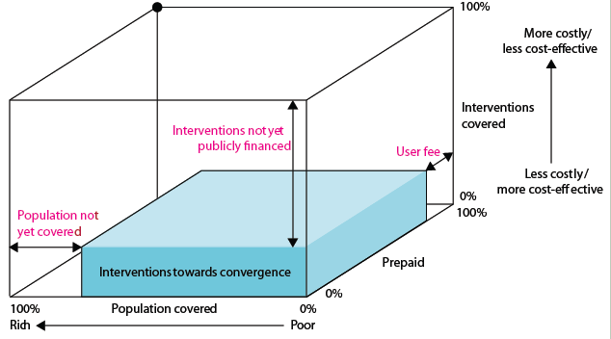
Our Recommendation on UHC:
Progressive Universalism (Blue Shading)
+ essential package for NCDIs

Slide 45
How to Move Through the Cube?
What works best depends on country’s starting point, nature/capacity of its institutions, national values, etc.
We argue for initial focus on interventions towards convergence + essential interventions for NCDIs to maximize health status and FRP
Progressive universalism:
“a determination to include people who are poor from the beginning” (Gwatkin & Ergo)
Gro Brundtland’s new universalism:
“if services are to be provided for all, then not all services can be provided. The most cost-effective services should be provided first.”

Slide 46
Progressive Universalism
Insurance covers whole population
Targets poor by insuring highly cost-effective health interventions for diseases disproportionately affecting poor
Interventions are funded through tax revenues, payroll taxes, or combination
No OOP expenses for defined benefit package of publicly financed services
As resource envelope grows, so does package (as seen in Mexico), e.g. add wider range of interventions for NCDs

Slide 47
Advantages of Progressive Universalism
Government does not have to incur costly administrative expenses identifying who is poor (everyone is covered)
Universal package promotes broader support among population and health providers than schemes targeting poor alone—such support helps to sustain financing over time

Slide 48
A Variant of Progressive Universalism
Larger package to whole population with patient copayment but poor are exempted from copay (e.g. Rwanda)
Uses a wider variety of financing mechanisms (general taxation, payroll tax, mandatory insurance premiums, copayments)
Advantages: wider package, engages non-poor in prepaid mandatory scheme from day 1, transition may be more feasible
Major disadvantage: costly to identify poor, to organize and collect copays/premiums

Slide 49
Four Benefits to Countries of Adopting Progressive Universalism
1
2
3
4
Poor gain the most in terms of health and FRP
Approach yields high health gains per $ spent
Public money is used to address negative externalities of infectious disease transmission
Implementation success in many low- and middle-income countries has shown feasibility

Slide 50
Launch and Post-Launch Activities
Jan 2014: UN and UNF briefings; Davos event (Bill Gates, Larry Summers, Jim Kim, Linah Mohohlo)
Feb-May 2014: Columbia university launch; briefings to UK and Norwegian Missions to the UN; upcoming briefings to USAID, CDC; presentations at Yale, Duke, Imperial College London
Planning: briefing to Secretary Kerry (Oct 2014); briefing UK parliament/DFID (fall 2014); possible national commissions on investing in health
Dec 3, 2013: International launch day (London, Tunis, Johannesburg); UCSF launch (Larry Summers, Dean Jamison, Ken Arrow)

Slide 51
A Few Reflections on These Events
Convergence seen as powerful, simple, unifying concept—but the word isn’t universally loved
Our greatest value: independent, academic, empirical modeling (we aren’t an advocacy group)
“Something for everyone” plus a very tangible way of expressing UHC

Slide 52
Thank you
GlobalHealth2035.org
#GH2035
@globlhealth2035
@gyamey

