Slide 1
PLOS Convergence Collection
Launch and Panel Discussion
ICID
Hyderabad, India
3 March 2016
Larry Peiperl MD
Chief Editor, PLOS Medicine

Slide 2
Publishing Today in Open Access
http://collections.plos.org/grand-convergence

Slide 3
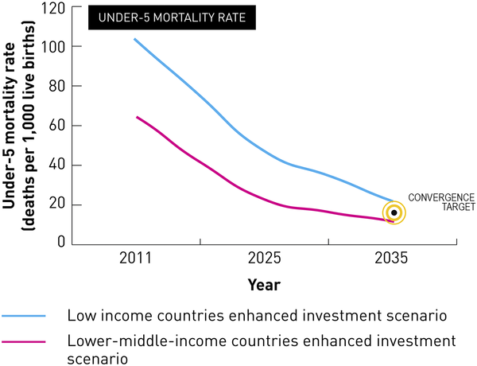

Fig 1. Impact of enhanced health investments on under-five mortality rate in low- and lower-middle-income countries.
Kruk ME, Yamey G, Angell SY, Beith A, Cotlear D, et al. (2016) Transforming Global Health by Improving the Science of Scale-Up. PLoS Biol 14(3): e1002360. doi:10.1371/journal.pbio.1002360
http://journals.plos.org/plosbiology/article?id=info:doi/10.1371/journal.pbio.1002360

Slide 4
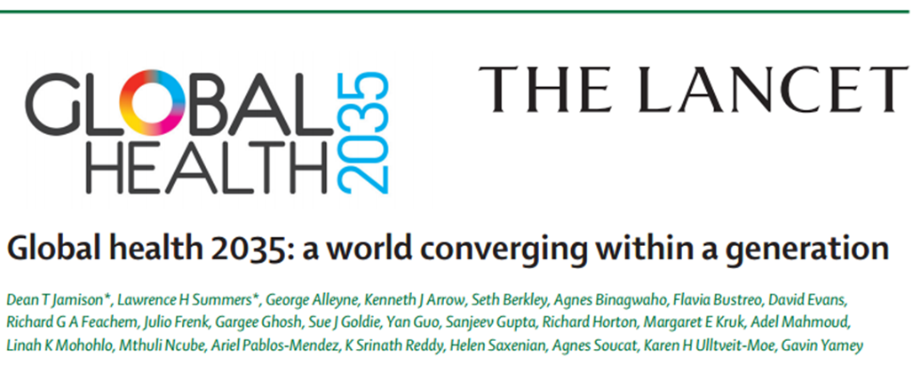
The Lancet Commission on Investing in Health
Jamison DT et al. Lancet 2013; 382: 1898–955
Re-examines the case for investing in health
Proposes a health investment framework for low- and middle-income countries
Provides a roadmap to achieving gains in global health through a ‘grand convergence’
Notes:
"Grand Convergence: Aligning Technologies and Realities in Global Health" builds on the Lancet report "Global Health 2035" which argued that it is possible, through a strategic investment plan, to achieve a "grand convergence" in health that would reduce avertable infectious, maternal, and child deaths down to universally low levels within a generation by aggressively scaling up health tools. But the report came to an important conclusion: the world cannot reach convergence with today's tools alone; tomorrow's tools will also be needed.

Slide 5
Steps to Achieve Convergence
Rapid scale-up of life-saving interventions
Build strong health delivery systems
Discover and develop new tools
Convergence interventions:
Reproductive maternal, newborn, and child health
HIV
Malaria
Tuberculosis
Neglected tropical diseases
Notes:
"Grand Convergence: Aligning Technologies and Realities in Global Health" builds on the Lancet report "Global Health 2035" which argued that it is possible, through a strategic investment plan, to achieve a "grand convergence" in health that would reduce avertable infectious, maternal, and child deaths down to universally low levels within a generation by aggressively scaling up health tools. But the report came to an important conclusion: the world cannot reach convergence with today's tools alone; tomorrow's tools will also be needed.

Slide 6
Impact and Cost of Convergence
Low-income countries | Lower middle-income countries
Annual deaths averted from 2035 onwards
4.5 million | 5.8 million
Approximate incremental cost per year, 2016-2035
$25 billion | $45 billion
Proportion of costs devoted to structural investments in health system
60-70% | 30-40%
Proportion of health gap closed by existing tools (rest closed by R&D)
2/3 | 4/5

Slide 7
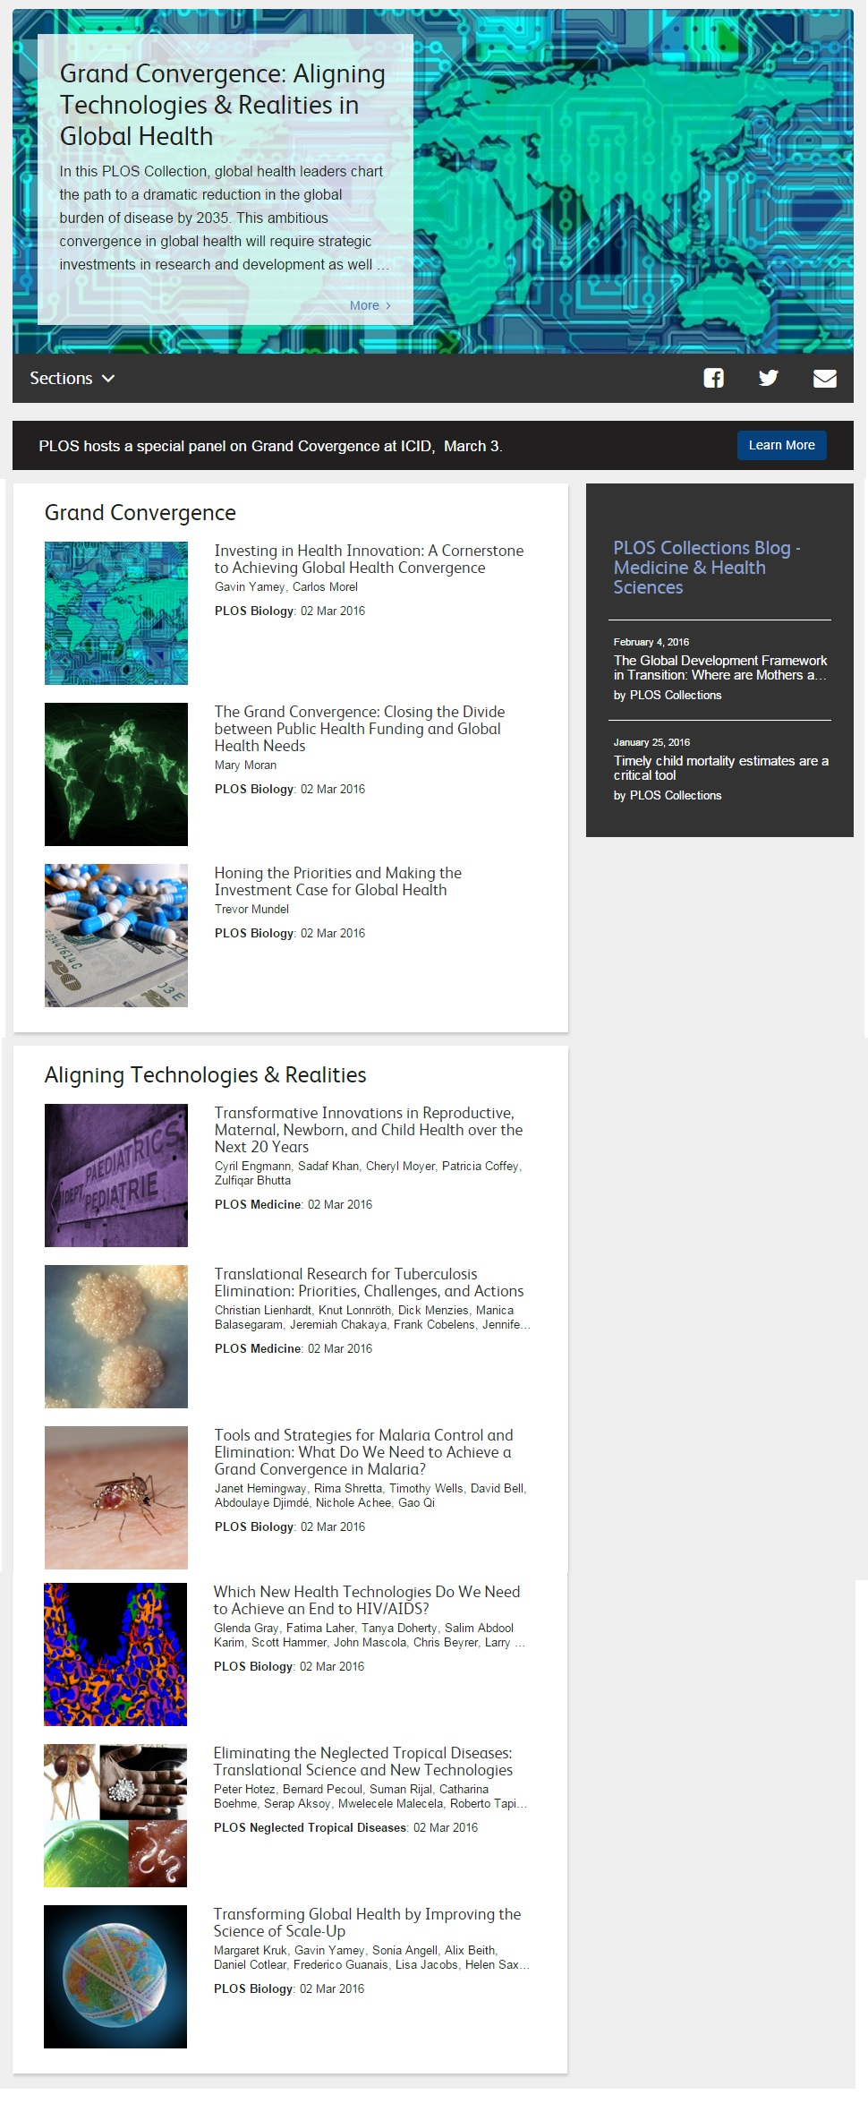

Slide 9
Convergence requires new technologies
AND
People must benefit from them
Secure funding for R&D
Overcome “market failure” – profit motive not aligned with health need
Strengthen delivery systems
Address “demand side” barriers to uptake
Allocate resources optimally between existing and new technologies

Slide 10
Thank You!
Editorial and Publications Staff of PLOS Biology, PLOS Medicine, PLOS NTDs
PLOS Collections and Marketing teams
Sara Fewer, UCSF Global Health Group, Evidence to Policy Initiative
Guest Editors Gavin Yamey, Duke Global Health Institute, USA, and Carlos Morel, Center for Technological Development in Health Oswaldo Cruz Foundation (Fiocruz) Brazil
Bill and Melinda Gates Foundation

Slide 11
Distinguished Panel
Soumya Swaminathan Secretary, Department of Health Research, Ministry of Health and Family Welfare, Government of India, and Director General of Indian Council of Medical Research
Stephan Duparc Chief Medical Officer, Medicines for Malaria Venture
Cyril Engmann Program Leader, Maternal, Newborn, and Child Health and Nutrition, PATH
Harish Iyer Senior Scientific Advisor, Scientific Programs, India Country Office, Bill and Melinda Gates Foundation
Notes:
This is the order of the panelists. I will introduce each panelist, who will have 10 minutes to speak on their topic.
We’ll then open the session to questions from the audience.

Slide 12
Soumya Swaminathan
Secretary, Department of Health Research, Ministry of Health and Family Welfare, Government of India, and Director General of Indian Council of Medical Research

Slide 13
Stephan Duparc
Chief Medical Officer, Medicines for Malaria Venture

Slide 14

MMV’s Supported Projects
Research
Translational
Product development
Access
Lead generation
Lead
optimization
Preclinical
Human volunteers
Patient exploratory
Patient confirmatory
Regulatory review
Post approval
Miniportfolio
Novartis
1 project
Novartis
P218
(Biotec)
MMV048
UCT/TIA
OZ439/PQP
Sanofi
Tafenoquine
GSK
Rectal Artesunate *
Cipla/Strides/WHO-TDR
Artemether-
lumefantrine
Dispersible
Novartis
1
Miniportfolio
GSK
2 projects
GSK
SJ733
St Jude/Eisai
OZ439/FQ
Sanofi
Dihydroartemisinin piperaquine
Paediatric
Sigma-Tau
Artesunate
for injection
Guilin
2
Miniportfolio
Sanofi
Orthologue Leads
Sanofi
DDD498
Merck Serono
(Univ. Dundee)
KAE609
Novartis
Dihydro-artemisinin- piperaquine
Sigma-Tau
3
Heterocycles
Univ. Campinas
Tetraoxanes
LSTM/Univ. Liverpool
PA92
(Drexel/UW/GNF)
KAF156
Novartis
Pyronaridine-
artesunate
Shin Poong
4
Heterocycles
Daiichi-Sankyo
DHODH
UTSW/UW/Monash
MMV253
(AstraZeneca)
DSM265
Takeda
Artesunate-
amodiaquine *
Sanofi/ DNDi
5
Heterocycles
Takeda
Heterocycles
UCT
GSK030
GSK
Artesunate-
Mefloquine *
Cipla/DNDi
DSM421
(UTSW/UW/
Monash)
To develop the individual compounds for combination into the TPPs, MMV has defined five Target Candidate Profiles (TCPs):
Asexual blood stage activity (TCP1,2)
Relapse prevention (TCP3a)
Transmission reduction (TCP3b)
Chemoprevention (TCP4)
Brought into portfolio after approval. Collaboration with DNDi
Heterocycles
Eisai
Open Source Drug Discovery
Univ. Sydney
SPAQ *
Guilin
6
Screening
Merck Serono
Heterocycles
Celgene
GSK692
GSK
Pyronaridine-
Artesunate Paediatric
Shin Poong
Pathogen Box
MMV
Whole cell
St Jude/Rutgers/USF
AN13762
Anacor
Other projects
24 projects
Diversity oriented Synthesis
Broad/Eisai
Footnotes: Brand names 1: Coartem® Dispersible; 2: Artesun®; 3: Eurartesim®; 4: Pyramax®; 5: CoarsucamTM ASAQ/Winthrop®;
6: SPAQ-COTM

Slide 15
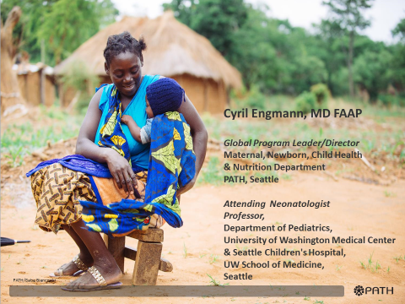
Transformative Innovations in Maternal, Newborn, and Child Health
Over the Next 20 Years

Slide 16
PLOS Authors
Cyril M. Engmann, MD, FAAP: Maternal, Newborn, Child Health and Nutrition, PATH & Department of Pediatrics, Neonatology, University of Washington, Seattle, Washington, United States
Sadaf A. Khan, MD, Dr.PH: Maternal, Newborn, Child Health and Nutrition, PATH, Seattle, Washington, United States
Cheryl A. Moyer, MPH, PhD: Departments of Learning Health Sciences and Obstetrics & Gynecology, University of Michigan Medical School, Ann Arbor, Michigan, United States
Patricia S. Coffey, PhD: Technical Solutions, PATH, Seattle, Washington, United States
Zulfiqar A. Bhutta, MD, Ph.D: Center for Global Child Health, Sick Kids, Toronto, Ontario, Canada. Center of Excellence in Women and Child Health, Aga Khan University, Karachi, Pakistan

Slide 17
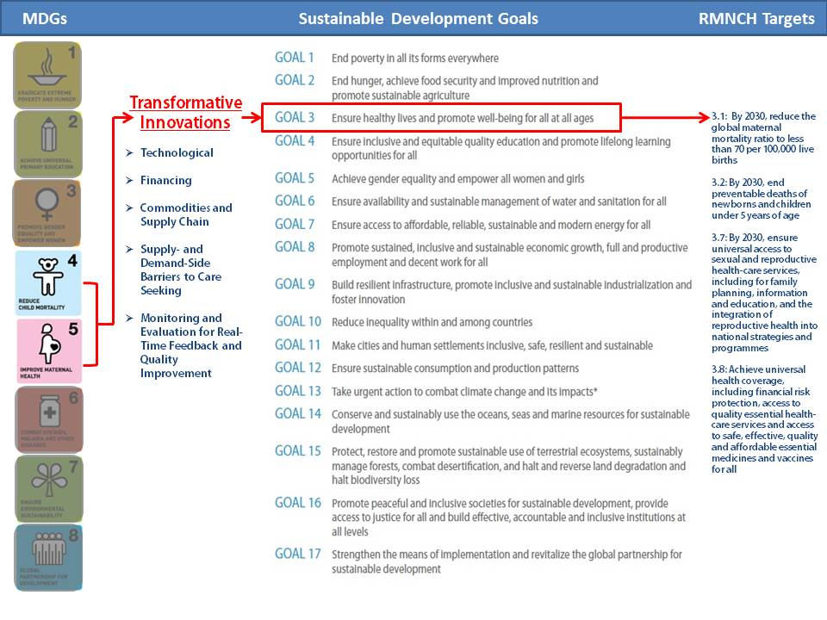

Slide 18
Essential areas of innovation for improving RMNCAH
Commodities and Supply Chain Improvements
New Technologies
New Methods of Financing
Healthcare System
Improvements in Monitoring, Measurement, and Feedback
Addressing Supply-Side Barriers to Increase Access
Addressing Demand-Side Barriers to Increase Access

Slide 19
Challenges To Maximum Uptake/
Effectiveness of MNCH Innovations
Development of Innovation: Lack of user-centric focus to understand care-seeking behaviors and social/cultural preferences of women and communities, capabilities and resources of HCP, national and local policies, and local contexts in which it will be implemented.
Integration of Innovation – into existing programs, local contexts and the continuum of care, across different platforms and beyond. e.g. reinforcing consistent messaging across schools, churches, community & health centers
Enabling and Supportive Environments/Settings – to address the current social, medical, and logistic contexts and needs.

Slide 20
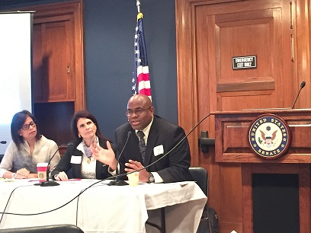
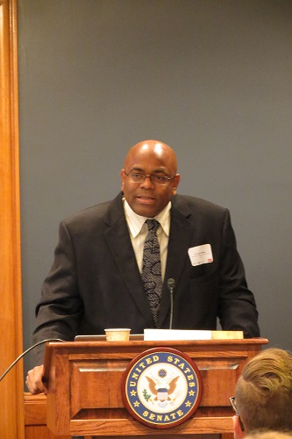

Bringing US Congressional attention to progress still needed to improve RMNCAH&N globally
Complete unfinished MDG agenda
Survive & thrive
Bridge “know-do” gap, utilize implementation science to implement effectively at scale,
Improve quality of care at birth
Promote multi-sectoral, integrated RMNCAHN+ approach
Address displaced & urban poor
Strengthen life-cycle approaches especially preconception, stillbirth, adolescent health
Mental health

Slide 21
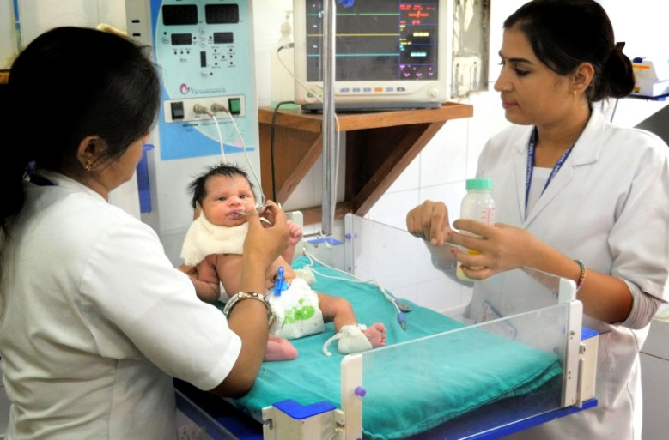
“Innovations matter. Innovations have powerful potential to result in transformative change when technologies are coupled with system-level, condition-sensitive, enabling environment's that support advocacy and political will, sufficient investment, large and well trained workforce, opportunities for real-time feedback and quality improvement”. PLOS Medicine, March 2016
Notes:
Introduce self, Recognize: HMB team at PATH,

Slide 22
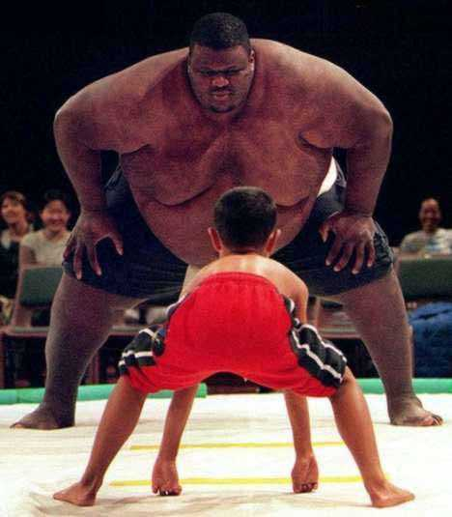
“It always seems impossible until it is done” Nelson Mandela

Slide 23
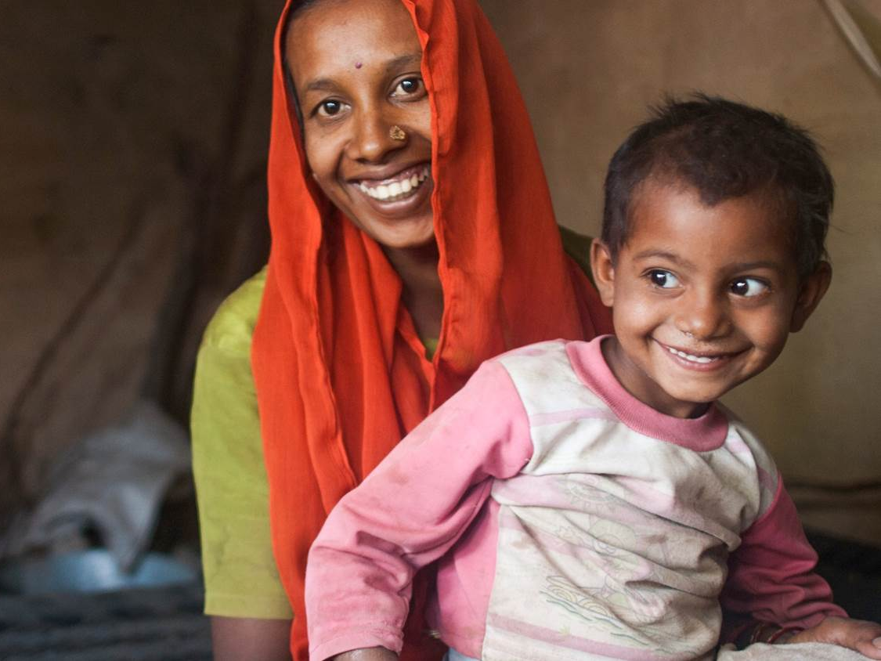

ICID, 2016
Grand Convergence
Innovation in Global Health
Harish Iyer

Slide 24

Adopted by the UN General Assembly in 2015 as goals for the next 15 YEARS

Slide 25
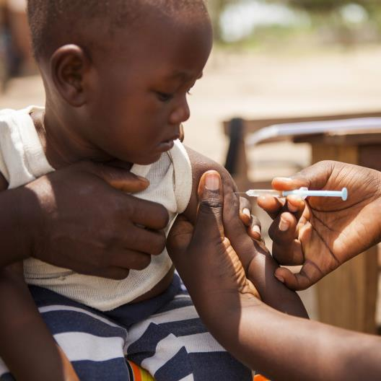
WHAT WE FOCUS ON
What are
the areas
of greatest
need?
Where can we have
the greatest impact?

Slide 26
HOW DO WE CHOOSE PROBLEMS?
Where can we have
the greatest impact?
What are
the areas
of greatest
need?
Mundel (2016), PLoS Biol. 14(3):e1002376

Slide 27
OUR WORK IN INDIA
Under-five mortality, India, 2012
Share by cause, percent
INNOVATION IN DELIVERY AND R&D
Innovation in Delivery
Piloting programs in areas such as MNCH
Supporting vaccine delivery and scale-up using technical units
New ways of delivery to improve compliance
Innovation in R&D
Data generation to understand where are
New vaccines (MenAfrivac, rotavirus, pneumo, cholera)
Potential new therapies – HIV, TB
Sanitation – re-inventing the toilet
Use feedback and data to correct strategies
Learn from mistakes & adapt in a complex environment
Source: UNICEF Progress Report 2013; World Bank U5MR and BR data

Slide 28
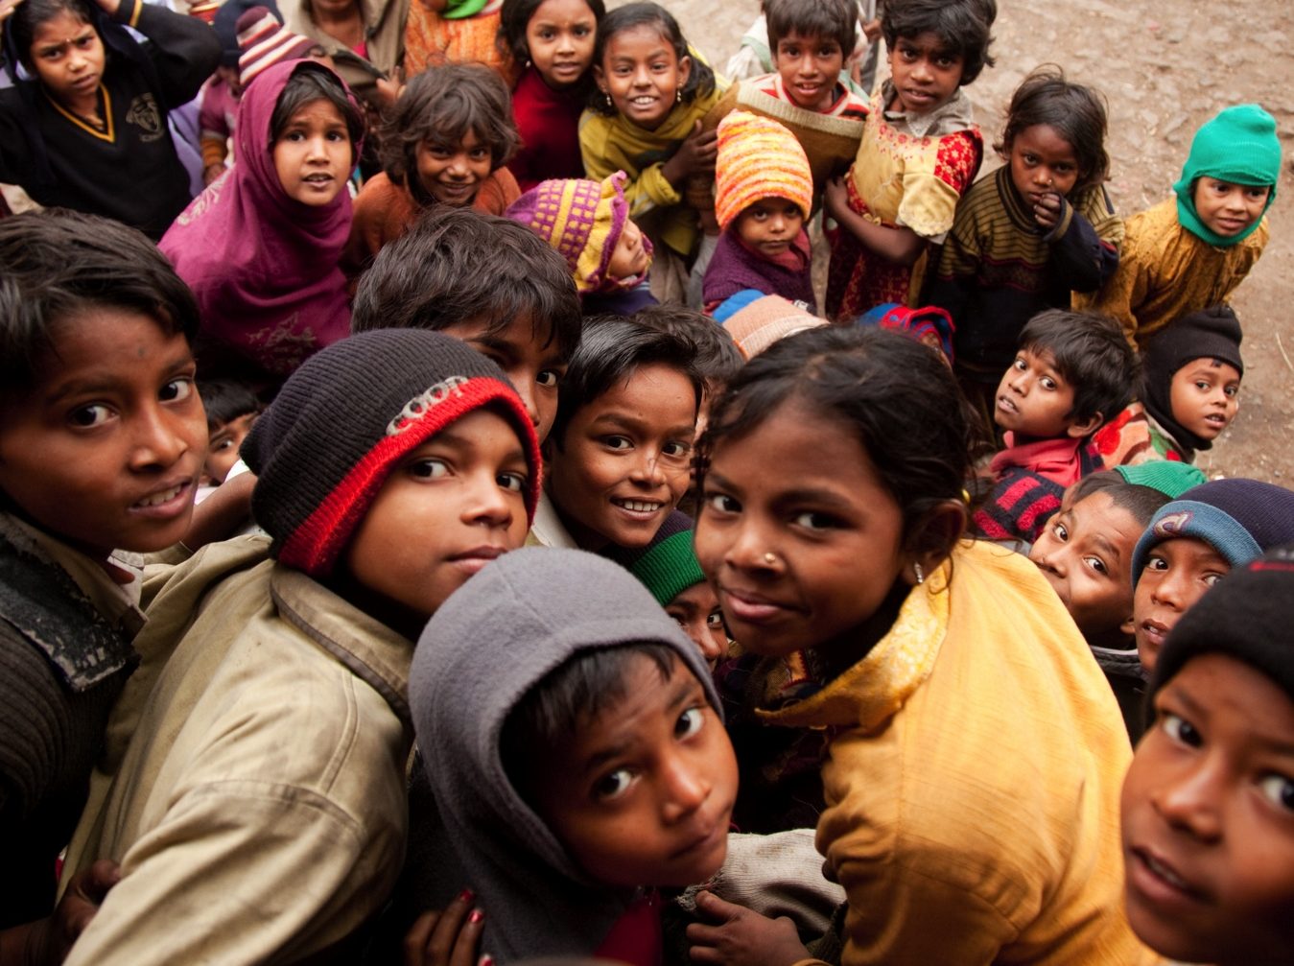
THE WORK IS COMPLICATED.
WHY WE
DO IT IS NOT.

Slide 29
Q&A

