Slide 1
Global Health 2035:
Implications for Economic Policy
Lawrence H. Summers
Charles W. Eliot University Professor, Harvard University
Presentation at IMF, Feb 12, 2014

Slide 2
Global Health 2035: 4 Key Messages
The returns from investing in health are extremely impressive
A grand convergence in health is achievable within our lifetime
Fiscal policies are a powerful, underused lever for curbing non-communicable diseases and injuries
Progressive pathways to universal health coverage are an efficient way to achieve health and financial protection

Slide 3
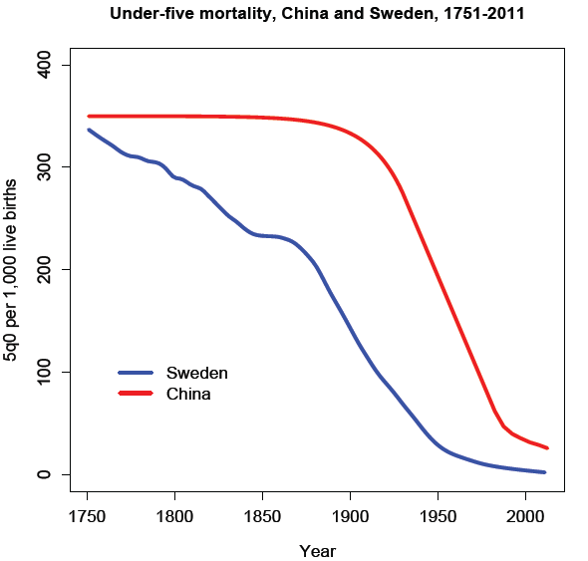
Two Centuries of Divergence; ‘4C Countries’ Then Converged

Slide 4
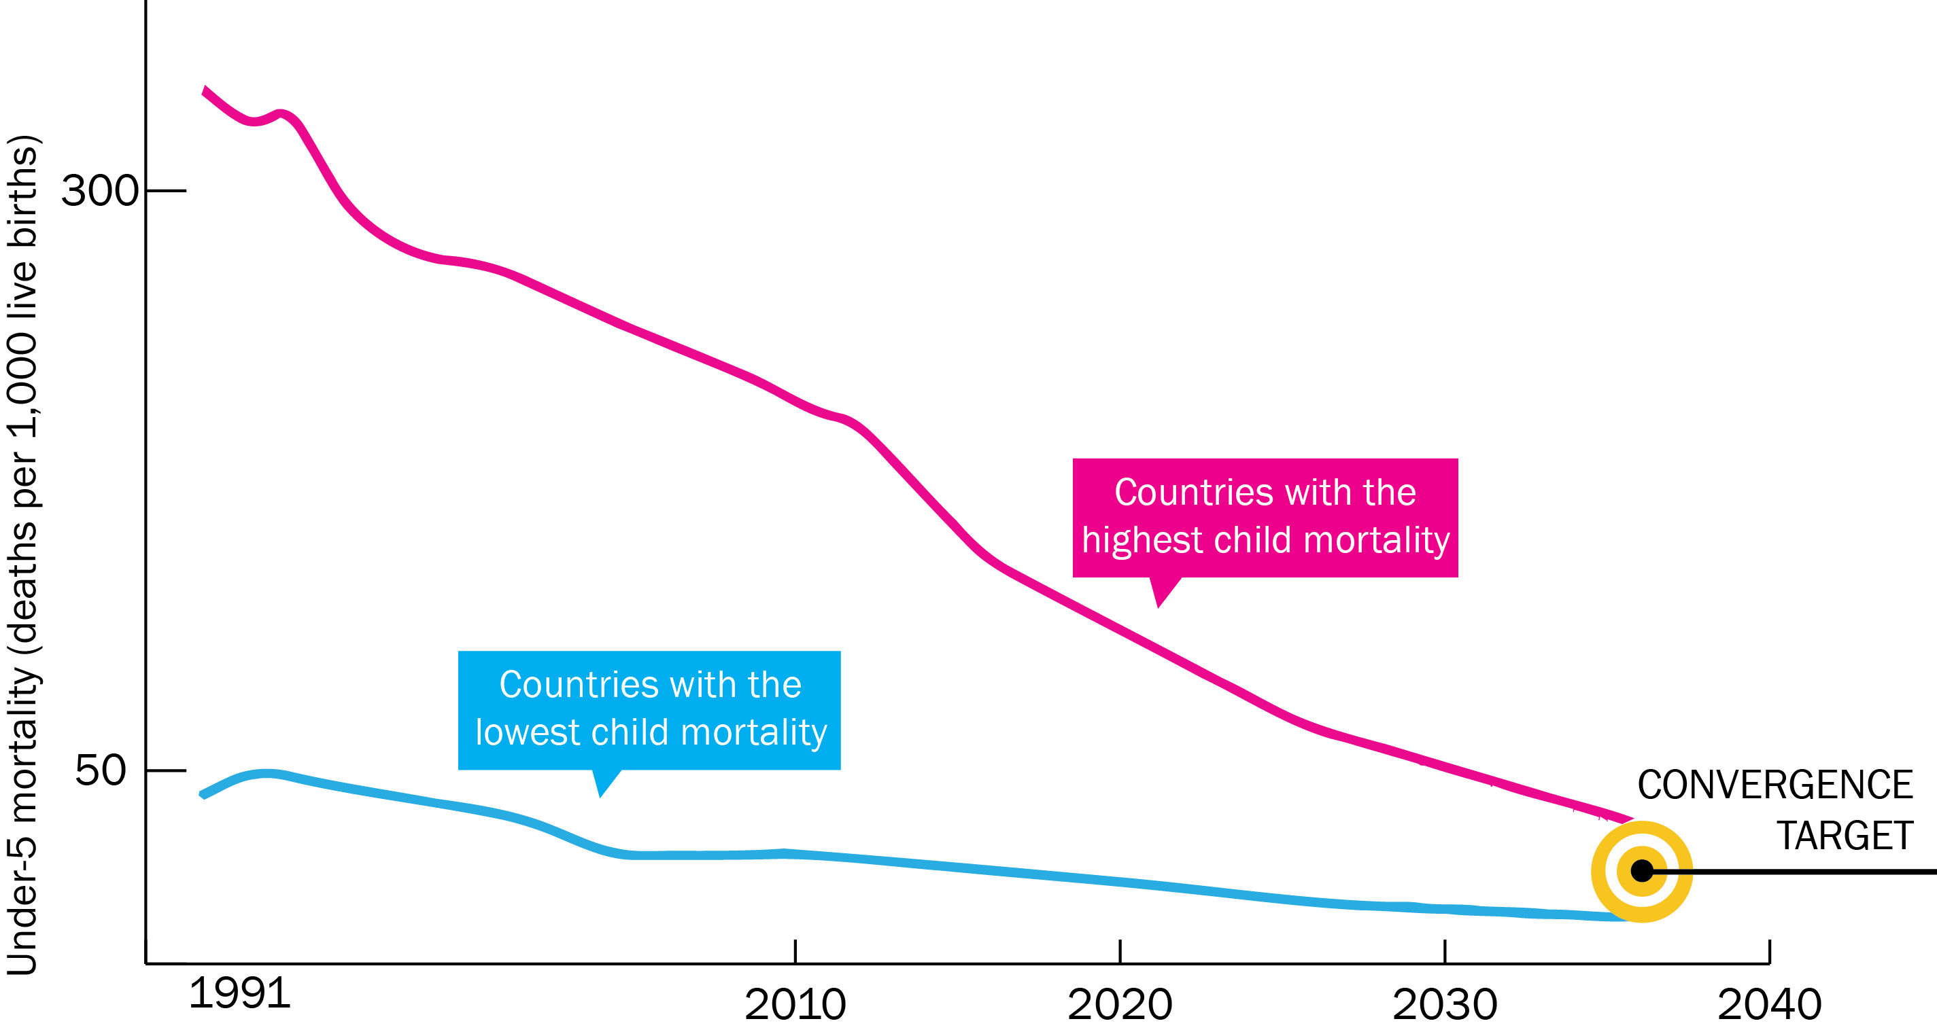
Now on Cusp of a Historical Achievement: Nearly All Countries Could Converge by 2035

Slide 5
Rwanda: Steepest Fall in Child Mortality Ever Recorded
Investment ($70B/year) is Not a High Risk Venture: Rapid Mortality Decline Is Possible
Farmer P, et al. BMJ 2013; 346: f65

Slide 6
2035 Grand Convergence Targets are Achievable: “16-8-4”
Under-5 death rate per 1,000 live births
16
Annual AIDS deaths per 100,000 population
8
Annual TB deaths per 100,000 population
4
In line with US/UK in 1980

Slide 7
Impact and Cost of Convergence
Low-income countries | Lower middle-income countries
Annual deaths averted from 2035 onwards
4.5 million | 5.8 million
Approximate incremental cost per year, 2016-2035
$25 billion | $45 billion
Proportion of costs devoted to structural investments in health system
60-70% | 30-40%
Proportion of health gap closed by existing tools (rest closed by R&D)
2/3 | 4/5

Slide 8
Full Income: A Better Way to Measure the Returns from Investing in Health
income growth
value life years gained (VLYs) in that period
change in country's full income over a time period
Between 2000 and 2011, about a quarter of the growth in full income in low-income and middle-income countries resulted from VLYs gained

Slide 9
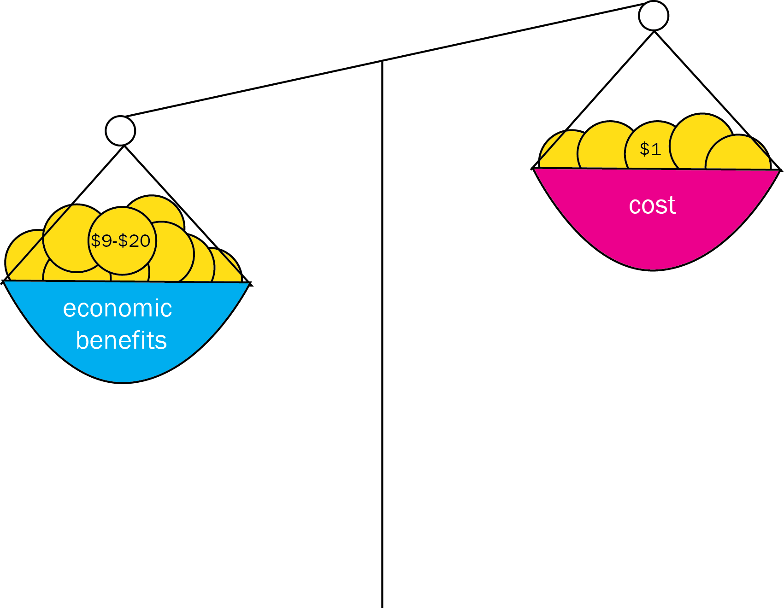
With Full Income Approach, Convergence Has Impressive Benefit: Cost Ratio

Slide 10
Sources of Income to Fund Convergence
Economic growth
IMF estimates $9.6 trillion/y from 2015-2035 in low- and lower middle-income countries
Mobilization of domestic resources
Taxation of tobacco, alcohol, sugar, extractive industries
Inter-sectoral reallocations and efficiency gains
Development assistance for health
Cost of convergence ($70 billion/y) is less than 1% of anticipated growth
Removal of fossil fuel subsidies, health sector efficiency
Subsidies account for an 3.5% of GDP on a post-tax basis
Will still be crucial for achieving convergence

Slide 11
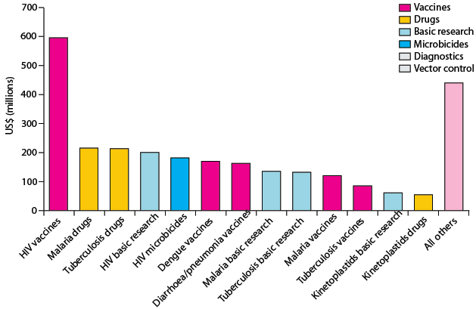
Crucial Role for International Collective Action: Global Public Goods & Managing Externalities
Best way to support convergence is funding
R&D for diseases disproportionately affecting LICs and LMICs
and managing externalities e.g. flu pandemic
Current R&D ($3B/y) should be doubled, with half the increment funded by MICs
Current global spending on R&D for ‘convergence conditions’ Total: $3B/y

Slide 12
Global Public Goods: Important or Game-Changing Products
Likely to be available before 2020:
 | Diagnostics | Drugs | Vaccines | Devices
Important | Point-of-care diagnostics for HIV, TB, malaria | New malaria and TB co-formulations; long-acting contraceptives; new influenza drugs | Efficacious malaria vaccine; heat-stable vaccines | Self-injected vaccines
Game-changing |  | Single dose cure for vivax and falciparum malaria
Likely to be available before 2030:
 | Diagnostics | Drugs | Vaccines | Devices
Important |  | Antibiotics based on new mechanism of action | Combined diarrhea vaccine (rotavirus, E.coli, typhoid, shigella)
Game-changing |  | New classes of antiviral drugs | HIV vaccine, TB vaccine, universal flu vaccine

Slide 13
Managing Cross-Border Externalities
Tackling global crisis of antibiotic resistance
Ending the global crisis of counterfeit drugs
Preparing for the next influenza pandemic

Slide 14
Preparing for the Next Influenza Pandemic
WHO’s influenza budget was just $7.7 million in 2013, less than a third of what one city, NYC, devotes to public health preparedness
International community must support development of a universal influenza vaccine and of surveillance and response systems
Must develop adequate production capacity for flu drugs and vaccines and an IP regime that ensures universal access
Growing concern about a new pandemic similar to 1918 pandemic, which killed 50 million people in era before mass international transit

Slide 15
Single Greatest Opportunity To Curb NCDs is Tobacco Taxation
50% rise in tobacco price from tax increases in China
prevents 20 million deaths + generates extra $20 billion/y in next 50 y
additional tax revenue would fall over time but would be higher than current levels even after 50 y
largest share of life-years gained is in bottom income quintile

Slide 16
We Argue for Taxes on Sugar and Sugar-Sweetened Sodas
Taxing empty calories, e.g. sugary sodas, can reduce prevalence of obesity and raise significant public revenue
Taxes need to be large (20% or more) to change behavior
These taxes do not hurt the poor: main dietary problem in low-income groups is poor dietary quality and not energy insufficiency

Slide 17
Our Recommendation on Universal Health Coverage: Progressive Universalism (Blue Shading)

Slide 18
Thank you @LHSummers
GlobalHealth2035.org
#GH2035
@globlhealth2035

