Slide 1
The Commission on Investing in Health
Lawrence Summers, Chair
Dean Jamison, Co-Chair
February 2, 2015

Slide 2
Acknowledgements
Bill and Melinda Gates Foundation
NORAD
DfID
WHO
Center for Disease Dynamics, Economics, and Policy (Delhi and Washington)

Slide 3
Agenda
  Global Health 2035: A World Converging within a Generation, the report of the Commission on Investing in Health
  Reflections on India

Slide 4
Global Health 2035: WDR 1993 @20 Years
The World Bank’s World Development Report 1993
Evidence-based health expenditures are an investment not only in health but in economic prosperity
The Lancet Commission on Investing in Health
Additional resources should be spent on cost-effective interventions to address high-burden diseases
Provides a roadmap to achieving dramatic gains in global health by 2035
Proposes a health investment framework for low- and middle-income countries
Re-examines the case for investing in health

Slide 5
2015-2035: Three Domains of Health Challenges
High rates of avertable infectious, child, and maternal deaths
Unfinished agenda
Demographic change and shift in GBD towards NCDs and injuries
Emerging agenda
Impoverishing medical expenses, unproductive cost increases
Cost agenda

Slide 6
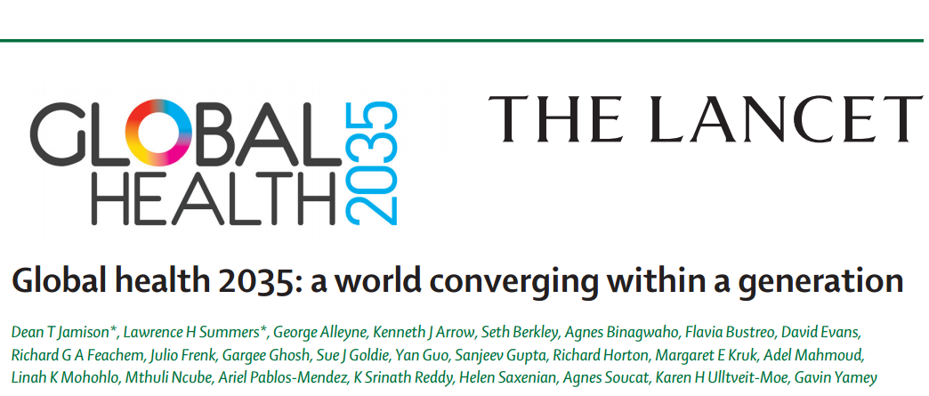

Slide 7
Global Health 2035: 4 Key Messages
The returns from investing in health are extremely impressive
A grand convergence in health is achievable within our lifetime
Pro-poor pathways to universal health coverage are an efficient way to achieve health and financial protection
Fiscal policies are a powerful, underused lever for curbing non-communicable diseases and injuries

Slide 8
Two Centuries of Divergence; ‘4C Countries’ Then Converged

Slide 9
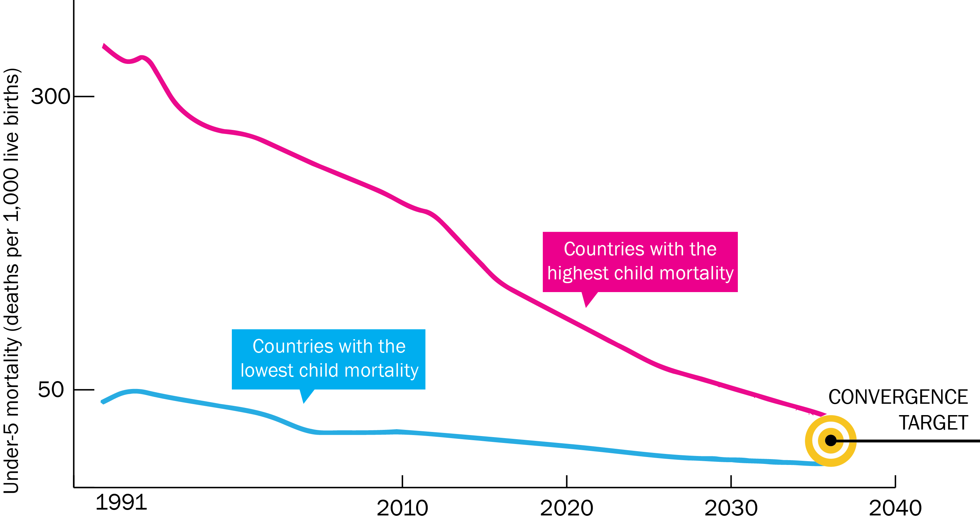
Now on Cusp of a Historical Achievement:
Nearly All Countries Could Converge by 2035

Slide 10
Impact and Cost of Convergence
Low-income countries | Lower middle-income countries
Annual deaths averted from 2035 onwards
4.5 million | 5.8 million
Approximate incremental cost per year, 2016-2035
$25 billion | $45 billion
Proportion of costs devoted to structural investments in health system
60-70% | 30-40%
Proportion of health gap closed by existing tools (rest closed by new tools)
2/3 | 4/5

Slide 11
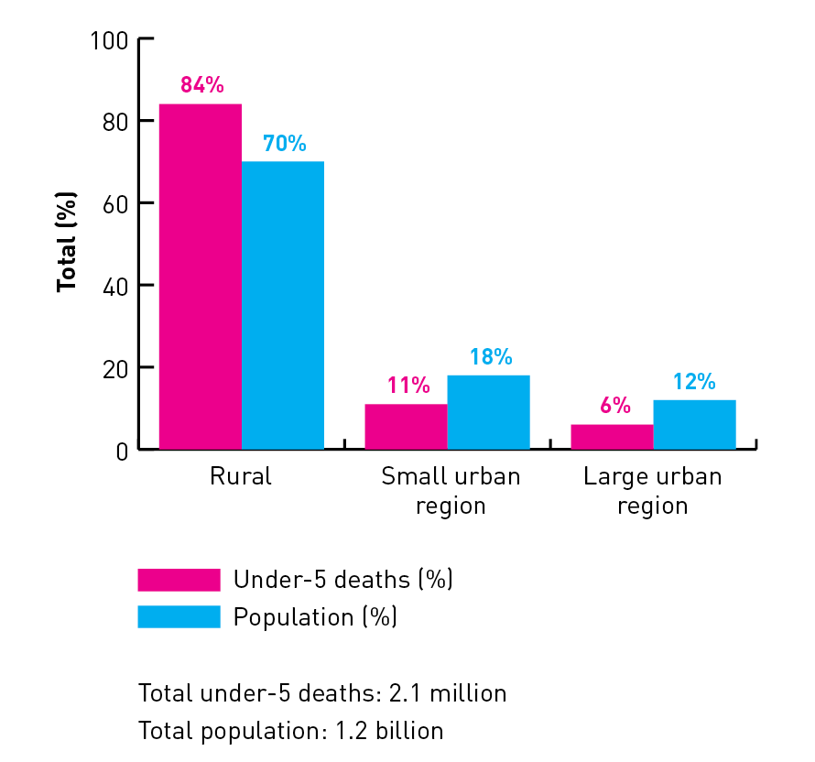
New Global Map of Disease
Under-5 child deaths by region, India, early 2000s

Slide 12
New Global Map of Disease
Births and under-5 deaths by wealth quintile in India

Slide 13
Sources of Income to Fund Convergence
Economic growth
IMF estimates $9.6 trillion/yr from 2015-2035 in low- and lower middle-income countries
Development assistance for health
Cost of convergence ($70 billion/yr) is less than 1% of anticipated growth
Will still be crucial for achieving convergence

Slide 14
Controlling Public Expenditures on Health:
A Role for Private Finance?
Health expenditures per capita in selected high-income regions, 2010

Slide 15
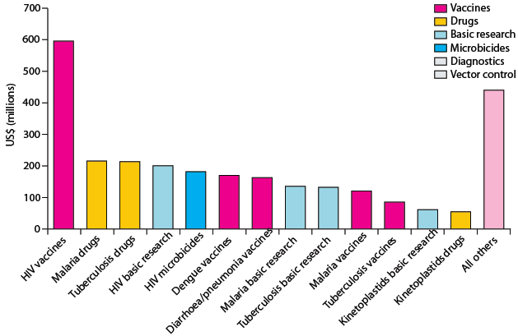
Crucial Role for International Collective Action:
Global Public Goods, Managing Externalities, Stewardship
Best way to support convergence is funding
R&D for diseases disproportionately affecting LICs and LMICs
and managing externalities e.g. flu pandemic
Current R&D ($3B/y) should be doubled, with half the increment funded by MICs
Current global spending on R&D for ‘convergence conditions’ Total: $3B/y

Slide 16
Global Health 2035: 4 Key Messages
The returns from investing in health are extremely impressive
A grand convergence in health is achievable within our lifetime
Fiscal policies are a powerful, underused lever for curbing non-communicable diseases and injuries
Pro-poor pathways to universal health coverage are an efficient way to achieve health and financial protection

Slide 17
Full Income: A Better Way to Measure the Returns from Investing in Health
income growth
value life years gained (VLYs) in that period
change in country's full income over a time period
Between 2000 and 2011, about a quarter of the growth in full income in low-income and middle-income countries resulted from VLYs gained

Slide 18
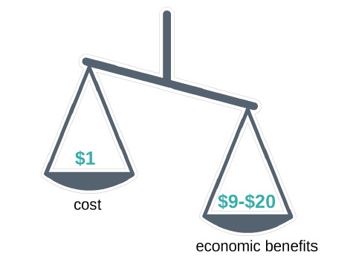
Using VLYs, Convergence Has Impressive
Benefit: Cost Ratio

Slide 19
Global Health 2035: 4 Key Messages
The returns from investing in health are extremely impressive
A grand convergence in health is achievable within our lifetime
Fiscal policies are a powerful, underused lever for curbing non-communicable diseases and injuries
Pro-poor pathways to universal health coverage are an efficient way to achieve health and financial protection

Slide 20
The Report’s Other Messages on NCDs
Tax alcohol and sugar-sweetened beverages (these are pro-poor)
We endorse WHO’s package of “best buy” clinical interventions
(we add HPV vaccine, HPV DNA test, morphine)
We lay out “expansion pathways” as countries get richer
We note that sudden price drops are common in global health → the drug, vaccine, or diagnostic could be added earlier

Slide 21
Global Health 2035: 4 Key Messages
The returns from investing in health are extremely impressive
A grand convergence in health is achievable within our lifetime
Fiscal policies are a powerful, underused lever for curbing non-communicable diseases and injuries
Pro-poor pathways to universal health coverage are an efficient way to achieve health and financial protection

Slide 22
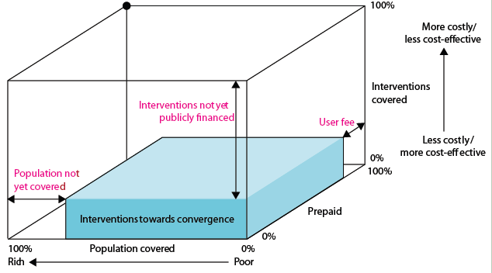
Our Recommendation on UHC:
Pro-Poor Pathway (Blue Shading)
+ essential package for NCDIs

Slide 23
Reflections on India

Slide 24
India’s Path to Convergence
Female life expectancy at birth for selected countries compared to the frontier

Slide 25
Health Status: Income or Policy?
 | INDIA, 2010 | CHINA, 1980 | CHINA, 2010
Income per capita (USD) | $1,030 | $220 | $2,870
Under-5 mortality (per 1000 live births) | 60 | 60 | 16
Life expectancy (both sexes) | 66 | 67 | 75

Slide 26
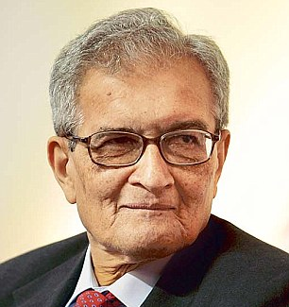
“…a number of poor countries have shown, through their pioneering public policies, that basic healthcare for all can be provided at a remarkably good level at very low cost if the society, including the political and intellectual leadership, can get its act together.”
Amartya Sen
In The Guardian, January 6, 2015

Slide 27
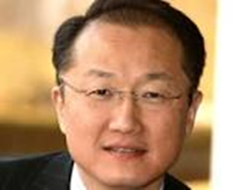
The Value of Investing in Health
“The Lancet Commission on Investing in Health provides further proof that improvements in human survival have economic value well beyond their direct links to GDP”
Jim Kim
World Bank President

Slide 28
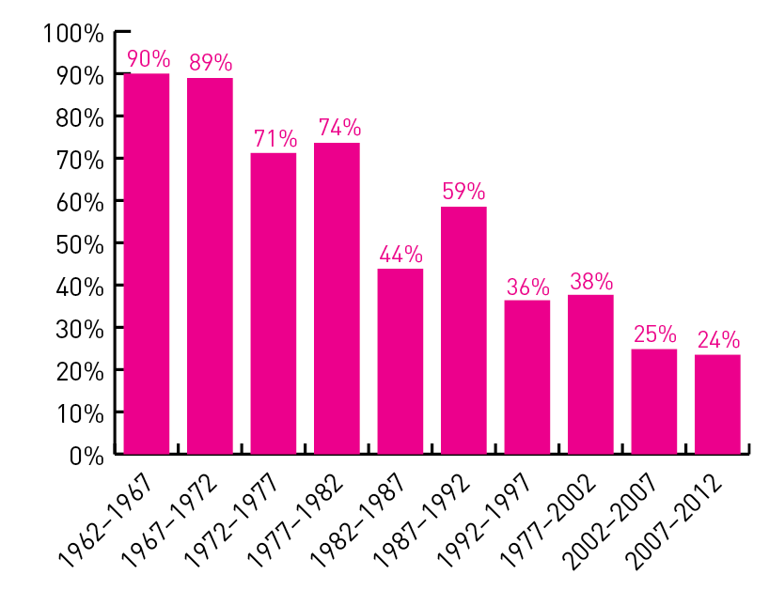
Value of Mortality Decline as % of Change in Full Income in India

Slide 29
Economic Benefits of Convergence in India
$1
$8-12

Slide 30
Ingredients for Addressing the Double Disease Burden
Reducing NCDs and Injuries
Pro-poor UHC

Slide 31
Financial Risk Protection

Slide 32
Large Reductions in Death by Investing in Convergence
Cause | 2011 (no. of deaths) | 2035 (no. of deaths) | % reduction
Maternal | 56,000 | 21,000 | 63%
Child | 1.8 million | 484,000 | 73%
Tuberculosis | 350,000 | 57,000 | 84%
HIV | 168,000 | 13,000 | 92%
Births | 28 million | 25 million | 11%
Total Fertility Rate | 2.6 | 2.1

Slide 33
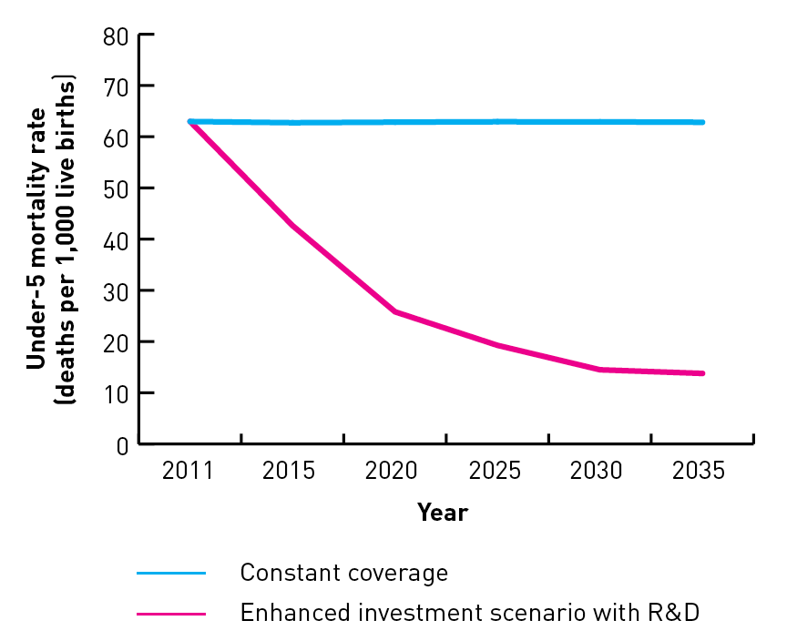
India Could Avert 1 Million Deaths per Year
Reductions in under-5 mortality rate with enhanced investments

Slide 34
Ingredients for Addressing
the Double Disease Burden
Reducing NCDs and Injuries
Pro-poor UHC

Slide 35
Fiscal Policy for Health
Win-win taxation
Taxation of tobacco, alcohol, sugar, extractive industries
Inter-sectoral reallocations and efficiency gains
Removal of fossil fuel subsidies, health sector efficiency
Worldwide carbon energy subsidies are worth 2.0 trillion USD (IMF, 2013)
“Triple, half, double” – Tripling the price of tobacco halves smoking and doubles revenues

Slide 36

Single Greatest Opportunity To Curb NCDs is Tobacco Taxation
Smoke-free legislation and increased tobacco taxation in India could:
  Avert 1.5+ million deaths from heart disease
  Avert 1 million deaths from stroke
  Over the next 50 years, a 50% price increase on cigarettes in India could:
  Prevent 4 million deaths
  Generate $2 billion in revenue annually
Sources: Basu; Jha

Slide 37
Looking ahead in taxes and subsidies
Tax policy is important (well understood)
Subsidy policies – also important for health (less well understood)
Forthcoming study being undertaken in India and South Africa under direction of Prof. Ramanan Laxminarayan will provide valuable new data and policy insights

Slide 38

Thank You
@globlhealth2035
GlobalHealth2035.org
Questions or comments, please contact:
Dean Jamison at djamison@uw.edu
Naomi Beyeler at naomi.beyeler@ucsf.edu

