Slide 1
Investing in Health:
Opportunities to Achieve Dramatic Global Health Gains by 2035
Dean Jamison
Senior Fellow, Global Health Sciences, University of California, San Francisco (UCSF)
Professor Emeritus, University of Washington
Gavin Yamey
Associate Professor of Epidemiology & Biostatistics, UCSF School of Medicine
Lead, Evidence to Policy Initiative, Global Health Group, UCSF
November 24, 2014

Slide 2
Agenda
Background on Global Health 2035
Key messages of the report
Achieving a “second convergence” in Mexico
  Completing the “unfinished agenda” of infectious, maternal and child deaths
  Tackling non-communicable diseases (NCDs) and injuries
  Providing financial risk protection

Slide 3
Global Health 2035: WDR 1993 @20 Years
The World Bank’s World Development Report 1993
Evidence-based health expenditures are an investment not only in health but in economic prosperity
The Lancet Commission on Investing in Health (chaired by Lawrence Summers and Dean Jamison)
Re-examines the case for investing in health
Additional resources should be spent on cost-effective interventions to address high-burden diseases
Provides a roadmap to achieving dramatic gains in global health by 2035
Proposes a health investment framework for low- and middle-income countries

Slide 4
2015-2035: Three Domains of Health Challenges
High rates of avertable infectious, child, and maternal deaths
Unfinished agenda
Demographic change and shift in GBD towards NCDs and injuries
Emerging agenda
Impoverishing medical expenses, unproductive cost increases
Cost agenda

Slide 5
Global Health 2035: 4 Key Messages
The returns from investing in health are extremely impressive
A grand convergence in health is achievable within our lifetime
Fiscal policies are a powerful, underused lever for curbing non-communicable diseases and injuries
Pro-poor pathways to universal health coverage are an efficient way to achieve health and financial protection

Slide 6
Global Health 2035: 4 Key Messages
The returns from investing in health are extremely impressive
A grand convergence in health is achievable within our lifetime
Pro-poor pathways to universal health coverage are an efficient way to achieve health and financial protection
Fiscal policies are a powerful, underused lever for curbing non-communicable diseases and injuries

Slide 7
Two Centuries of Divergence; ‘4C Countries’ Then Converged

Slide 8
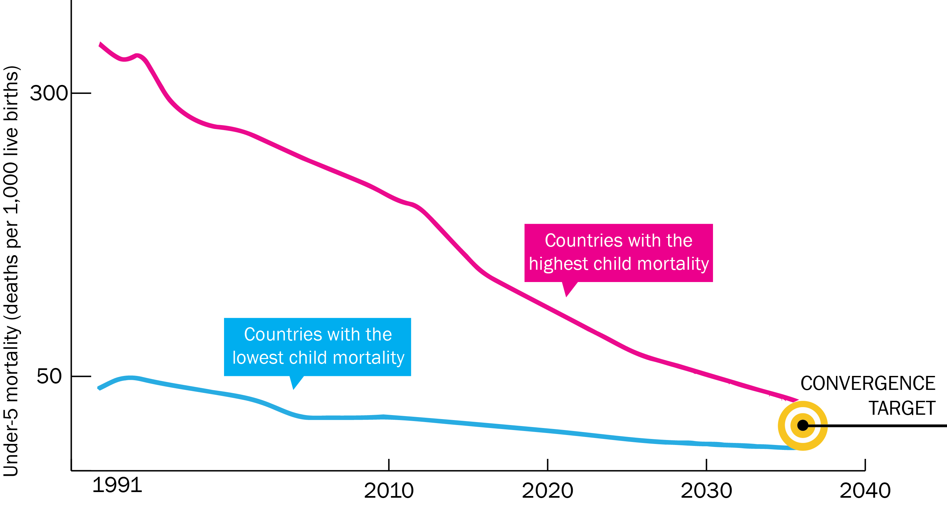
Now on Cusp of a Historical Achievement:
Nearly All Countries Could Converge by 2035

Slide 9
Impact and Cost of Convergence
Low-income countries | Lower middle-income countries
Annual deaths averted from 2035 onwards
4.5 million | 5.8 million
Approximate incremental cost per year, 2016-2035
$25 billion | $45 billion
Proportion of costs devoted to structural investments in health system
60-70% | 30-40%
Proportion of health gap closed by existing tools (rest closed by new tools)
2/3 | 4/5

Slide 10
New Global Map of Disease: “Pockets of Poverty”

Slide 11
Sources of Income to Fund Convergence
Economic growth
IMF estimates $9.6 trillion/yr from 2015-2035 in low- and lower middle-income countries
Development assistance for health
Cost of convergence ($70 billion/yr) is less than 1% of anticipated growth
Will still be crucial for achieving convergence

Slide 12
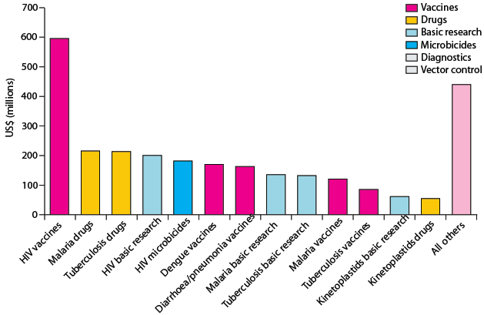
Crucial Role for International Collective Action:
Global Public Goods, Managing Externalities, Stewardship
Best way to support convergence is funding
R&D for diseases disproportionately affecting LICs and LMICs
and managing externalities e.g. flu pandemic
Current R&D ($3B/y) should be doubled, with half the increment funded by MICs
Current global spending on R&D for ‘convergence conditions’ Total: $3B/y

Slide 13
Global Health 2035: 4 Key Messages
The returns from investing in health are extremely impressive
A grand convergence in health is achievable within our lifetime
Fiscal policies are a powerful, underused lever for curbing non-communicable diseases and injuries
Pro-poor pathways to universal health coverage are an efficient way to achieve health and financial protection

Slide 14
Global Health 2035: 4 Key Messages
The returns from investing in health are extremely impressive
A grand convergence in health is achievable within our lifetime
Fiscal policies are a powerful, underused lever for curbing non-communicable diseases and injuries
Pro-poor pathways to universal health coverage are an efficient way to achieve health and financial protection

Slide 15
Full Income: A Better Way to Measure the Returns from Investing in Health
income growth
value life years gained (VLYs) in that period
change in country's full income over a time period
Between 2000 and 2011, about a quarter of the growth in full income in low-income and middle-income countries resulted from VLYs gained

Slide 16
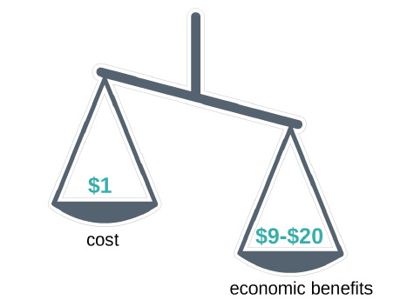
Using VLYs, Convergence Has Impressive
Benefit: Cost Ratio

Slide 17
Global Health 2035: 4 Key Messages
The returns from investing in health are extremely impressive
A grand convergence in health is achievable within our lifetime
Fiscal policies are a powerful, underused lever for curbing non-communicable diseases and injuries
Pro-poor pathways to universal health coverage are an efficient way to achieve health and financial protection

Slide 18
Global Health 2035: 4 Key Messages
The returns from investing in health are extremely impressive
A grand convergence in health is achievable within our lifetime
Fiscal policies are a powerful, underused lever for curbing non-communicable diseases and injuries
Pro-poor pathways to universal health coverage are an efficient way to achieve health and financial protection

Slide 19

Single Greatest Opportunity To Curb NCDs is Tobacco Taxation
50% rise in tobacco price from tax increases in China
  prevents 20 million deaths + generates extra $20 billion/y in next 50 y
  additional tax revenue would fall over time but would be higher than current levels even after 50 y
  largest share of life-years gained is in bottom income quintile

Slide 20
The Report’s Other Messages on NCDs
Tax alcohol and sugar-sweetened beverages (these are pro-poor)
We endorse WHO’s package of “best buy” clinical interventions
(we add HPV vaccine, HPV DNA test, morphine)
We lay out “expansion pathways” as countries get richer
We note that sudden price drops are common in global health → the drug, vaccine, or diagnostic could be added earlier

Slide 21
Global Health 2035: 4 Key Messages
The returns from investing in health are extremely impressive
A grand convergence in health is achievable within our lifetime
Fiscal policies are a powerful, underused lever for curbing non-communicable diseases and injuries
Pro-poor pathways to universal health coverage are an efficient way to achieve health and financial protection

Slide 22
Global Health 2035: 4 Key Messages
The returns from investing in health are extremely impressive
A grand convergence in health is achievable within our lifetime
Fiscal policies are a powerful, underused lever for curbing non-communicable diseases and injuries
Pro-poor pathways to universal health coverage are an efficient way to achieve health and financial protection

Slide 23
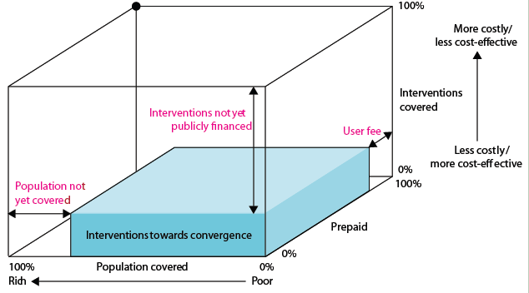
Our Recommendation on UHC:
Pro-Poor Pathway (Blue Shading)
+ essential package for NCDIs

Slide 24
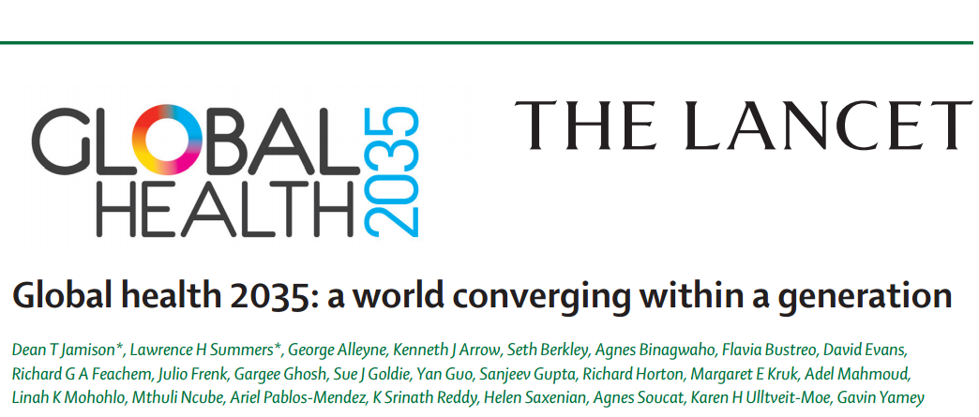

Slide 25
Mexico is Converging with Upper Income Countries

Slide 26
Can Mexico Reach a Second Convergence?

Slide 27

The Value of Investing in Health
“The Lancet Commission on Investing in Health provides further proof that improvements in human survival have economic value well beyond their direct links to GDP”
Jim Kim
World Bank President

Slide 28
Value of Mortality Decline as % of Change in Full Income in Mexico

Slide 29
Ingredients for a Second Convergence
Aggressive control of NCDs and injury risks
Complete the unfinished agenda of infectious, maternal and child deaths
Financial risk protection and cost containment

Slide 30
Ingredients for a Second Convergence
Aggressive control of NCDs and injury risks
Complete the unfinished agenda of infectious, maternal and child deaths
Financial risk protection and cost containment

Slide 31
The Unfinished Agenda of Infectious, Maternal and Child Deaths

Slide 32
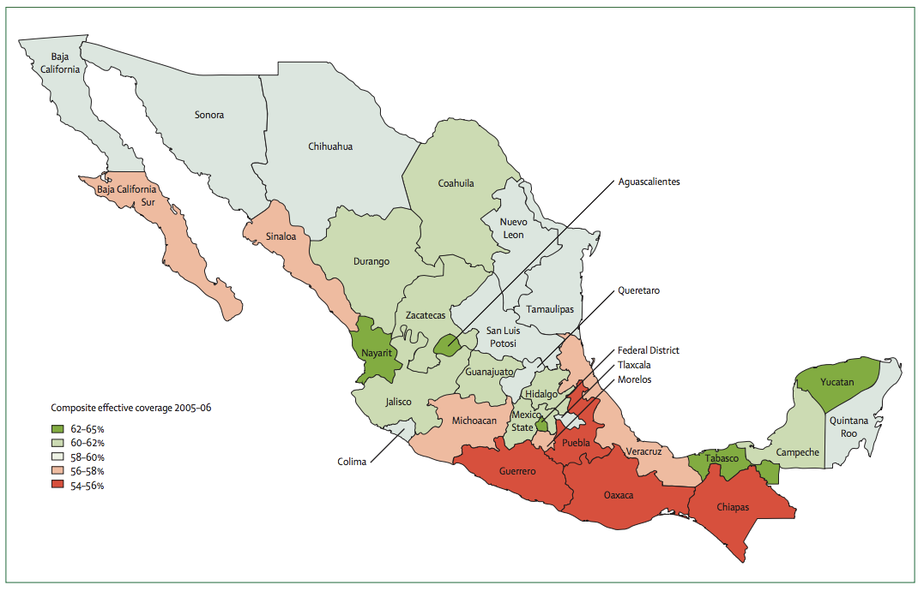
Close Remaining Health Gaps
Composite effective coverage of 14 interventions by state for 2005 - 2006
Lozano R et al. Benchmarking of performance of Mexican states with effective coverage. Lancet 2006; 368:1729 – 1741.

Slide 33
Ingredients for a Second Convergence
Aggressive control of NCDs and injury risks
Complete the unfinished agenda of infectious, maternal and child deaths
Financial risk protection and cost containment

Slide 34
Ingredients for a Second Convergence
Aggressive control of NCDs and injury risks
Complete the unfinished agenda of infectious, maternal and child deaths
Financial risk protection and cost containment

Slide 35
Fiscal Policy for a Second Convergence
Win-win taxation
Taxation of tobacco, alcohol, sugar, extractive industries
Inter-sectoral reallocations and efficiency gains
Removal of fossil fuel subsidies, health sector efficiency
Worldwide carbon energy subsidies are worth 2.0 trillion USD (IMF, 2013)
“Triple, half, double” – Tripling the price of tobacco halves smoking and doubles revenues

Slide 36
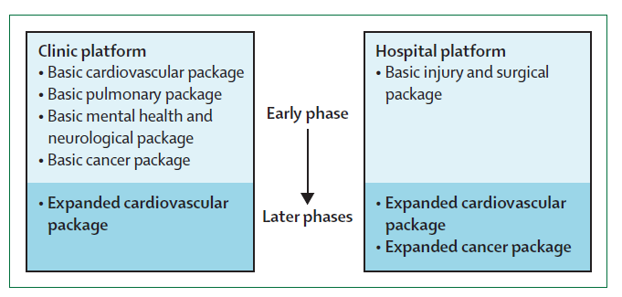
Health System Evolution

Slide 37
Ingredients for a Second Convergence
Aggressive control of NCDs and injury risks
Complete the unfinished agenda of infectious, maternal and child deaths
Financial risk protection and cost containment

Slide 38
Ingredients for a Second Convergence
Aggressive control of NCDs and injury risks
Complete the unfinished agenda of infectious, maternal and child deaths
Financial risk protection and cost containment

Slide 39
First Law of Health Economics
Mexico 2010
Mexico 1995

Slide 40
Financial Risk Protection

Slide 41
Cost Containment
Most promising approaches to cost containment
1. Hard budget constraints
2. Minimize fee for service payments
3. Institute reference pricing

Slide 42

Thank You
@globlhealth2035
GlobalHealth2035.org
#GH2035

