Slide 1
Learning from Other Countries: Significance of Investing in Health for Economic Growth and Social Development
Overview
Helen Saxenian
Myanmar Health Forum
Nay Pyi Taw, Myanmar
July 28, 2015

Slide 2
Key global reports on health and development
World Development Report (1980) on poverty and human development: documented links between health, education, fertility and poverty
World Development Report: Investing in Health (1993): rapid improvements in health would lead to increased economic output and rapid gains in welfare for the poor
WHO’s Commission on Macroeconomics and Health Report (2001): evidence that “a healthy population is an engine for economic growth”
MDGs (2000): committing world leaders to combat poverty, hunger, disease, illiteracy, environmental degradation and discrimination against women
  Recognize interdependence of health and all MDGs
The Lancet Global Health 2035 by the Commission on Investing in Health (2013)

Slide 3
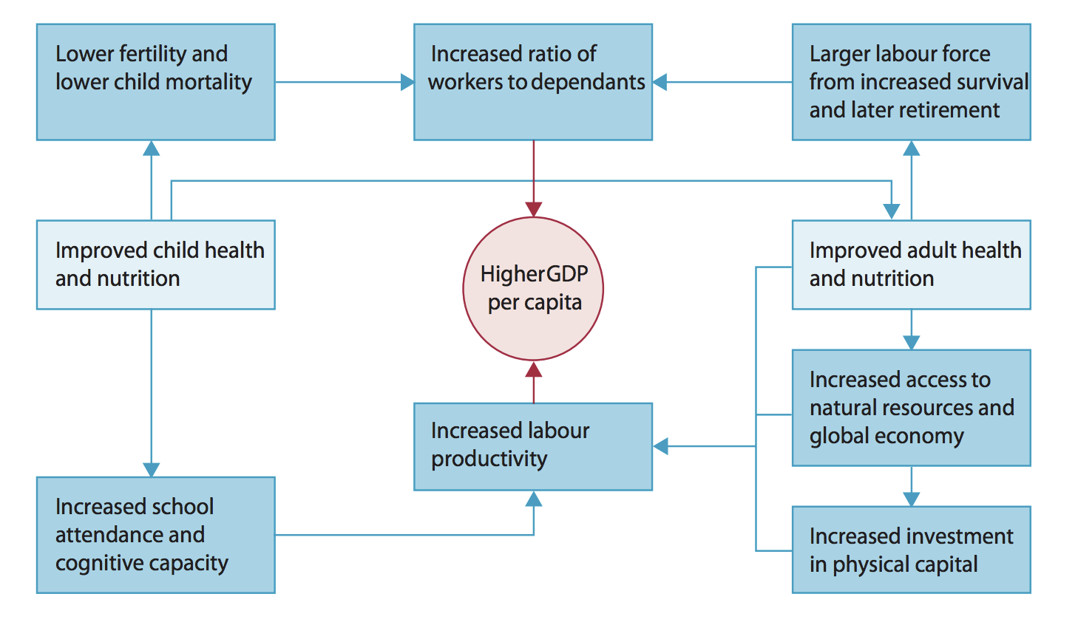
How improved health leads to increased personal and national income
Adapted from WHO World Health Report 1999 and Ruger, Jamison, Bloom. Health in the economy. In: Merson, Black, Mills, eds. International public health, 2nd edn. Sudbury: Jones and Barlett, 2006.

Slide 4
Evidence for health improvements stimulating economic development
Historical case studies
Microeconomic studies at individual or household level
Macroeconomic studies on the effect of health improvements on income, income growth, or investment rates
Jamison, Lau, and Wang¹ reviewed this literature and concluded that 11% of economic growth in low- and middle-income countries from 1970-2000 was from reductions in adult mortality
¹ Jamison, Lau, Wang. Health’s contribution to economic growth in an environment of partially endogenous technical progress. In: Lopez-Casasnovas, Rivera, Currais, eds. Health and economic growth: findings and policy implications. Cambridge, MA: The MIT Press, 2005: 67-91.

Slide 5
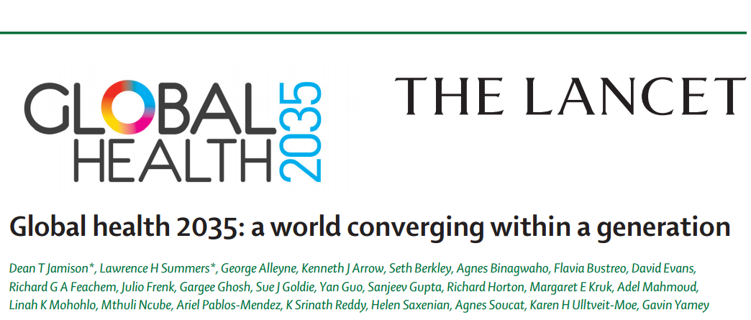
5
Notes:
.

Slide 6
Better Health Increases “Full Income”
People place a high value on living a longer, healthier life
National income accounts measure income in a narrow sense
“Full income” is a broader concept that values income accounting as well as mortality risk
income growth
value life years gained (VLYs) in that period
change in country's full income over a time period
We used “full income” approach to better assess health’s contribution to a nation’s economic well-being

Slide 7
Myanmar total health expenditure as % of GDP compared to countries of similar GNI per capita, 2004-13
GNI per capita, 2014
Kenya: $1,280
Myanmar: $1,270
Mauritania: $1,260
Kyrgyzstan: $1,250
Bangladesh: $1,080
Source: World Health Organization Global Health Expenditure Database

Slide 8
Myanmar government expenditure on health as % of total government expenditure compared to countries of similar GNI per capita, 2004-13
GNI per capita, 2014
Kenya: $1,280
Myanmar: $1,270
Mauritania: $1,260
Kyrgyzstan: $1,250
Bangladesh: $1,080
Source: World Health Organization Global Health Expenditure Database

Slide 9
Myanmar total health expenditure as % of GDP compared to other ASEAN countries, 2004 - 2013
Source: World Health Organization Global Health Expenditure Database

Slide 10
Myanmar government health expenditure as % of total government expenditure compared to other ASEAN countries, 2004-13
Source: World Health Organization Global Health Expenditure Database

Slide 11
Conclusions
Evidence is compelling: there is an enormous payoff from investing in health
  Better health stimulates economic growth
  Better health has a value in and of itself
Growth in “full income” quantifies both income growth and the value of increased life expectancy
High priority for investing in health and in investments that affect health (e.g. water and sanitation)

