Slide 2
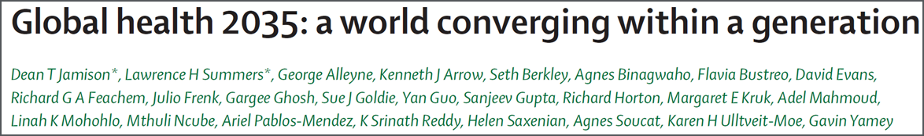
Global Health 2035: WDR 1993 @20 Years
The World Bank’s World Development Report 1993
Evidence-based health expenditures are an investment not only in health, but in economic prosperity
The Lancet Commission on Investing in Health
Re-examines the case for investing in health
Additional resources should be spent on cost-effective interventions to address high-burden diseases
Provides a roadmap to achieving gains in global health through a ‘grand convergence’
Proposes a health investment framework for low- and middle-income countries

Slide 3
2015-2035: Three Domains of Health Challenges
High rates of avertable infectious, child, and maternal deaths
Unfinished agenda
Demographic change and shift in GBD towards NCDs and injuries
Emerging agenda
Impoverishing medical expenses, unproductive cost increases
Cost agenda

Slide 4
Global Health 2035: 4 Key Messages
The returns from investing in health are extremely impressive
A grand convergence in health is achievable within our lifetime
Fiscal policies are a powerful, underused lever for curbing non-communicable diseases and injuries
Progressive pathways to universal health coverage are an efficient way to achieve health and financial protection

Slide 5
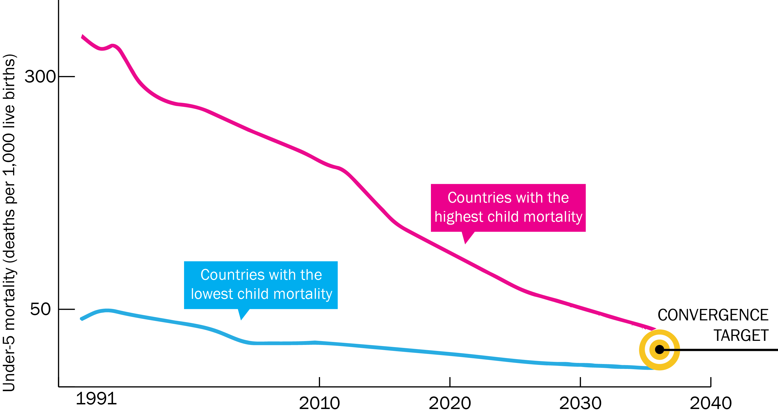
Now on Cusp of a Historical Achievement:
Nearly All Countries Could Converge by 2035

Slide 6
Rwanda: Steepest Fall in Child Mortality Ever Recorded
Investment ($70B/year) is Not a High Risk Venture: Rapid Mortality Decline Is Possible
Farmer P, et al. BMJ 2013; 346: f65

Slide 7
Modeling Convergence Investment Case¹
Compares scale-up versus constant coverage
HIV
UN One Health tool
Country-level cost and impact model to 2035
Malaria
Burden reduction
Intervention costs
“Service delivery” costs
RMNCH
Burden, interventions, coverage, efficacy

Slide 8
Global Health 2035: 4 Key Messages
The returns from investing in health are extremely impressive
A grand convergence in health is achievable within our lifetime
Fiscal policies are a powerful, underused lever for curbing non-communicable diseases and injuries
Progressive pathways to universal health coverage are an efficient way to achieve health and financial protection

Slide 9
Full Income: A Better Way to Measure the Returns from Investing in Health
income growth
value life years gained (VLYs) in that period
change in country's full income over a time period
Between 2000 and 2011, about a quarter of the growth in full income in low-income and middle-income countries resulted from VLYs gained

Slide 10
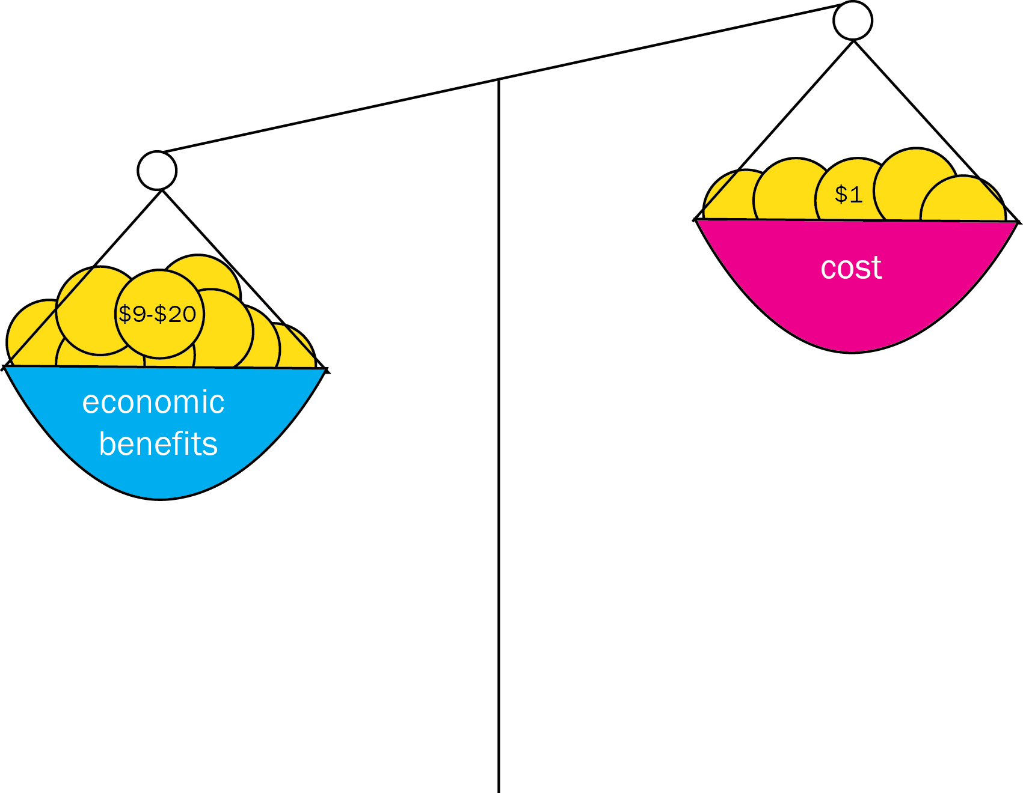
With Full Income Approach, Convergence Has Impressive Benefit: Cost Ratio

Slide 11
Sources of Financing for Convergence
Economic growth
IMF estimates $9.6 trillion/y from 2015-2035 in low- and lower middle-income countries
Mobilization of domestic resources
Taxation of tobacco, alcohol, sugar “win-wins”
Inter-sectoral reallocations and efficiency gains
Development assistance for health
Cost of convergence ($70 billion/y) is less than 1% of anticipated growth
Removal of fossil fuel subsidies, health sector efficiency
Subsidies account for an 3.5% of GDP on a post-tax basis
Will still be crucial for achieving convergence
Broadening and strengthening tax base

Slide 12
Global Health 2035: 4 Key Messages
The returns from investing in health are extremely impressive
A grand convergence in health is achievable within our lifetime
Fiscal policies are a powerful, underused lever for curbing non-communicable diseases and injuries
Progressive pathways to universal health coverage are an efficient way to achieve health and financial protection

Slide 13

Single Greatest Opportunity To Curb NCDs is Tobacco Taxation
50% rise in tobacco price from tax increases in China
  prevents 20 million deaths + generates extra $20 billion/y in next 50 y
  additional tax revenue would fall over time but would be higher than current levels even after 50 y
  largest share of life-years gained is in bottom income quintile

Slide 14

We Also Argue for Taxes on Sugar e.g. product taxes on Sugar-Sweetened Sodas
  Taxing empty calories, e.g. sugary sodas, can reduce prevalence of obesity and raise public revenue
  These taxes do not hurt the poor: main dietary problem in low-income groups is poor dietary quality and not energy insufficiency

Slide 15

Lessons from Taxing Tobacco and Alcohol
Taxes must be large to change consumption
Must prevent tax avoidance (loopholes) and tax evasion (smuggling, bootlegging)
Design taxes to avoid substitution
Young/low-income groups respond most

Slide 16
Global Health 2035: 4 Key Messages
The returns from investing in health are extremely impressive
A grand convergence in health is achievable within our lifetime
Fiscal policies are a powerful, underused lever for curbing non-communicable diseases and injuries
Progressive pathways to universal health coverage are an efficient way to achieve health and financial protection

Slide 17
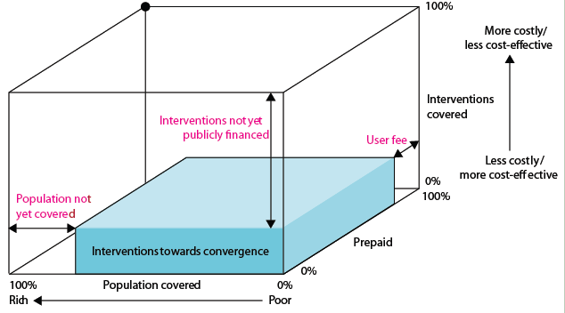
Our Recommendation on UHC:
Progressive Universalism (Blue Shading)
+ essential package for NCDIs

Slide 18
Progressive Universalism
Insurance covers whole population
Targets poor by insuring highly cost-effective health interventions for diseases disproportionately affecting poor
Interventions are funded through tax revenues, payroll taxes, or combination
No OOP expenses for defined benefit package of publicly financed services
As resource envelope grows, so does package (as seen in Mexico), e.g. add wider range of interventions for NCDs

Slide 19
Advantages of Progressive Universalism
Government does not have to incur costly administrative expenses identifying who is poor (everyone is covered)
Universal package promotes broader support among population and health providers than schemes targeting poor alone—such support helps to sustain financing over time

Slide 20
A Variant of Progressive Universalism
Larger package to whole population with patient copayment but poor are exempted from copay (e.g. Rwanda)
Uses a wider variety of financing mechanisms (general taxation, payroll tax, mandatory insurance premiums, copayments)
Advantages: wider package, engages non-poor in prepaid mandatory scheme from day 1, transition may be more feasible
Major disadvantage: costly to identify poor, to organize and collect copays/premiums

Slide 21
Thank you
GlobalHealth2035.org

Slide 22
Caveats & Challenges
Inherent uncertainties in any modeling exercise
Assumes aggressive coverage levels (typically 90-95% by 2035)—would all countries have the institutional capacity?
Model does not account for role of other development sectors (e.g. climate, water ) or social determinants of health
May over-play or under-play role of R&D

