Slide 1
Achieving a ‘Grand Convergence’ in Global Health
Chair: Richard Feachem, University of California, San Francisco
Presenter: Dean Jamison, University of Washington
Discussants: Marie-Louise Newell, University of Southampton
Anthony Costello, University College London
Lesong Conteh, Imperial College London
Ariel Pablos-Méndez, USAID
Global Health 2035 London Symposium
Royal College of Physicians
3 December 2013

Slide 2
Global Health 2035’s work on convergence was undertaken with valuable inputs from
World Health Organization
Partnership for Maternal, Newborn & Child Health and UNAIDS

Slide 3
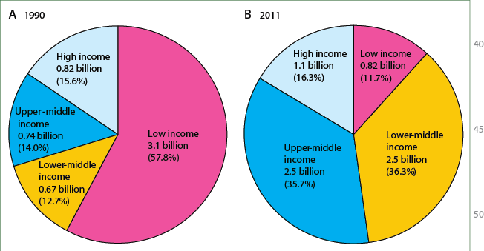
1993-2013: Extraordinary economic progress...
Movement of populations from low income to higher income between 1990 and 2011

Slide 4
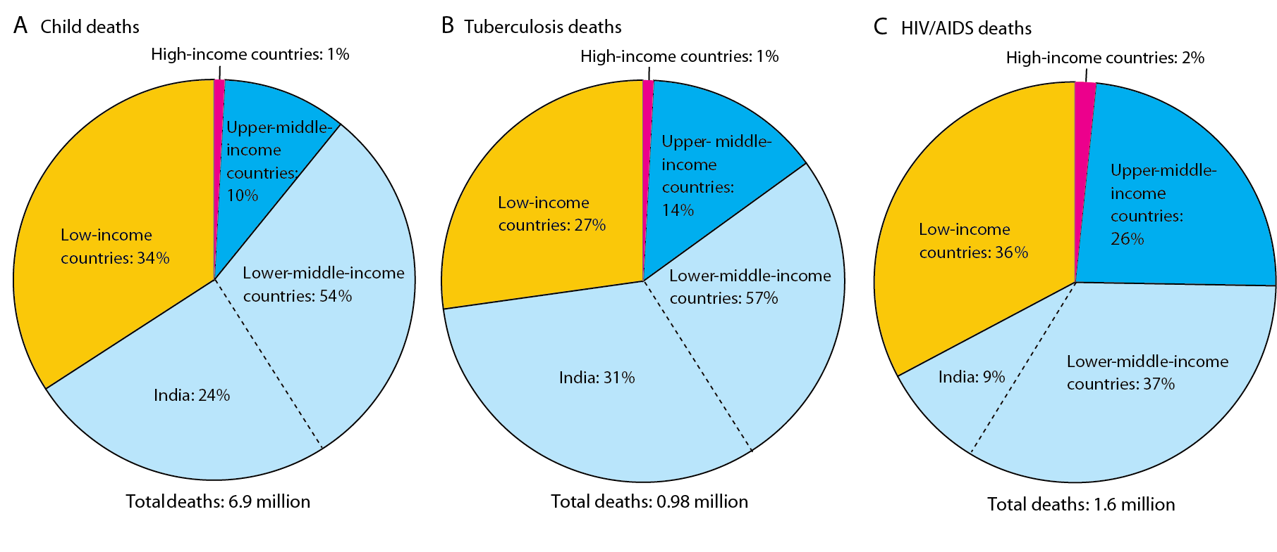
… but persistent health disparities

Slide 5
The Global Mortality Gap
Years of life expectancy lost relative to the 4C countries in 2008, by region
 | Total | Under-5 mortality | Tuberculosis (age > 5 years) | HIV/AIDS (age > 5 years) | Maternal mortality*
Low-income countries Ethiopia Rwanda | 19.5 16.5 17.3 | 6.7 4.2 2.6 | 0.6 0.4 0.4 | 1.4 2.1 2.4 | 0.5 0.6 0.7
Lower-middle-income-countries^ India | 9.9 11.4 | 3.6 3.4 | 0.3 0.4 | 0.3 0.1 | 0.2 0.2
Upper-middle-income countries^ South Africa | 5.8 18.6 | 0.8 2.1 | 0.0 0.5 | 0.4 3.0 | 0.0 0.9
Worldwide^ | 9.0 | 3.8 | 0.2 | 0.5 | 0.2
*Life expectancy changes for women only. ^Based on 2008 life tables. Data from Professor Ole Norheim.

Slide 6
Interventions included in the convergence model
RMNCH
Pregnancy related interventions; Abortion & complications; Family planning; Diarrhoea management; Pneumonia treatment; Immunisation; Nutrition
HIV
Prevention activities; Management of opportunistic infections; Care and treatment; Collaborative tuberculosis-HIV treatment
Tuberculosis
Diagnosis, care and treatment of drug-sensitive TB; Diagnosis, care and treatment of multidrug-resistant TB
Malaria
Treatment with appropriate drugs; Long-lasting insecticidal bed nets; Intermittent presumptive treatment in pregnancy
Neglected tropical diseases
Interventions to control: lymphatic filariasis, onchocerciasis, schistosomiasis, trachoma, soil-transmitted helminths

Slide 7
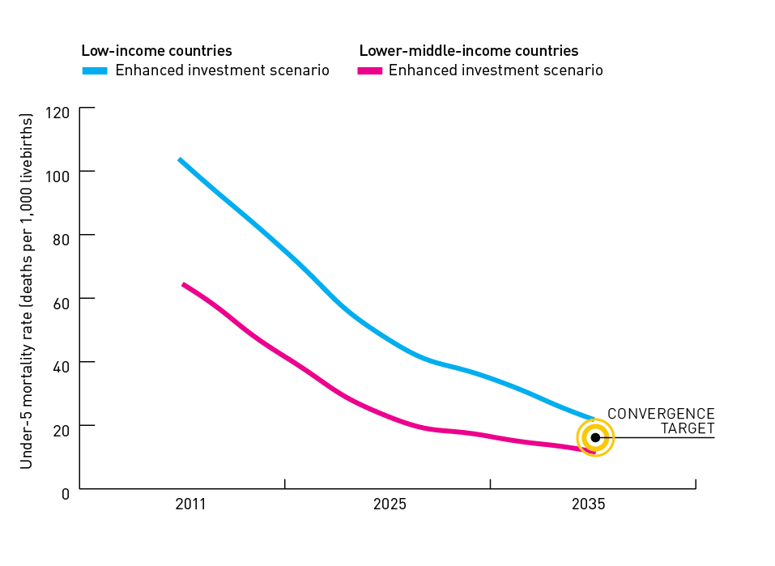
Achieving Convergence: 16—8—4
With enhanced investment,
we could achieve a
grand convergence in global health by 2035 – bringing deaths from infections and RMNCH conditions in LICs and LMICs down to rates in the best-performing MICs.
Impact of enhanced investments on under-five mortality rates in low- and lower-middle income countries

Slide 8
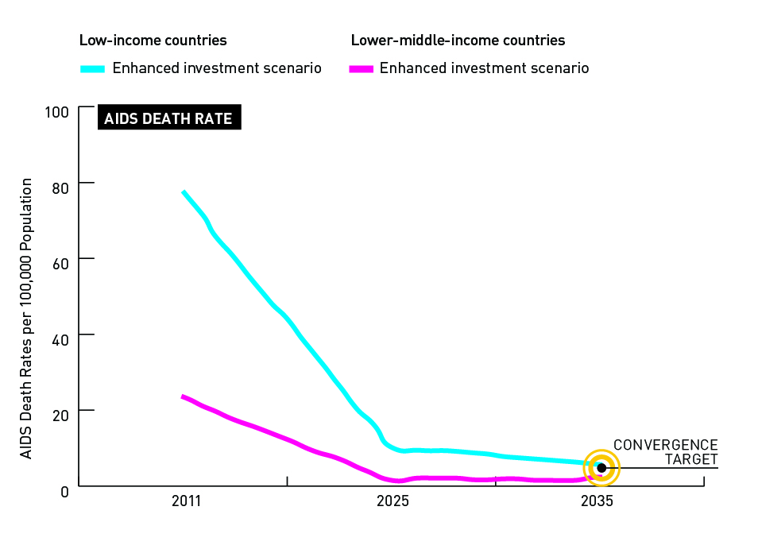
Achieving Convergence: 16—8—4
Impact of enhanced investments on AIDS death rates in low- and lower-middle income countries

Slide 9
Achieving Convergence: 16—8—4
Impact of enhanced investments on TB death rates in low- and lower-middle income countries

Slide 10
Global Health 2035: A Call to Action
Opportunities for National Governments
Aggressively scale up disease control tools
Focus on high-burden settings
Increase domestic spending on health
Opportunities for the International Community
Finance global public goods, including R&D and control of externalities
Transitional financing to select countries
Capacity support for international institutions
Notes:
New slide.

