Slide 1
Progressive Pathways to Universal Health Coverage
David B Evans, Director Health Systems Governance & Financing

Slide 2
Background
Grand Convergence: once in a lifetime opportunity
It will cost money – in low-income countries, increases in external financial will be necessary unless exceptional growth
Nevertheless, virtually all countries could raise or spend more on health if they wished - Sanjay Gupta IMF gave options for raising and spending wisely
What to do with the money?

Slide 3
The Objective: Universal Health Coverage
All people have access to needed services
Without the risk of financial ruin linked to paying for care
Universal Health Coverage:
coverage with needed health services (of good quality);
coverage with financial risk protection
for all

Slide 4
Financial Risk Protection
1. Requires:
Prepayment and pooling of resources - compulsory
Minimizing user fees and charges – zero for the poor and vulnerable (possibly "negative fees")
Good quality services are available
2. The combination of financial risk protection with the availability of good quality services – instrumental to increasing health and economic wellbeing, but also valued for its own sake

Slide 5
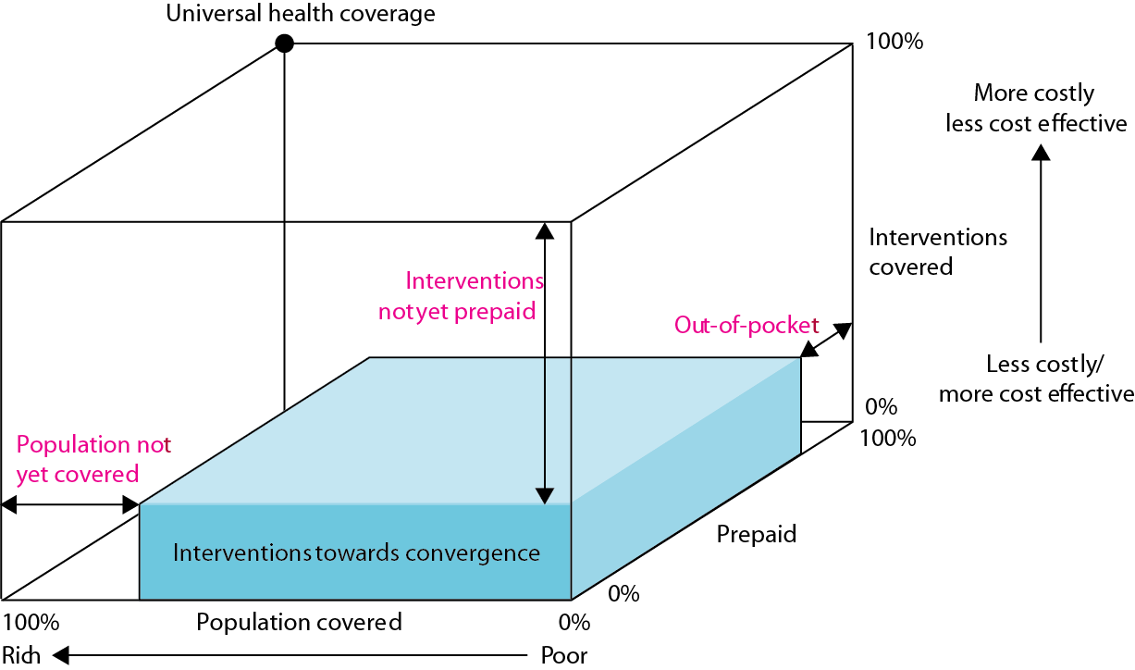
Resource Scarcity and Progressive Universalism

Slide 6
Progressive Universalism: Features
The poor and vulnerable should be covered from the start – do not start with insurance for the formal sector and civil servants with the intention of bringing in the poor and informal sector later
Start by covering interventions against infectious diseases, targeting RNMCH, expanding to NCDs rapidly – the most highly cost-effective interventions
Limited if any payments at the point of service – poor and vulnerable exempted if fees are charged
Expand health services over time as rapidly as possible – prevention, promotion, treatment, rehabilitation, palliation

Slide 7
Country Choices: Practicality and Politics
Begin by targeting poor and vulnerable versus universal from the start – practical questions: how easy to identify, restrict
Ways of ensuring poor can afford: zero user fees/co-payments vs. exemptions (or cash transfers) – efficiency question
What to call compulsory prepaid contributions: taxes, charges or compulsory insurance? Sometimes people more willing to contribute to a tax called insurance than pay increases in overall taxation used to fund health
How many pools? Less fragmentation better
How to purchase services from pooled funds: fee for service inefficient, what role for results based payments?

Slide 8
What Does Not Work
  Voluntary insurance cannot get to UHC – at best, a supplement to compulsory pooling
  Catastrophic insurance – e.g. insurance for unpredictable high cost items such as inpatient care - cannot get to UHC

Slide 10


Thank you

