Slide 1
Cost-Effective Interventions to Curb Non-Communicable Diseases and Injury
Chair: Karen-Helene Ulltveit-Moe, University of Oslo
Presenter: Gavin Yamey, University of California, San Francisco
Discussants: Majid Ezzati, Imperial College London
Richard Smith, UnitedHealth Group
Cary Adams, NCD Alliance and CEO of UICC
Global Health 2035 London Symposium
Royal College of Physicians
3 December 2013

Slide 2
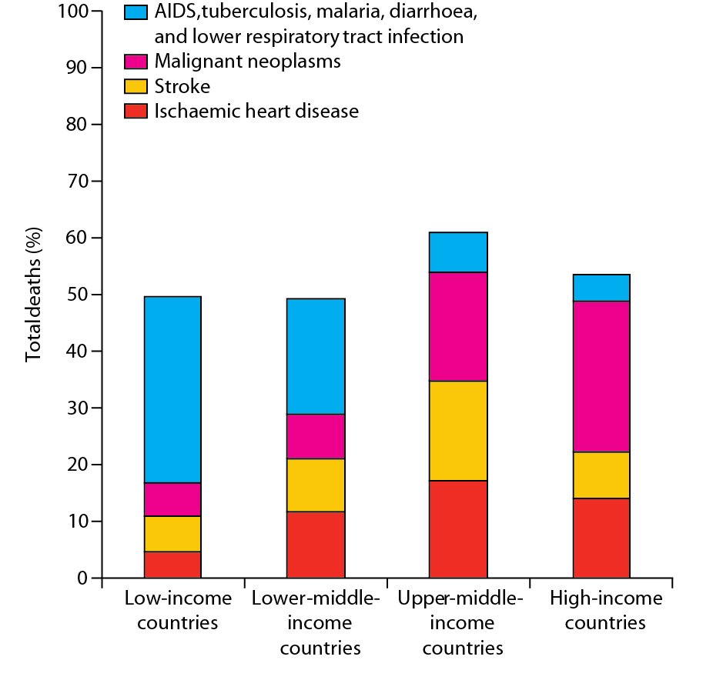
A paradox of success
Deaths from selected important causes across different income levels

Slide 3
Age-standardized death rates from CVD are higher in all six World Bank regions than in HICs

Slide 4
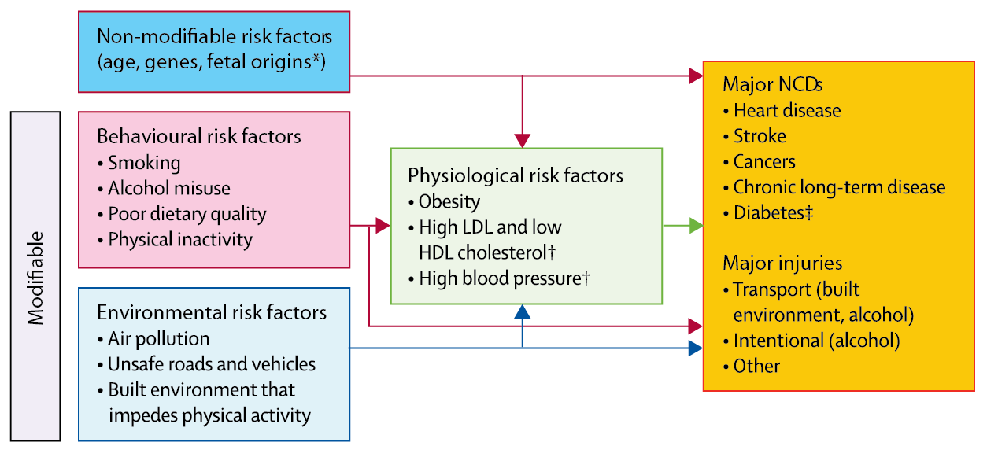
What steps can countries take to delay onset?
Relations between key risk factors for major NCDs and injuries
† Amenable to drug therapy

Slide 5
Large loss of life expectancy
Smoking: smoker in U.S. → Loses about 10 y
Pollution: 65-y-old woman in moderately polluted Chinese city → Loses about 4 y
Obesity: 60-y-old with:
BMI 27-30 → Loses about 1-2 y
BMI 30-35 → Loses about 2-4 y
BMI 40-50 → Loses about 8-10 y
Life expectancy

Slide 6
Essential packages of interventions
Specific interventions in each package will vary by country
Depends on which risk factors dominate
Population package: reduces incidence of NCDs and injuries
Clinical package: reduces incidence and manages consequences

Slide 7
We structure our population-based package by policy instrument
¹ Taxes and subsidies
² Regulation and legislation
³ Information and communication
⁴ Built environment

Slide 8
Essential package of population-based interventions
 | Taxes and subsidies | Laws and regulations | Information | Built environment
Tobacco | Large (170%) excise taxes* | Bans on use in public places and on promotion* | Mass media messages* | --
Alcohol | Large taxes in countries where high burden* | Bans on promotion and restriction on sales* | Mass media messages* | --
Poor diet | Tax sugar and potentially other foods | Bans on salt and trans fats in processed food* | Increase public awareness of healthy diet and physical activity* | --
Unsafe roads and vehicles | -- | Enforce speeding and drink-driving laws | -- | Safe roads and vehicles
Air pollution | Reduce fossil fuel subsidies. Selectively subsidise LPG to replace kerosene for household use. | Promote LPG | -- | --
LPG=liquefied petroleum gas. *Represent WHO best buys for control of NCDs

Slide 9
Taxes: the single greatest opportunity is tobacco
50% rise in tobacco price from tax increases in China
prevents 20 million deaths + generates extra $20 billion/y in next 50 y
additional tax revenue would fall over time but would be higher than current levels even after 50 y
largest share of life-years gained is in bottom income quintile

Slide 10
Lessons from taxing tobacco and alcohol
Taxes must be large to change consumption
Must prevent tax avoidance (loopholes) and tax evasion (smuggling, bootlegging)
Design taxes to avoid substitution
Young/low-income groups respond most

Slide 11
Subsidies: the single greatest opportunity is ending fossil fuel subsidies
Health and economic impacts
Expenditures
Subsidies (post-tax) were US $2.0 trillion in 2011
Energy subsidy reform is a crucial lever to curb NCDs
Multiple NCDs
cancers, heart disease, lung disease, respiratory infection

Slide 12
Three other policy instruments
²Regulation and legislation
Powerful, immediate government lever: ban industrially produced trans fats
³Information and communication
Dietary information improves knowledge but little evidence of behaviour change
⁴Built environment
Substituting solid fuels with cleaner technologies; electricity, LPG
globalhealth2035.org

Slide 13
Essential package of clinical interventions
WHO “best buys”
NCD | Intervention
Liver cancer | Hepatitis B vaccine
Cervical cancer | VIA and treatment of pre-cancerous lesions
CVD and diabetes | Counselling and multi-drug therapy for high-risk patients
Heart attack | Aspirin

Slide 14
We recommend scale-up in all countries
Cost-effective
80% coverage by 2020 would avert 37% of global burden of cardiovascular disease
Low coverage
Except for hepatitis B vaccine, very low coverage across LICs/MICs
Feasible
1st step for all countries; costs $9bn/y; we argue that HPV vaccine should be included

Slide 15
Phased expansion pathways
Choice of packages and expansion pathway will vary with pattern of disease, delivery capacity, domestic health spending

Slide 16
Why did we include childhood cancers?
Disease Control Priorities Project 3rd edition examines evidence on treating pediatric cancers in a range of LICs/MICs
Treating common childhood malignancies in many settings would be cost-effective: treatments are effective and those cured can live for decades
Malawi: treating a single child with Burkitt lymphoma would be very cost-effective up to a cost of US $14,000 (actual cost of chemotherapy + supportive drugs is US $50)
Hesseling PB. Burkitt lymphoma treatment: the Malawi experience.
J Afr Cancer 2009;1:72–9.

Slide 17
Sudden price drops affect expansion pathway
For drugs, diagnostics, and vaccines, which can usually be delivered without complex infrastructure, price reductions can sometimes occur very rapidly
Price drop might be large enough for intervention to be used earlier in expansion pathway
Price

Slide 18
“Interventions don’t deliver themselves”
 | Community outreach | Clinics | District hospitals | Referral hospitals
CVD, diabetes | Diabetes prevention programmes | Drugs for primary & secondary prevention of CVD | Medical treatment of acute heart attack | Angiography services
Cancers | HPV vaccination | Cervical cancer screening/treatment | Hormonal therapy and surgery for breast cancer | Treatment of selected paediatric cancers
Psychiatric and neurological conditions | Rehabilitation for chronic psychosis | Antidepressants and psychotherapy for depression or anxiety | Detoxification for alcohol dependence | Neurosurgery for intractable epilepsy
Injuries | Training of lay first responders | Treatment of minor burns | Management of fractured femur | Complex orthopaedic surgery—e.g. for pelvic injury

Slide 19
What role for international collective action?
Curbing NCDs and Injuries
Leadership and stewardship | Advocacy and technical assistance for taxation, trade and subsidy policies
Provision of global public goods | “PPIR” (population, policy, and implementation research) Expanding the menu of cost-effective population-based and clinical interventions Surveillance on implementing the WHO FCTC
Managing cross-border externalities | Regional collaboration to prevent tobacco smuggling
Direct country assistance | Aid to LICs to support selected NCD and injury interventions (e.g. HPV and hepatitis B vaccines)

Slide 20
Thank you yameyg@globalhealth.ucsf.edu www.globalhealth2035.org

