Slide 1
Quantifying the Sustainable Development Goal for Health (SDG3)
Gavin Yamey, Associate Professor of Epidemiology & Biostatistics, University of California, San Francisco
New York, NY
Thursday, October 23, 2014

Slide 2
Two Approaches to Quantification

Slide 3
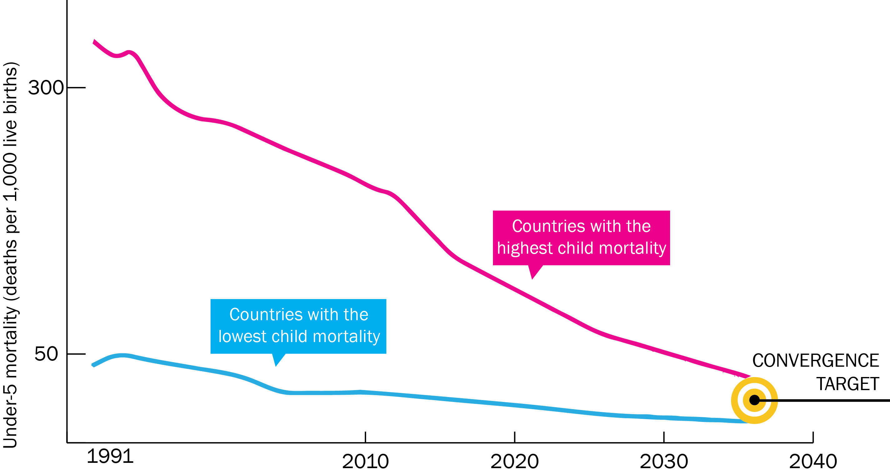

Slide 4
Modeling Convergence Investment Case¹ Compares scale-up versus constant coverage
HIV
UN One Health tool
Country-level cost and impact model to 2030 and 2035
Malaria
Burden reduction
Intervention costs
“Service delivery” costs
RMNCH
Burden, interventions, coverage, efficacy

Slide 5
Modeling Convergence Investment Case²
34 LICs and 48 Lower MICs
HIV
One Health
Country-level cost and impact model to 2035
One Health
Country-level cost and impact model to 2035
One Health
Country-level cost and impact model to 2035
+
Malaria
One Health
Country-level cost and impact model to 2035
TB
NTDs
HSS (HLTF)
New tools (extra 2%/year decline)
One Health
Country-level cost and impact model to 2035
One Health
Country-level cost and impact model to 2035
One Health
Country-level cost and impact model to 2035
RMNCH
One Health
Country-level cost and impact model to 2035
UN One Health
Tool
Country-level cost and impact model to 2030 and 2035

Slide 6
Impact of Scale-Up to 2030
 | Low-income countries (LICs) | Lower-middle income countries (LMICs) | Average across LICs and LMICs
Under-5 death rate per 1,000 live births | 27 | 13 | 20
Convergence: reduction in avertable infectious, maternal, and child deaths in low- income countries (LICs) and lower-middle-income countries (LMICs) down to levels seen today in high-performing middle-income countries.
Child mortality rate of 20 per 1,000 live births is seen today in a set of four high-performing upper-middle-income countries, conveniently labeled “the 4 Ps” (Palau, Panama, Paraguay, and Peru), i.e. model shows “convergence” to the 4Ps

Slide 7
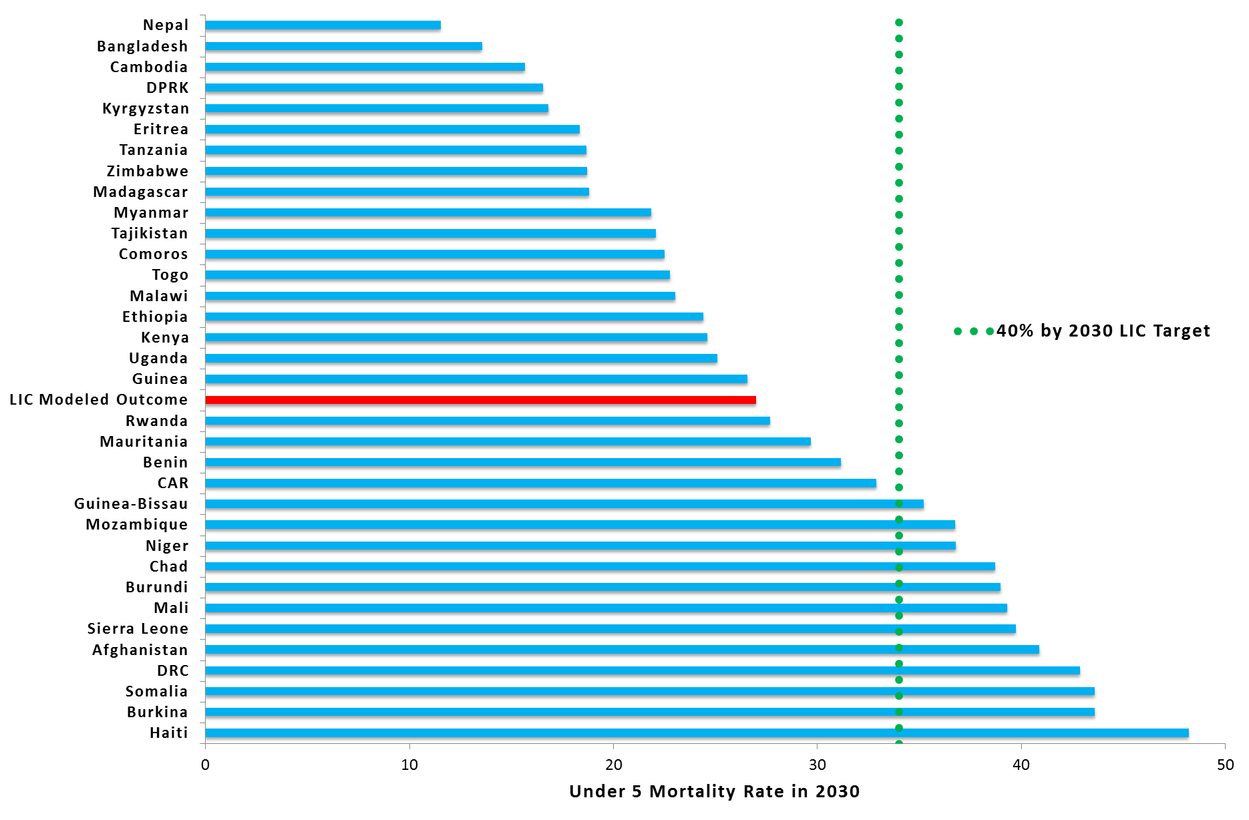
Modeled under 5 mortality rates in low income countries in 2030 (convergence modeling)

Slide 8
Mortality Reduction in SDG 3: Convergence, NCDs and Injuries
Infection & maternal/child health
3.1 reduce the global maternal mortality ratio to under 70 per 100,000 live births
3.2 end preventable deaths of newborns and under-5 children
3.3 end the epidemics of AIDS, TB, malaria, and neglected tropical diseases and combat hepatitis, water-borne diseases, and other communicable diseases
NCDs and injuries
3.4 pre-mature mortality from NCDs
3.6 reduce global deaths and injuries from road traffic accidents
“Convergence”
1/3 reduction in deaths
“40% reduction in deaths by 2030”
(“40 by 30”)

