Slide 1
Sweden´s development assistance for health – policy options to support the Global Health 2035 goals
Gavin Yamey, Helen Saxenian, and Hester Kuipers
Seminar on development finance and poverty
March 19, 2015
Sida Headquarters, Stockholm, Sweden

Slide 2
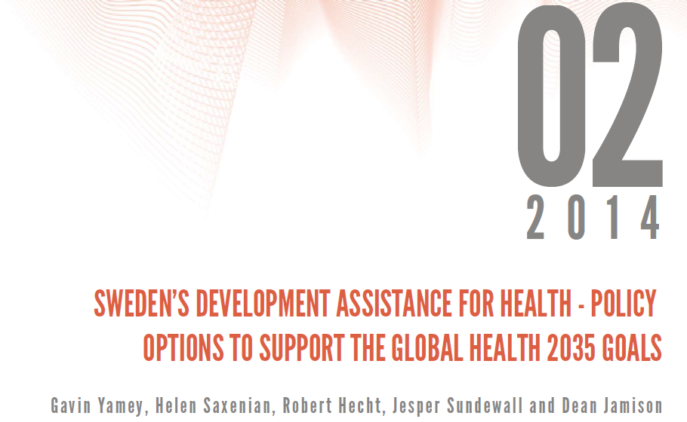

Gavin Yamey
Associate Professor of Epidemiology & Biostatistics, UCSF School of Medicine
Lead, Evidence to Policy Initiative, Global Health Group, UCSF
March 19, 2015
Stockholm, Sweden

Slide 3
Our Approach
1. Summarize GH2035 and implications for DAH
2. Lay out key post-2015 global health challenges and opportunities
3. Develop new classification of DAH by function
5. Assess Sweden’s strengths & impacts in global health
6. Policy options for Swedish DAH to support GH2035 goals—based on strengths and neglected functions
4. Analyze Swedish DAH by function

Slide 4
Our Approach
1. Summarize GH2035 and implications for DAH
2. Lay out key post-2015 global health challenges and opportunities
3. Develop new classification of DAH by function
5. Assess Sweden’s strengths & impacts in global health
6. Policy options for Swedish DAH to support GH2035 goals—based on strengths and neglected functions
4. Analyze Swedish DAH by function

Slide 5
Global Health 2035: Key Findings
For infectious, maternal & child deaths, a grand convergence is possible by 2035
The returns from investing in convergence are impressive
DAH is likely to shift away from supportive towards core functions
Fiscal policies are a powerful, underused lever for curbing non-communicable diseases and injuries
Pro-poor pathways to UHC could efficiently achieve health & financial protection

Slide 6
DAH Needs to Shift Towards Core Functions
Function | Key Examples
Core: Providing global public goods | ▪ R&D for health tools ▪ Knowledge generation and sharing ▪ Intellectual property and market shaping activities
Core: Controlling cross-border externalities | ▪ Surveillance, information sharing, regulatory regimes e.g. to tackle cross-border outbreaks, counterfeit drugs, antibiotic resistance, tobacco marketing
Core: Leadership and stewardship | ▪ Global health advocacy, priority setting, aid effectiveness
Supportive: Direct country assistance | ▪ Financial and technical assistance
Jamison DT, Frenk J, Knaul F. International collective action in health: objectives, functions, and rationale. Lancet 1998; 351: 514–17.

Slide 7
Our Approach
1. Summarize GH2035 and implications for DAH
2. Lay out key post-2015 global health challenges and opportunities
3. Develop new classification of DAH by function
5. Assess Sweden’s strengths & impacts in global health
6. Policy options for Swedish DAH to support GH2035 goals—based on strengths and neglected functions
4. Analyze Swedish DAH by function

Slide 8
Our Approach
1. Summarize GH2035 and implications for DAH
2. Lay out key post-2015 global health challenges and opportunities
3. Develop new classification of DAH by function
5. Assess Sweden’s strengths & impacts in global health
6. Policy options for Swedish DAH to support GH2035 goals—based on strengths and neglected functions
4. Analyze Swedish DAH by function

Slide 9
Post-2015 Challenges/Opportunities
1. Unfinished MDGs agenda
2. Microbial evolution
For infectious, maternal & child deaths, a grand convergence is possible by 2035
The returns from investing in convergence are impressive
DAH is likely to shift away from supportive towards core functions
Fiscal policies are powerful, underused lever for curbing NCDs & injuries
Pro-poor UHC could efficiently achieve health & financial protection
3. Crisis of NCDs and injuries
4. Medical impoverishment
5. International collective action arrangements and financing are not “fit for purpose”

Slide 10
Our Approach
1. Summarize GH2035 and implications for DAH
2. Lay out key post-2015 global health challenges and opportunities
3. Develop new classification of DAH by function
5. Assess Sweden’s strengths & impacts in global health
6. Policy options for Swedish DAH to support GH2035 goals—based on strengths and neglected functions
4. Analyze Swedish DAH by function

Slide 11
Our Approach
1. Summarize GH2035 and implications for DAH
2. Lay out key post-2015 global health challenges and opportunities
3. Develop new classification of DAH by function
5. Assess Sweden’s strengths & impacts in global health
6. Policy options for Swedish DAH to support GH2035 goals—based on strengths and neglected functions
4. Analyze Swedish DAH by function

Slide 12
Policy-oriented DAH framework
Function | Type of DAH | Definition | Example
Core functions: GPGs, cross-border externalities, leadership | Global | Funding to address global issues | R&D of new health tools
 | Local plus | Funding to a LIC/MIC for core functions disbursed at country level | DAH to a country to support regional malaria elimination
Country-specific support | Local | Fungible aid to a LIC/MIC that could be easily replaced with domestic financing as countries get richer | DAH to support the purchase of health commodities or to pay health workers to deliver MNCH services
 | Special Local Support (SLS) | Funding for vulnerable groups and politically problematic services | DAH for displaced persons; DAH for family planning

Slide 13
Our Approach
1. Summarize GH2035 and implications for DAH
2. Lay out key post-2015 global health challenges and opportunities
3. Develop new classification of DAH by function
5. Assess Sweden’s strengths & impacts in global health
6. Policy options for Swedish DAH to support GH2035 goals—based on strengths and neglected functions
4. Analyze Swedish DAH by function

Slide 14
Our Approach
1. Summarize GH2035 and implications for DAH
2. Lay out key post-2015 global health challenges and opportunities
3. Develop new classification of DAH by function
5. Assess Sweden’s strengths & impacts in global health
6. Policy options for Swedish DAH to support GH2035 goals—based on strengths and neglected functions
4. Analyze Swedish DAH by function

Slide 15
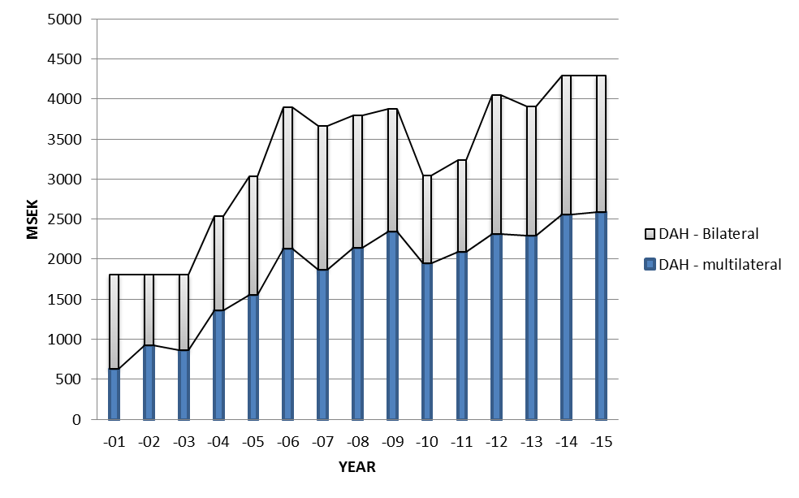
Swedish DAH Reached About 4 Billion SEK in 2013
1.6 billion SEK in 2013
2.3 billion SEK in 2013
GFATM | 0.7
UNFPA | 0.43
GAVI | 0.37

Slide 16

Our Analysis of Swedish DAH by Function
80% country-specific support
20% core functions
85% of Swedish DAH is for
country-specific support
89% country-specific support
11% core functions

Slide 17
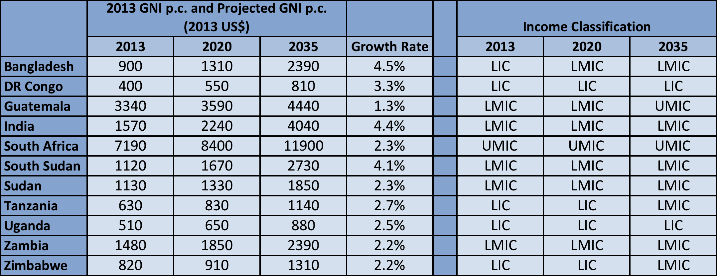
Economic Growth Means Some Countries May Graduate from Swedish DAH by 2035
Example: applying GAVI graduation cut-off of $1570 p.c., only 4 countries would be eligible for Swedish support

Slide 18
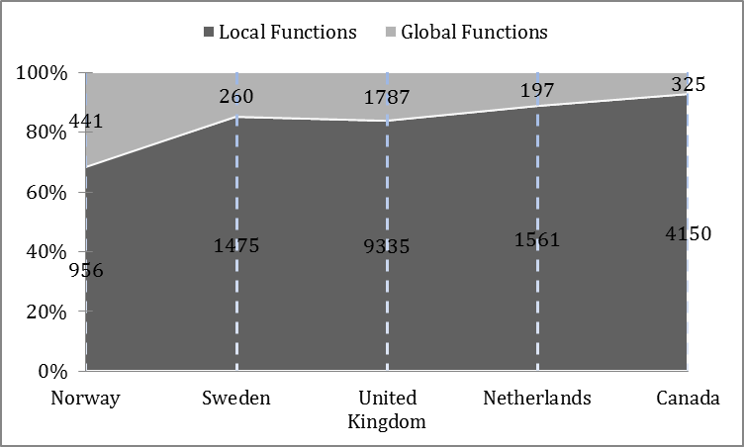
Dominance of Funding for Local Functions is True for Bilateral DAH of Other Donors

Slide 19
Our Approach
1. Summarize GH2035 goals and implications for DAH
2. Lay out key post-2015 global health challenges and opportunities
3. Develop new classification of DAH by function
5. Assess Sweden’s strengths & impacts in global health
6. Policy options for Swedish DAH to support GH2035 goals—based on strengths and neglected functions
4. Analyze Swedish DAH by function

Slide 20
Our Approach
1. Summarize GH2035 goals and implications for DAH
2. Lay out key post-2015 global health challenges and opportunities
3. Develop new classification of DAH by function
5. Assess Sweden’s strengths & impacts in global health
6. Policy options for Swedish DAH to support GH2035 goals—based on strengths and neglected functions
4. Analyze Swedish DAH by function

Slide 21
Global Health is a Core Priority for Swedish Aid:
Active, Visible, Influential Health Donor
Sexual and reproductive health and rights, including family planning and safe abortion
Midwifery, e.g. major support to UNFPA for midwifery programs
Growing reputation and expertise on NCDs and injuries, including road traffic safety
Antibiotic resistance; research on infections of poverty (only about 200 million SEK per y)

Slide 22
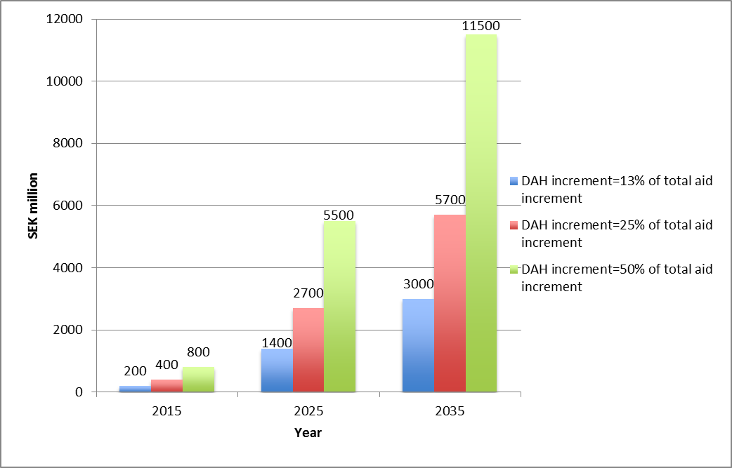
Growth in Swedish DAH by 2035
Notes:
We argue that a greater % of ODA should go to health. Why? First, health aid has a strong record of exceptional implementation success, as shown for example by the robust association between development assistance for health for scaling up HIV and malaria control tools and reduced mortality from these infections. Second, the returns to investing in the health sector have historically been very large—benefit-cost analyses can be around 5-10 or even higher

Slide 23
Our Approach
1. Summarize GH2035 and implications for DAH
2. Lay out key post-2015 global health challenges and opportunities
3. Develop new classification of DAH by function
5. Assess Sweden’s strengths & impacts in global health
6. Policy options for Swedish DAH to support GH2035 goals—based on strengths and neglected functions
4. Analyze Swedish DAH by function

Slide 24
Our Approach
1. Summarize GH2035 and implications for DAH
2. Lay out key post-2015 global health challenges and opportunities
3. Develop new classification of DAH by function
5. Assess Sweden’s strengths & impacts in global health
6. Policy options for Swedish DAH to support GH2035 goals—based on strengths and neglected functions
4. Analyze Swedish DAH by function

Slide 25
Overarching Policy Considerations
Invest in high priority core functions, avoid sudden shifts, be synergistic with other sectors
When providing country-specific support, direct SEK to countries below agreed threshold (e.g. IDA eligibility)
In supporting “local plus” and “special local support” functions, assess fungibility as criterion for SEK: can function be funded domestically?
For local, “local plus,” and “special local support,” couple SEK with dialogue to influence policy change

Slide 26
Reminder: Five Major Post-2015 Challenges/Opportunities
1. Unfinished MDGs agenda
2. Microbial evolution
For infectious, maternal & child deaths, a grand convergence is possible by 2035
The returns from investing in convergence are impressive
DAH is likely to shift away from supportive towards core functions
Fiscal policies are powerful, underused lever for curbing NCDs & injuries
Pro-poor UHC could efficiently achieve health & financial protection
3. Crisis of NCDs and injuries
4. Medical impoverishment
5. International collective action arrangements and financing are not “fit for purpose”

Slide 27
Examples of Policy Options
Post-2015 Challenge
Sweden’s strengths
Opportunities
Unfinished MDGs agenda (achieving convergence)
Antimicrobial evolution
Crisis of NCDs/injuries
Support for infectious disease research (including HIV vaccine/microbicides)
World leader in control of antimicrobial resistance
Spends increasing political capital on advocacy for NCDs; world leader on road injuries
Local plus: Build national capacity to conduct I.D. research of global value (e.g. scale-up methods)
Global: fund coalition to ramp up surveillance & control of AMR
Local plus: Build national capacity to conduct NCD research of global value (e.g. PPIR)

Slide 28

Classifying DAH by functions helps articulate roles of DAH post-2015
Swedish DAH mostly targets local functions
Some countries may graduate from Swedish DAH by 2035
Sweden can play a key role in tackling the 5 key post-2015 challenges, given its impacts/strengths in global health
Significant additional Swedish DAH likely to be available from 2015 to 2035
Investing this additional Swedish DAH in specific global, local, “local plus” and “special local support” functions could help reach the GH 2035 goals

Slide 29
Global Health 2035: Findings related to financing and poverty
Helen Saxenian
Commission on Investing in Health
Senior Consultant, Results for Development Institute
March 19, 2015
Stockholm, Sweden

Slide 30
Basic findings of The Lancet CIH and Swedish DAH reports related to financing convergence package and to poverty
A. Role of poor health in pushing people into poverty
B. Impact of convergence package on the poor
C. Pro-poor pathways to Universal Health Coverage
D. How might convergence be financed
E. Role of external assistance in supporting convergence and beyond convergence

Slide 31
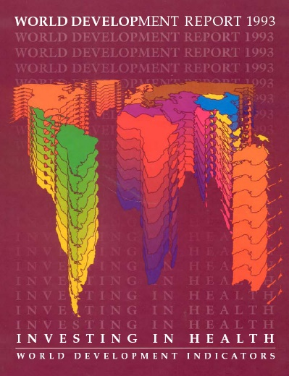
A. Role of poor health and out of pocket expenditures in pushing households into poverty
Out of pocket spending on health services can reach
catastrophic levels for households and push households
into poverty
Theme not drawn out in 1993 World Development Report,
but much subsequent research since
Financial risk protection now well recognized as one of the main
goals of health systems
CIH report argues for pro-poor pathways to Universal
Health Coverage (UHC)

Slide 32
Measuring Financial Risk Protection
Approach #1: measure population experiencing adverse outcomes (crossing poverty threshold, selling assets or borrowing to pay for health services, high out of pocket expenditures, forgoing health services)
Approach #2: measure insurance value provided by health services
Newer area of research: “extended cost-effectiveness analysis”, examining not only health gains per $$ spent but also how much financial protection purchased
  Example: universal public finance of TB treatment in India (Verguet et al). Large health and financial protection benefits, these accrue largely to bottom quintile of population
  Some low cost interventions (e.g. immunization) can have large financial protection benefits by reducing risk of costly medical expenditures later
  Potentially useful to identify trade offs in health investments (health benefits, financial risk protection)

Slide 33
B. Investments in the convergence package would disproportionately benefit the poor
Convergence agenda focuses on infectious, maternal, and child morbidity and mortality
Rates of avoidable infectious diseases, maternal mortality and child deaths are higher in rural areas and among the poor
Over 70% of the world’s poor now live in middle income countries
Achievement of grand convergence requires greater attention to lower income groups, particularly in rural areas, in middle income countries as well as low-income countries

Slide 34
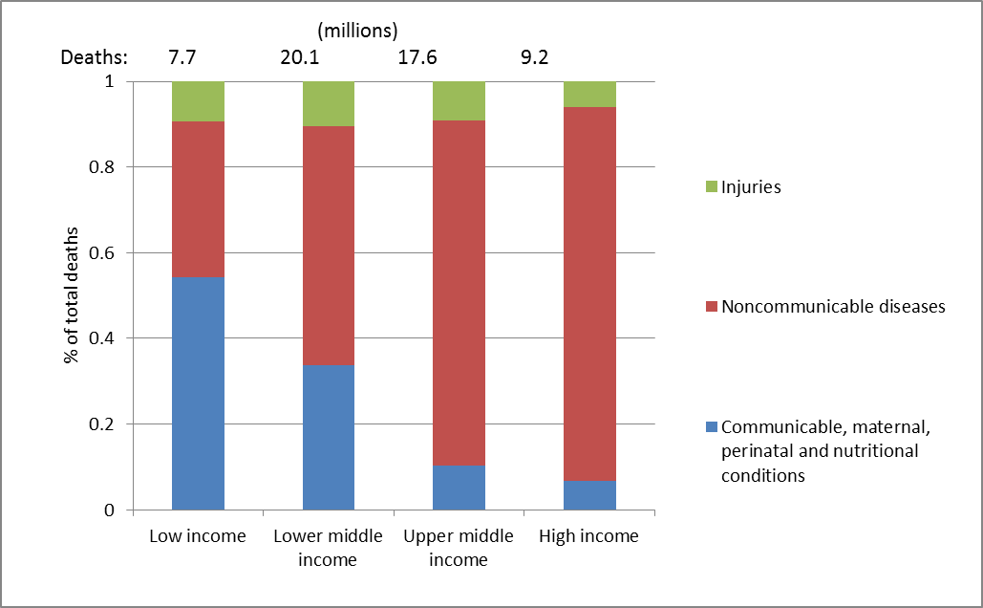
Worldwide distribution of child deaths and infectious diseases by country income level
Figure: Deaths by broad groups of cause across different income levels, 2011

Slide 35
10 countries account for over 70% of the world’s extreme poor, 2011
Country | Share
India | 30%
Nigeria | 10%
China | 8%
Bangladesh | 6%
DR Congo | 5%
Indonesia | 4%
Ethiopia | 3%
Pakistan | 2%
Tanzania | 2%
Madagascar | 2%
Rest of world | 28%
Source: World Bank. Based on $1.25/day poverty line in 2005 prices.
Notes:
Note the mix of low income, lower middle income (India, Indonesia, Nigeria) and one upper middle income country (China).
The table doesn’t show the rapid change that has occurred. Extreme extreme poverty rates within fell within China from 84% in 1981 to 60% in 1999, 36% in 1999, and 12% in 2010. Not as dramatically, but still important, India’s extreme poverty rates fell from 60% in 1981 to 33% in 2010. There are also countries without such progress. For SSA as a whole, rates increased from 51% in 1981 to 58% in 1999, but subsequently fell to 48% in 2010. SSA is the only region for which the number of poor individuals has risen in absolute terms between 1981 and 2010.

Slide 36
Impact and Cost of Convergence
Low-income countries | Lower middle-income countries
Annual deaths averted from 2035 onwards
4.5 million | 5.8 million
Approximate incremental cost per year, 2016-2035
$25 billion (a doubling of current public spending on health) | $45 billion (a 20% increase over current public spending on health)
Proportion of costs devoted to structural investments in health system
60-70% | 30-40%

Slide 37
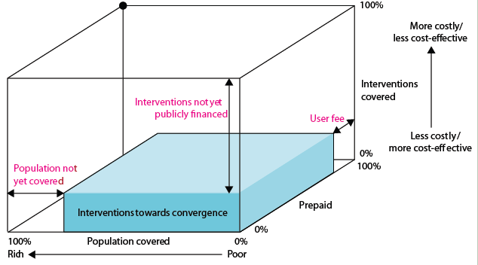
C. Pro-Poor UHC
Risk pooling covers the entire population but focuses on health interventions for diseases that disproportionately affect the poor
As public resources grow, the package of interventions grows
+ essential package for NCDIs

Slide 38
D. Financing the Convergence Package
Economic growth
CIH projections: annual GDP growth of 4.5% for LICs, 4.3% for LMICs, 2011-2035
Mobilization of domestic resources
Taxes of special interest to health: tobacco, alcohol, sugar
Inter-sectoral reallocations and efficiency gains
Development assistance for health
Removal of fossil fuel subsidies; Fuel fossil subsidies account for 2% of government revenue and 07% of global GDP
Will still be crucial for achieving convergence, particularly in poorest countries
Broaden tax base
Improve tax administration and compliance
Improvements in health sector efficiency

Slide 39
Economic growth
Most recent IMF projections¹ for 2013-2019
GDP growth per most recent World Bank income classification
  HIC: 2.2%
  UMIC: 5.1%
  LMIC: 5.8%
  LIC: 6.5%
GDP growth per capita
  HIC: 1.8%
  UMIC: 4.3%
  LMIC: 4.1%
  LIC: 4.2%
Some countries will cross into the next income category over the coming years, implying
  Larger group of donor countries
  Shrinking pool of LIC and LMIC countries
¹ IMF October 2014 World Economic Forecast

Slide 40
Changes in global population distribution by World Bank analytical income category, 1995-2012 (millions)

Slide 41
Projected change in world population distribution across income categories: calculations presented in Swedish DAH report
Notes:
Of interest to show, while recognizing that analytical income classification cutoffs are somewhat arbitrary and as world income grows, aspirations for development assistance should grow as well

Slide 42
Looking at recent experience: Trends in GNI p.c., selected countries (current US$, released July 1 of following year from World Bank)
Very poor performance of some countries (e.g. Malawi, Niger)
Forecasts inherently inaccurate: Ghana’s rapid growth was not predicted back in 2008
Rebasing can cause large changes, e.g. Nigeria, Ghana
Higher incomes do not necessarily lead to better health (Angola, Nigeria: Angola has the highest under-five mortality rate of the countries shown)
 | 2008 | 2009 | 2010 | 2011 | 2012 | 2013
Angola | 3450 | 3590 | 3960 | 4060 | 4580 | 5010
Bangladesh | 520 | 590 | 640 | 770 | 840 | 900
Burundi | 140 | 150 | 160 | 250 | 240 | 280
Ghana | 670 | 700 | 1240 | 1410 | 1550 | 1760
India | 1070 | 1170 | 1340 | 1420 | 1530 | 1570
Lao | 770 | 880 | 1010 | 1130 | 1260 | 1460
Malawi | 290 | 280 | 330 | 340 | 320 | 270
Nicaragua | 1080 | 1010 | 1080 | 1170 | 1650 | 1780
Niger | 330 | 340 | 360 | 360 | 370 | 410
Nigeria | 1160 | 1140 | 1180 | 1200 | 1430 | 2760
Vietnam | 910 | 1010 | 1100 | 1260 | 1400 | 1730

Slide 43
GNI p.c., 2013 and key health indicators, selected countries
 | GNI p.c. 2013 | Under-five mortality rate, 2013 | Maternal mortality ratio, 2013 | TFR, 2012
Angola | 5010 | 167 | 460 | 6.0
Bangladesh | 900 | 41 | 170 | 2.2
Burundi | 280 | 83 | 740 | 6.1
Ghana | 1760 | 78 | 380 | 3.9
India | 1570 | 53 | 190 | 2.5
Lao | 1460 | 71 | 220 | 3.1
Malawi | 270 | 68 | 510 | 5.5
Nicaragua | 1780 | 24 | 100 | 2.5
Niger | 410 | 104 | 630 | 7.6
Nigeria | 2760 | 117 | 560 | 6.0
Vietnam | 1730 | 24 | 49 | 1.8
Source: World Bank release of 2013 GNI p.c. in July 2014, World Development Indicators for under-five mortality rate, maternal mortality ratio (modeled), and TFR

Slide 44
Large rebasing of GDP: How common? Why?
IMF recommends rebasing exercise for GDP estimation at a minimum every 5 years: opportunity to improve GDP estimates by better reflecting changing prices, structure of economy
Doesn’t always lead to increase in GDP, sometimes decreases (Lesotho) or small changes (Niger, Ethiopia)
Nigeria’s rebasing in 2014: extreme case, because previous base year was 1990 and economy had undergone much change. Rebasing almost doubled its GDP estimate.
Other large changes, 2014: Kenya and Zambia (increase in GDP by one quarter), Tanzania (increase by 1/3)
India: recent rebasing no change in GDP
Uganda: recent rebasing 10% increase in GDP
Upcoming: South Africa

Slide 45
D. Financing the Convergence Package
Economic growth
CIH projections: annual GDP growth of 4.5% for LICs, 4.3% for LMICs, 2011-2035
Mobilization of domestic resources
Taxes of special interest to health: tobacco, alcohol, sugar
Inter-sectoral reallocations and efficiency gains
Development assistance for health
Removal of fossil fuel subsidies; Fuel fossil subsidies account for 2% of government revenue and 0.8% of global GDP
Will still be crucial for achieving convergence, particularly in poorest countries
USD 10 trillion would be added to GDP
About 1% of this growth would fund annual cost in 2035
Broaden tax base
Improve tax administration and compliance
Improvements in health sector efficiency

Slide 46
Domestic resource mobilization: as countries develop, on average the tax base broadens and tax compliance and administration improve
Total government revenue as a share of GDP (simple average)
 | 1990 | 1995 | 2000 | 2005 | 2011
Low income | 16.8 | 18.7 | 16.9 | 18.5 | 20.7
Lower middle income | 25.5 | 23.7 | 24.8 | 28.0 | 27.9
Upper middle income | 28.3 | 25.7 | 28.1 | 31.0 | 31.1
Total government revenue as a share of GDP (GDP weighted)
 | 1990 | 1995 | 2000 | 2005 | 2011
Low income | 13.4 | 15.7 | 13.8 | 16.0 | 17.3
Lower middle income | 16.3 | 18.7 | 18.8 | 21.0 | 20.1
Upper middle income | 21.8 | 18.3 | 22.2 | 25.6 | 27.9
Source: provided by Sanjeev Gupta, IMF
Countries classification based on country status in 2011.

Slide 47
Some of the taxes/subsidies of special interest to health
Risk factor | Price changes (taxes or subsidies) | Notes
Unsafe sex | Subsidies (free or subsidized condoms and rapid saliva HIV tests)
Tobacco use | Tobacco taxation | Large excise taxes, e.g. 170%. Along with other measures, key to discouraging consumption, and can raise significant revenue.
Harmful alcohol use | Alcohol taxes in countries with high burden of alcohol consumption | Along with other measures, key to discouraging consumption, and can raise significant revenue.
Poor diet | Tax sugar and potentially other foods | Knowledge of “what works” well behind tobacco and alcohol taxation.
Ambient air pollution | Reduce/remove of fossil fuel subsidies. Price subsidies for improved indoor stoves. Consider selectively subsidizing LPG to replace kerosene in indoor stoves. | IMF estimates subsidies for petroleum products, electricity, natural gas and coal amount to 0.7% of global GDP and 2% of government revenue in 2011. Highly regressive.

Slide 48
Financing the Convergence Package
Economic growth
CIH projections: annual GDP growth of 4.5% for LICs, 4.3% for LMICs, 2011-2035
Mobilization of domestic resources
Taxes of special interest to health: tobacco, alcohol, sugar
Inter-sectoral reallocations and efficiency gains
Development assistance for health
Removal of fossil fuel subsidies; Fuel fossil subsidies account for 2% of government revenue and 0.7% of global GDP
Will still be crucial for achieving convergence, particularly in poorest countries
USD 10 trillion would be added to GDP
About 1% of this growth would fund annual cost in 2035
Broaden tax base
Improve tax administration and compliance
Improvements in health sector efficiency

Slide 49
Reallocations
Remove fossil fuel subsidies, redirect some of funds to health and other priorities
Other reallocations: reallocations across government spending, other reductions in inefficient subsidies
Efficiency gains from within the health system (small but real gains possible)
Notes:
Fossil fuel subsidies regressive: mostly benefit upper income groups (although measures need to be in place when removed to help protect the poor).

Slide 50
Financing the Convergence Package
Economic growth
CIH projections: annual GDP growth of 4.5% for LICs, 4.3% for LMICs, 2011-2035
Mobilization of domestic resources
Taxes of special interest to health: tobacco, alcohol, sugar
Inter-sectoral reallocations and efficiency gains
Development assistance for health
Removal of fossil fuel subsidies; Fuel fossil subsidies account for 2% of government revenue and 0.7% of global GDP
Will still be crucial for achieving convergence, particularly in poorest countries
USD 10 trillion would be added to GDP
About 1% of this growth would fund annual cost in 2035
Broaden tax base
Improve tax administration and compliance
Improvements in health sector efficiency
Notes:
Just recalculated the growth projections based on latest IMF projections (October 2014). LICs, 4.2% from 2014-2019, LMICs 4.1%. UMIC, slightly higher at 4.3%, HICs at more modest growth, 1.8%.

Slide 51
E. DAH: 3 broad categories
Global: supporting global public goods (e.g. R&D for new tools), addressing cross border externalities (e.g. pandemic preparedness and response), supporting development of leadership and stewardship
Local plus: local funding of activities with transnational benefits e.g. towards regional malaria elimination
Local: Fungible aid that could be replaced by domestic financing as country ability to pay increases
    Special local support: funding for vulnerable groups and politically problematic services

Slide 52
Targeting of DAH: key messages of reports
Categories 1 and 2 (Global, Local plus) of DAH underfunded
DAH most needed in poorest countries or in countries with the most poor people?
    The poorest countries have the least ability to finance convergence and other pressing priorities. DAH needed to fill the gap.
    And the largest share of the poor live in middle income countries. DAH also needed and over time, countries should be able to increasingly finance more and more of the convergence package, and other health priorities, from domestic resources.
DAH will not be superfluous in 2030—far from it. But its role will need to change to have greatest impact
Notes:
Aid needed heavily for poorest and fragile states.
For middle income countries, aid could increasingly focus on mutually agreed changes in policies, programs, institutions and on results based financing, given ountries need to move increasingly into funding on their own.

Slide 53
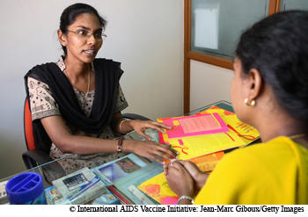
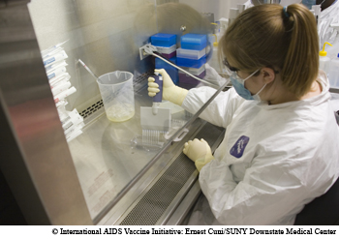
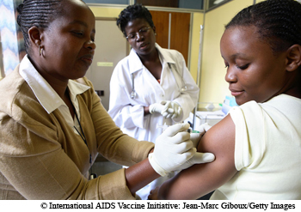

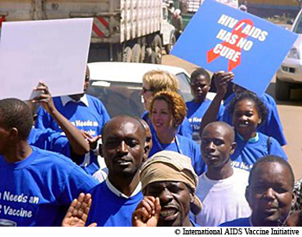
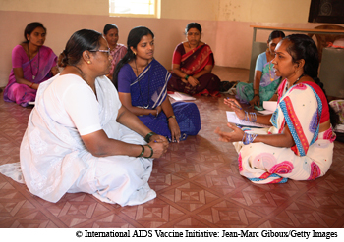
The role of R&D
to achieve greater equity in health
Hester Kuipers
Executive Director, IAVI Europe
Sida Seminar 19 March 2015

Slide 54
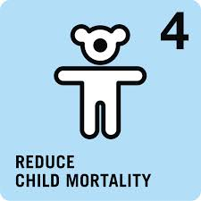
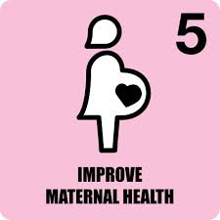
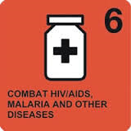
The unfinished MDG health agenda
Notes:
Mortality rates in children under 5 has almost halved since 1990; BUT over 6 million children still die every year
Maternal mortality fell by 45% since 1990; BUT only halve of women in developing regions receive recommended healthcare during pregancy
Despite the many advances in global health over the past half-century, an estimated 15 million people die every year from infectious diseases
Every year, malaria, tuberculosis and AIDS kill about 4.2 million people, accounting for about one-tenth of the world's deaths. Infectious diseases kill six in 10 of the poorest people who die each year.
Almost 10 million people living with HIV are receiving live-saving ARV treatment; BUT every year more than 2 million people become infected with HIV
3.3 million malaria deaths were prevented over the last 12 years; BUT malaria still kills more than 600,000 people every year

Slide 55
Ending HIV/AIDS: the role of new technologies
New Infections – NPTs added to full scale-up of Enhanced Investment Framework (IFE)
New Infections with HIV
  Illustrative vaccine with an assumed efficacy of 70%, not representative of any specific candidate . Coverage in generalized epidemics: routine 10 years old 70%, catch-up 11-14 years old 60%, 15-17 years old 55%, 18-49 years old 50%; in high risk populations in concentrated epidemics: 50%
Modeling project – UNAIDS, Avenir Health, IAVI, AVAC [funded by USAID]
55
Notes:
This work enables us to look at how new prevention technologies, in combination with scaled-up HIV/AIDS programs in line with the IFE, can really bring us toward the end of AIDS.
This chart shows the “layered” impact of the IFE plus vaccines, treatment as prevention, and PrEP (which includes microbicides as a modality)
Combination of all three new prevention technologies with the IFE – new infections below 50,000 a year by 2070 - 9% of annual infections with just the IFE
Makes the case for how we need to sustain innovation and research while scaling up what we have
Background
In combination with IFE
TasP: 80% effectiveness and 60% coverage
PrEP: 44% (<2018) to 75% (>2018) effectiveness) and 25% to 60% coverage depending on population.

Slide 56

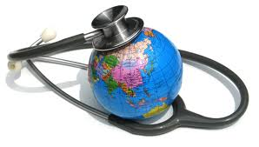
The need for R&D
R&D for new health interventions has made a major contribution to improving child and maternal health and combatting infectious diseases
The tools needed are getting better but many priority drugs, vaccines, and diagnostics for diseases that primarily affect developing countries are wanting
Many communities need improved or new tools: e.g. women & girls, marginalized and difficult-to-reach populations
Market failure - incentives for private sector investment are woefully inadequate to ensure the development of, and access to Global Public Goods
Source: The Need for Global Health R&D and Product Development Partnerships Message Manual, November 2011
Notes:
From 1975 to 2000, there was little Investment in neglected disease research and development, and of 1,393 medicines developing during that time, only 16 were for diseases that predominately affect populations in developing countries.
Companies can expect minimal return on investments to develop products for this market, especially relative to the kinds of profits that they might expect from markets in wealthier countries.

Slide 57
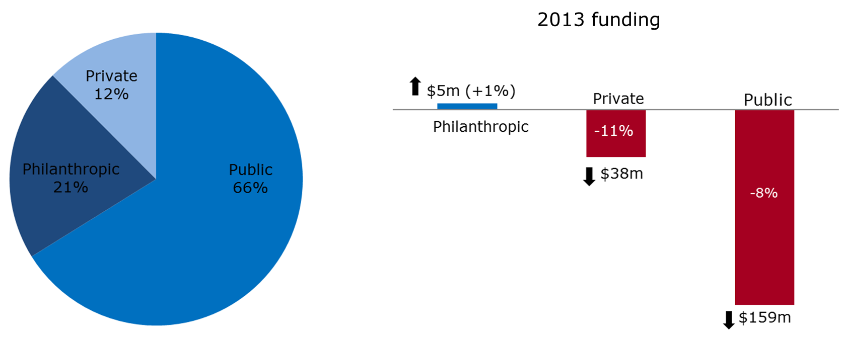
R&D funding for povery-related & neglected diseases
$3,219m in 2013

Slide 58

The Product Development Partnership (PDP) model
A partnership of public and private organizations:
  Pooled knowledge and expertise in the pursuit of better products for poverty-related and neglected diseases
  Pooled donor funds accross development portfolio (risk mitigation in pursuit of a global public good)
  Operate as non-profit Research & Development organizations
Strive to increase developing countries’ capacity for research in combating such diseases.
  Bring private-sector expertise to applied research and product development, portfolio management.
  Access at the core: from R&D to final uptake
Source: he role of PDPs within the product development pipeline. Moran M, Ropars A-L, Guzman J, Diaz J, Garrison C (2005). The New Landscape of Neglected Disease Drug Development. Wellcome Trust.

Slide 59
How to stimulate product development?
PDP Funding in 2013: 500m USD
225m bi-lat gov’t grants
5m investments
250m philantropic grants
20m multi-lat & pooled funding

Slide 60

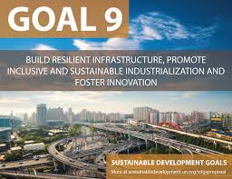
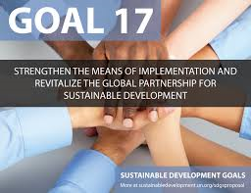
GH R&D and the Sustainable Development Goals
Support R&D for new health technologies for diseases that primarily affect developing countries (target 3b)
Support research & innovation in developing countries; enhance scientific research and strengthen technological infrastructure (9.5, 9a, 9b)
Facilitate global & multi-sectorial partnerships, including N-S and S-S, that share knowledge, expertise, technology and financial resource (17.6, 17.8, 17.9, 17.16, 17.17)

Slide 61







Global Health R&D: defining indicators
Financing for Development Summit
Addis Ababa, July 2015
Launch of a report on indicators for Global Health R&D
Consultations: April - May

Slide 62

Thank You
GlobalHealth2035.org
@gyamey
@globlhealth2035
#GH2035

