Slide 2
Towards a Grand Convergence in Global Health:
What Convergence Means for Health After 2015
United Nations
January 16, 2014
Moderator:
Dr. Margaret Kruk
Columbia University

Slide 3
What is Convergence?
Dr. Gavin Yamey
University of California, San Francisco

Slide 4
Global Health 2035: 4 Key Messages
The returns from investing in health are enormous
A grand convergence in health is achievable within our lifetime
Fiscal policies are a powerful and underused lever for curbing non-communicable diseases and injuries
Progressive pathways to universal health coverage are an efficient way to achieve health and financial protection

Slide 5
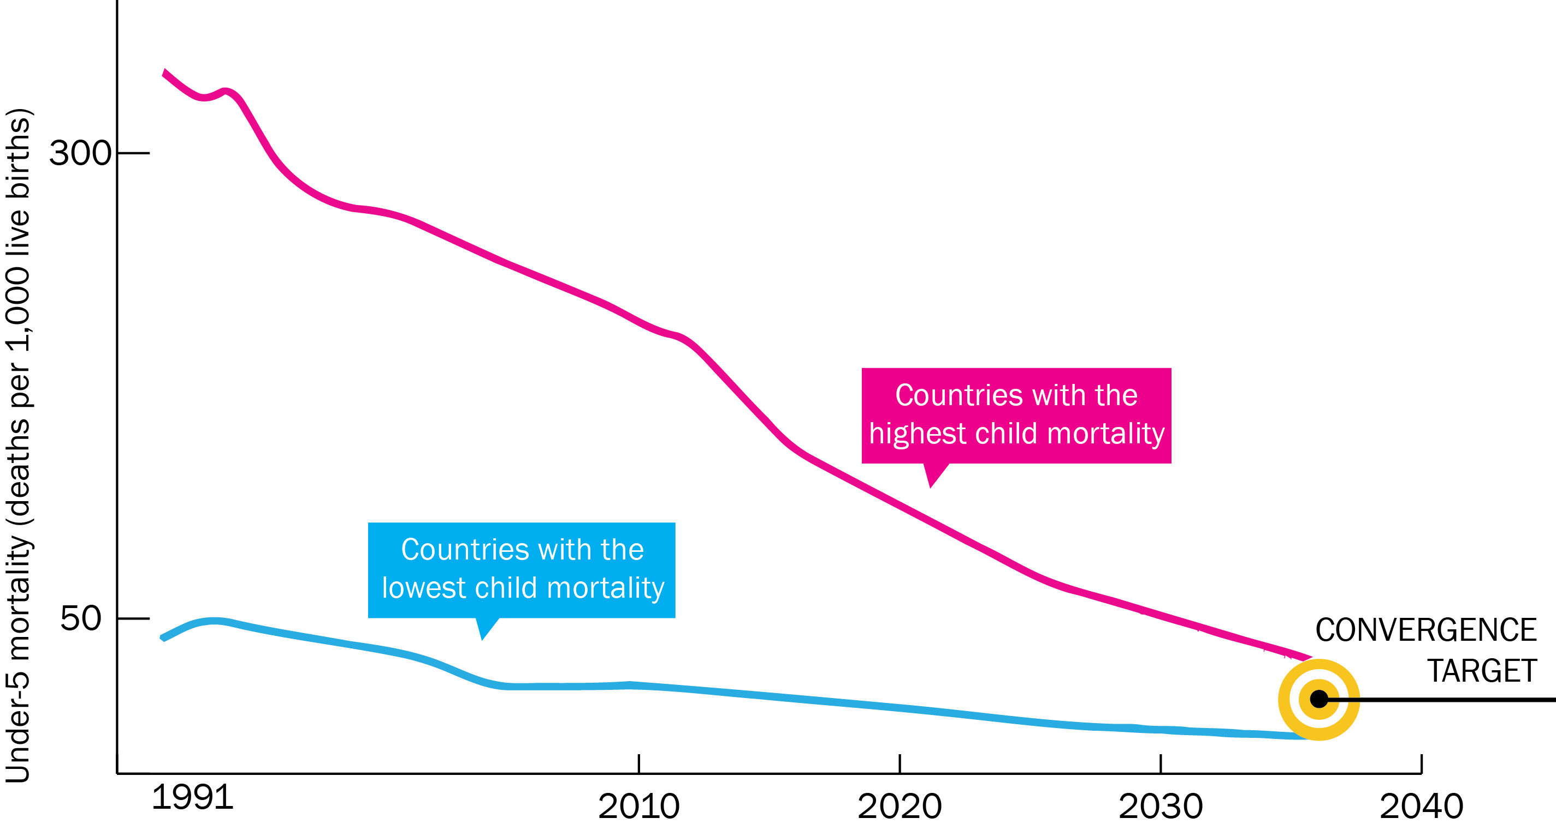
A Grand Convergence in Global Health by 2035

Slide 6
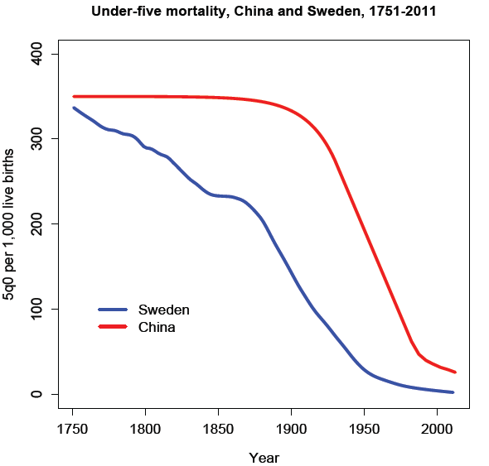
Historical Precedent: China

Slide 7
Rwanda: Steepest Drop in Child Mortality Ever Recorded
Farmer P, et al. BMJ 2013; 346: f65

Slide 8
2035 Grand Convergence Targets = “16-8-4”
Under-5 death rate per 1,000 live births
16
Annual AIDS deaths per 100,000 population
8
Annual TB deaths per 100,000 population
4

Slide 9
Death Rates Today in Poorest Countries
 | Low-Income Countries | Lower Middle-Income Countries | 2035 Target
Under-5 death rate per 1,000 live births | 104 | 63 | 16
Annual AIDS death rate per 100,000 population | 77 | 23 | 8
Annual TB death rate per100,000 population | 55 | 28 | 4

Slide 10
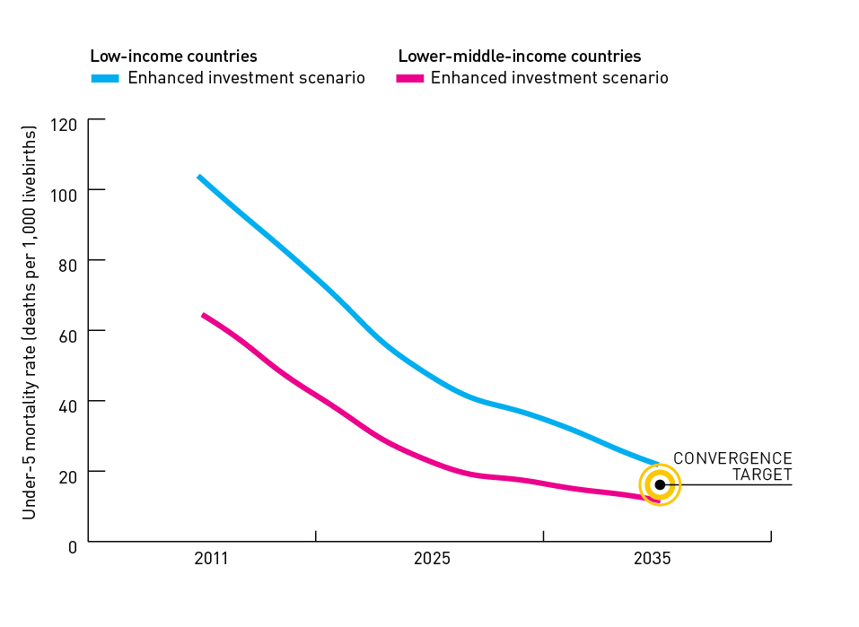
16-8-4 Targets are Achievable
104
With enhanced investment,
we could achieve a
grand convergence in global health in the next generation – reaching an under-5 mortality rate of 16 per 1,000 live births
63

Slide 11
How We Modeled Convergence
Diverse group of middle-income countries showed the way
Previously had high death rates
Low- or lower middle-income in 1991
Achieved high level of health status by 2011 largely because of scale-up of health sector interventions
“4C Countries”
Costa Rica, Cuba, Chile, China
We show that nearly all countries could reach the same health status by 2035

Slide 12
Convergence Targets are Based on Death Rates Today in 4C Countries
Indicator | Low-Income Countries | Lower Middle-Income Countries | 4C Countries (Range) | 2035 Convergence Targets
Under-5 death rate per 1,000 live births | 104 | 63 | 6 - 14 | 16
Annual AIDS deaths per 100,000 population | 77 | 23 | 1.4 - 8.7 | 8
Annual TB deaths per 100,000 population | 55 | 28 | 0.3 - 3.5 | 4

Slide 13
Modeling Convergence Investment Case¹
HIV
UN One Health tool
Country-level cost and impact model to 2035
Malaria
Burden reduction
Intervention costs
HR needs and impact
RMNCH
TB
Burden, interventions, coverage, efficacy

Slide 14
Modeling Convergence Investment Case²
LICs and Lower MICs
HIV
One Health
Country-level cost and impact model to 2035
One Health
Country-level cost and impact model to 2035
One Health
Country-level cost and impact model to 2035
+
Malaria
One Health
Country-level cost and impact model to 2035
NTDs
HSS
New tools
One Health
Country-level cost and impact model to 2035
One Health
Country-level cost and impact model to 2035
One Health
Country-level cost and impact model to 2035
RMNCH
One Health
Country-level cost and impact model to 2035
UN One Health
Tool
Country-level cost and impact model to 2035
TB

Slide 15
Impact and Cost of Convergence
Low-income countries | Lower middle-income countries
Annual deaths averted from 2035 onwards
4.5 million | 5.8 million
Approximate incremental cost per year, 2016-2035
$25 billion | $45 billion
Proportion of costs devoted to structural investments
60-70% | 30-40%
Proportion of health gap closed by existing tools
2/3 | 4/5

Slide 16
Full Income: A Better Way to Measure the Returns from Investing in Health
income growth
value life years gained (VLYs) in that period
change in country's full income over a time period

Slide 17
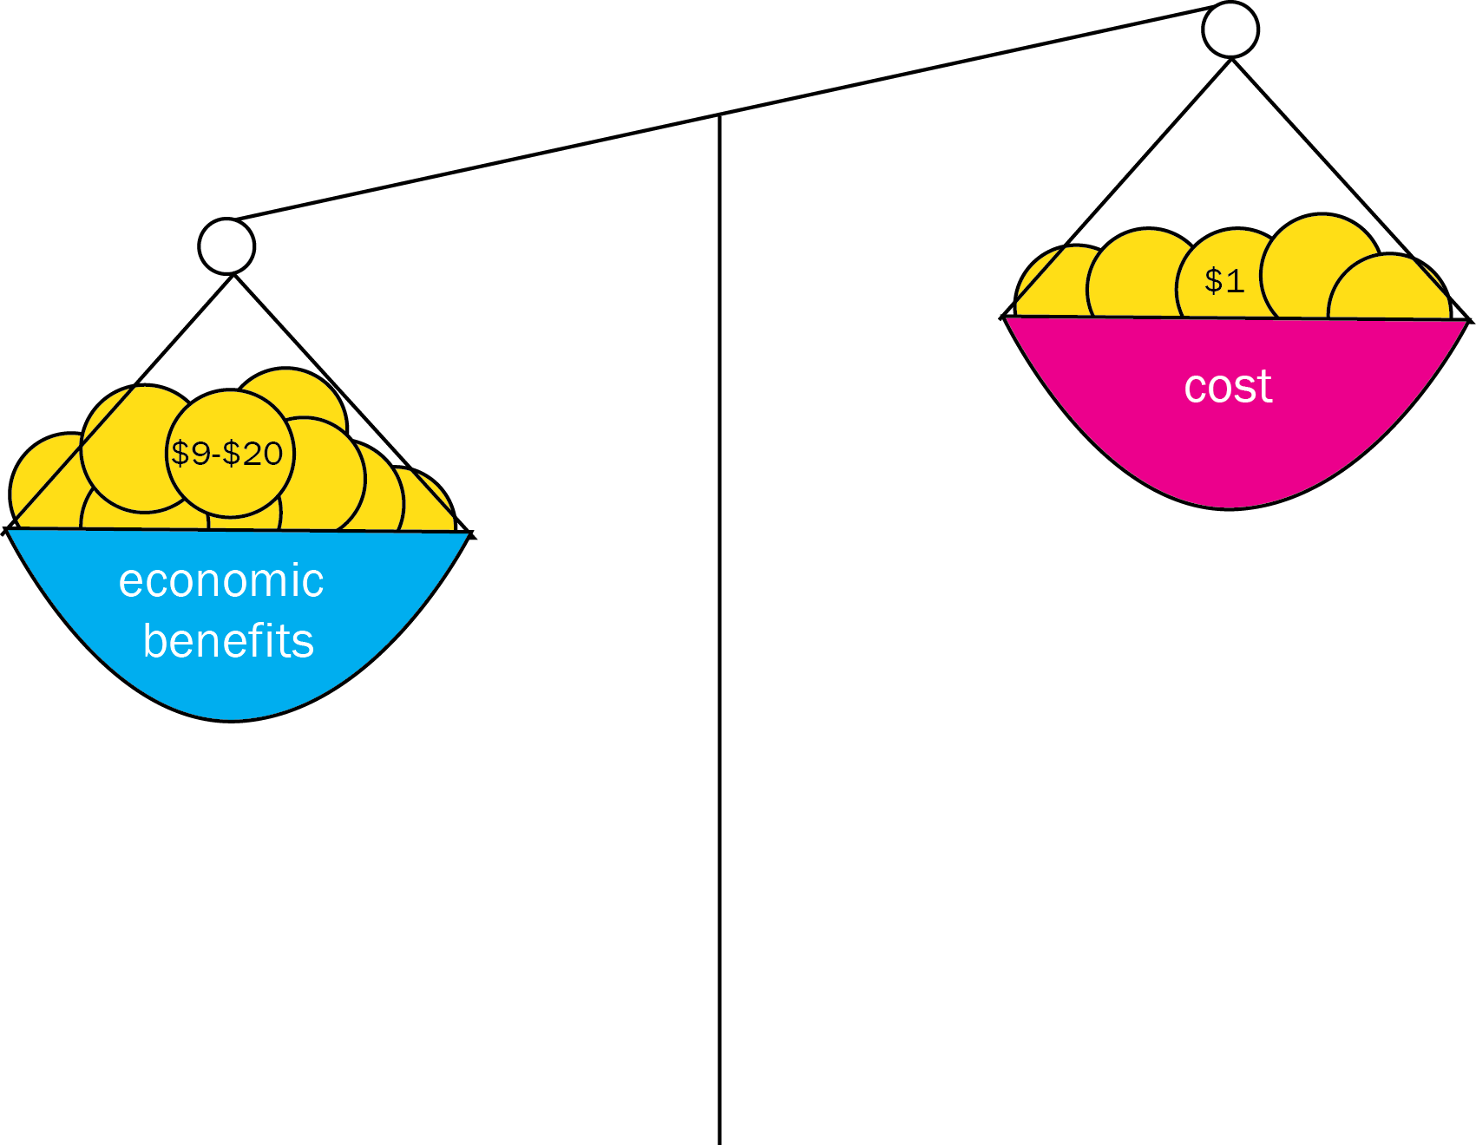
Impressive Benefit: Cost Ratio

Slide 18
Sources of Income
Economic growth
IMF estimates $9.6 trillion/y from 2015-2035 in low- and lower middle-income countries
Mobilization of domestic resources
Taxation of tobacco, alcohol, sugary drinks, and extractive industries
Inter-sectoral reallocations and efficiency gains
Development assistance for health
Cost of convergence ($70 billion/y) is less than 1% of anticipated growth
50% tobacco tax in China over next 50 y raises US $20 billion/y, saves 20 million lives
Removal of fossil fuel subsidies, health sector efficiency
Subsidies account for an 3.5% of GDP on a post-tax basis
Will still be crucial for achieving convergence

Slide 19
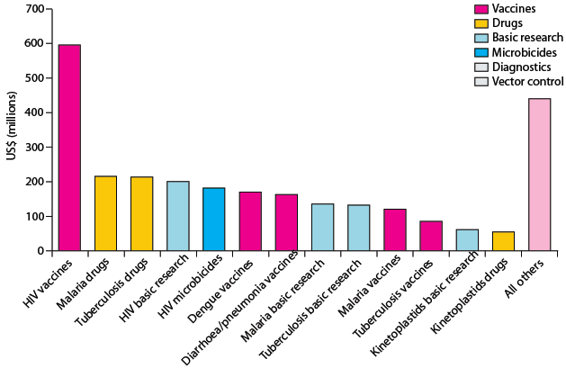
Opportunities for International Collective Action
Best way to support convergence is funding development and delivery of new health technologies R&D targeted at diseases disproportionately affecting LICs and LMICs
and managing externalities such as pandemics.
These core functions have been neglected in the last 20 years.

Slide 20
Progress on Maternal Mortality Ratio by 2035
 | Today | 2035
Low-income countries | 412 | 102
Middle-income countries | 260 | 64
4C countries (range) | 25-73
Number of deaths in pregnancy and childbirth per 100,000 live births

Slide 21
2030 Outcomes
 | 4C Countries Today (range) | Low-Income Countries 2030 | Lower Middle-Income Countries, 2030
Maternal mortality ratio per 100,000 live births | 25 - 73 | 119 | 69
Under-5 death rate per 1,000 live births | 6 - 14 | 27 | 13
Annual AIDS deaths Per 100,000 population | 1.4 - 8.7 | 5 | 1
Annual TB deaths per 100,000 population | 6 - 14 | 5 | 3

Slide 22
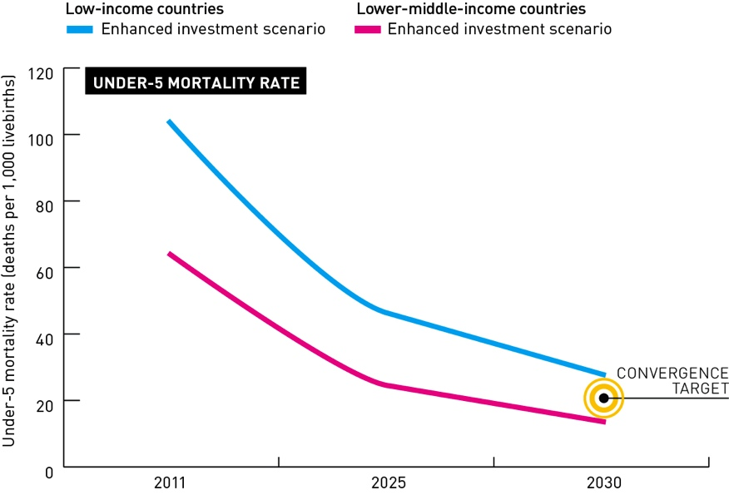
2030 Convergence with the “3P Countries” Panama, Peru, Paraguay

Slide 23
Grand Convergence in Post-2015 Framework
Encapsulates multiple conditions—could serve to unite global health community
Preventing avertable mortality is a “prize within reach”
Easy to understand, operationalize, and monitor
Once in a generation opportunity
Feasible targets, backed by robust evidence on health impacts, costs, and financing sources—these are not overly optimistic “advocacy aspirations”
Simple, single overarching goal

Slide 24
Grand Convergence in Post-2015 Framework (continued)
Based on economic calculus that measures the value of health to individuals and societies (“full income” accounting)
Grand convergence encapsulates UHC in a specific, tangible way: argues for “pro-poor” UHC that initially ensures universal coverage for tackling infections + RMNCH conditions + essential interventions for NCDs/injury
Program investments are accompanied by structural investments in health system→ would coalesce over time into a functional delivery system, prepared to address NCDs/injury
Not special pleading by health community—it is an investment with real economic returns

Slide 25
Caveats & Challenges
Inherent uncertainties in any modeling exercise
Assumes aggressive coverage levels (typically 90-95% by 2035)—would all countries have the institutional capacity?
Model does not account for role of other development sectors (e.g. climate, water ) or social determinants of health
Risk of back-sliding if tools lose effectiveness (e.g. artemisinin)

Slide 26
Further Research
Further validation of modeling results
Map out implementation steps
Historical analysis of rates of decline of U5MR, MMR, AIDS deaths, and TB deaths
show that rapid declines have occurred
learn lessons from best performers

Slide 27
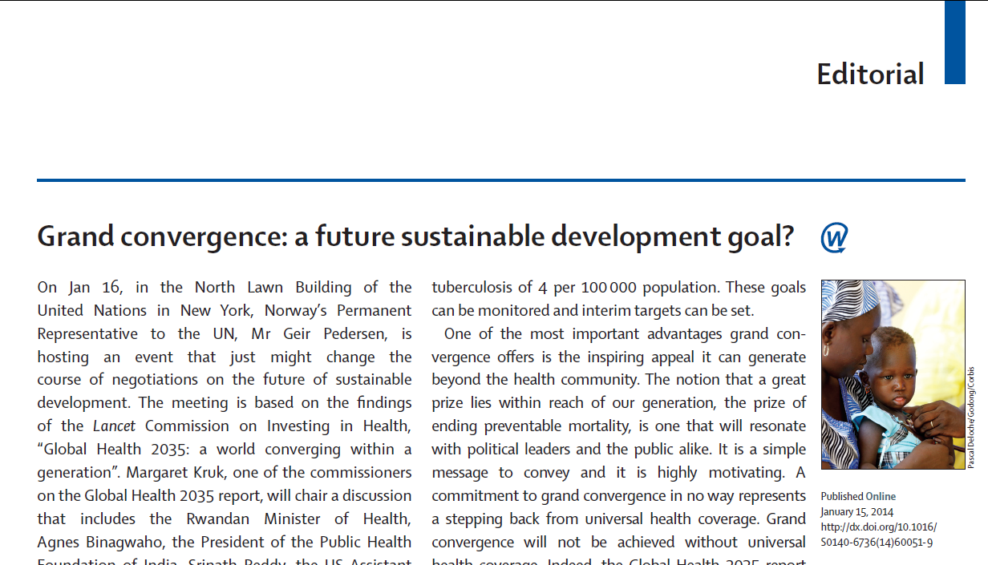

Slide 28
“A commitment to grand convergence in no way represents a stepping back from universal health coverage. Grand convergence will not be achieved without universal health coverage.”

Slide 29
“The idea of grand convergence enables one to combine simplicity—the goals of 16-8-4— with complexity (these goals will only be reached with a transformational health system response). And as the health system is strengthened, so it will be prepared to address the new epidemic of non- communicable diseases and injuries that the grand convergence will bring the world towards.”

Slide 30
Thank You
Gavin Yamey
yameyg@globalhealth.ucsf.edu
@gyamey
#GH2035
GlobalHealth2035.org

Slide 31
Rwanda’s Story: A Country Level Perspective
H.E. Dr. Agnes Binagwaho
Minister of Health, Rwanda

Slide 33
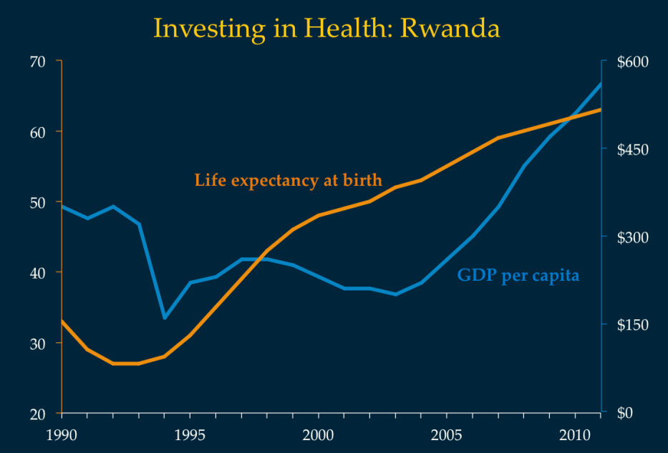
World Bank (2013). DataBank: World Development Indicators. http://data.worldbank.org/

Slide 34
Institute for Health Metrics and Evaluation (2013). GBD 2010: GBD Cause Patterns Visualization Tool.
http://www.healthmetricsandevaluation.org/gbd/visualizations/gbd-cause-patterns

Slide 35
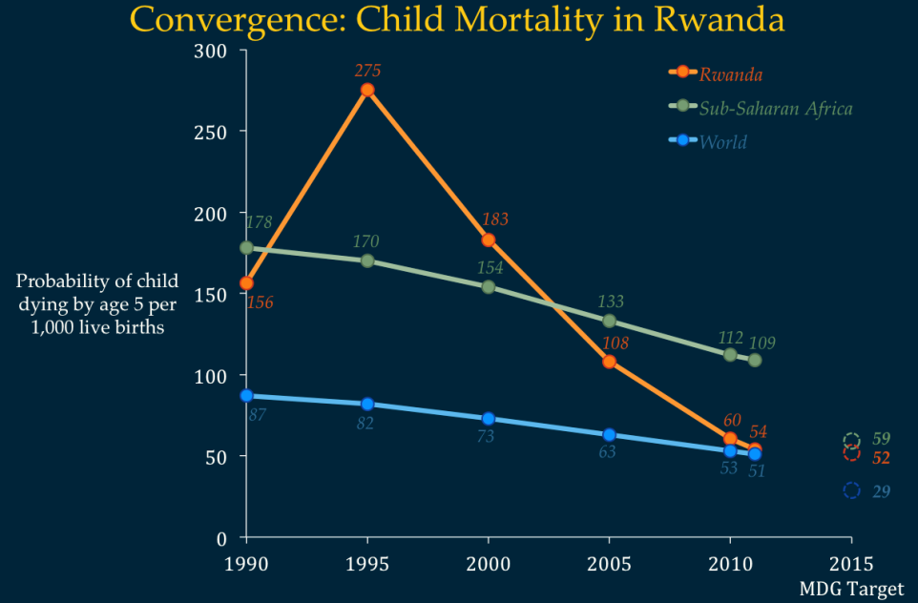
Farmer PE, et al. (2013) “Reduced Premature Mortality in Rwanda: Lessons from Success,” BMJ 346(f65): 20-22.

Slide 36
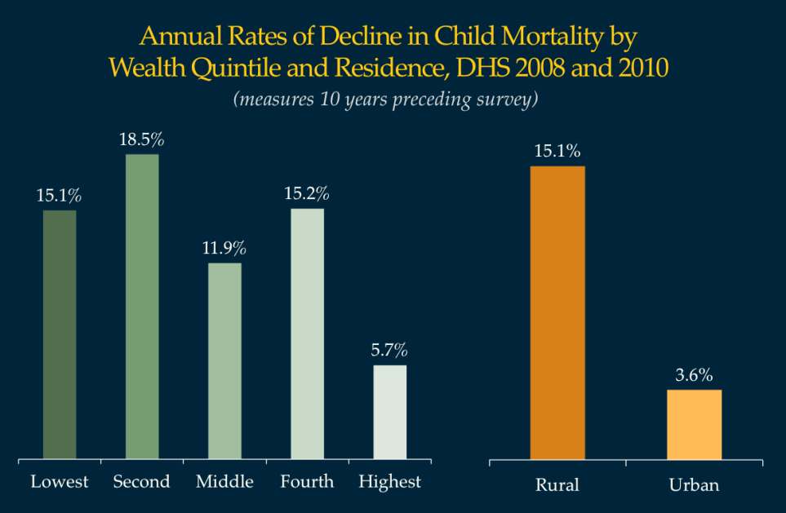
National Institute of Statistics of Rwanda, Macro International, Inc. (2012). Rwanda Demographic and Health Survey 2010. Calverton, MD: Macro International, Inc.

Slide 37
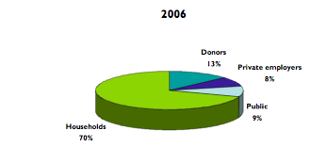
Health Financing

Slide 38
Decline in NCD mortality <40 years Rwanda 2000-2010 = Innovations
 | % decline
Non-communicable diseases | -49%
Neoplasms | -21%
Cardiovascular and circulatory diseases | -52%
Chronic respiratory diseases | -70%
Cirrhosis of the liver | -63%
Digestive diseases (except cirrhosis) | -57%
Neurological disorders | -28%
Mental and behavioral disorders | -15%
Diabetes, urogenital, blood, and endocrine diseases | -39%
Musculoskeletal disorders | -7%
Other NCD excl congenital | -77%
Congenital anomalies | -61%
All causes | -54%
Communicable, maternal, neonatal, and nutritional disorders | -55%
Non-communicable diseases | -49%
Injuries Next cancer Cervical cancer | -48%

Slide 40
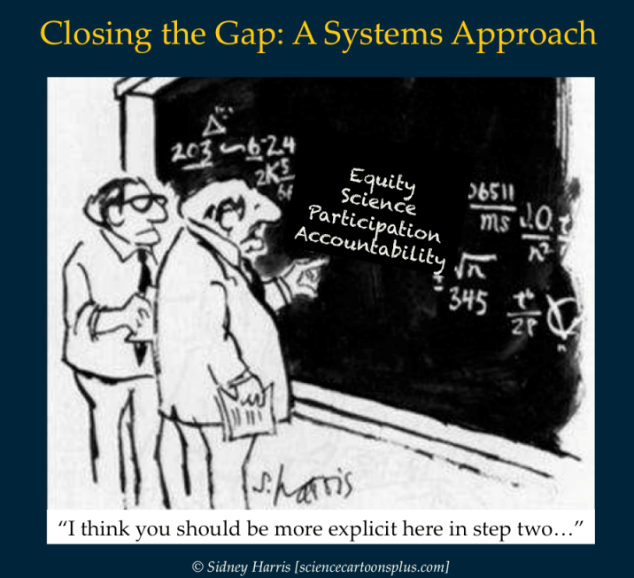

Slide 41
Government Working as One
Governance Cluster
Ministry of Local Government
Ministry of Justice
Ministry of Finance
Ministry of Employment
Social Cluster
Ministry of Health
Ministry of Infrastructure (Water & Sanitation)
Ministry of Education
Ministry of Local Government
Ministry of Sport, Youth, & Culture
Ministry of Gender
Economic Cluster
Ministry of Finance
Ministry of Commerce
Ministry of Infrastructure
Ministry of ICT
Ministry of Agriculture
Ministry of Environment

Slide 42
The Economic Transition and the Grand Convergence in Global Health
Dr. Ariel Pablos Méndez
Assistant Administrator for Global Health, USAID

Slide 43
"Funeral of First Born" (Rural Russia, 1983). Oil on Canvas by Nicolai Yaroshenko (Russian, 1846-1898)
Notes:
"Funeral of First Born" (Rural Russia, 1983). Oil on Canvas by Nicolai Yaroshenko (Russian, 1846-1898)
http://www.nejm.org/doi/full/10.1056/NEJMra1111421?query=TOC
* For centuries, the cumulative weight of experience fostered the conclusion that childhood deaths were inevitable. Many families, even those of plentiful means, lost half or more of their children. Seemingly nothing could be done — medically, politically, or economically — save to let nature take its course. Indeed, the mind of the public had changed little since the 2nd century, when the emperor Marcus Aurelius wrote, “One man prays, `How I may not lose my little child', but you must pray, `How I may not be afraid to lose him'” (Meditations 9.40).
* One has but to view the tombstones in colonial cemeteries to understand that death in childhood represented a grievous but seemingly inexorable trajectory. The death toll from infection among the very young was often obscured in colonial epidemics, when smallpox, diphtheria, cholera, dysentery, and measles typically killed without respect to age. Apart from these individual tragedies, however, there was little recognition of the special susceptibility of children, particularly those under 5 years of age, until the diphtheria epidemic in New England (1735 through 1740), in which 80% of its 5000 victims — almost 2.5% of the population — were children.13
* By the middle of the 19th century, a child's death, far from intolerable, was frequently viewed as blessed, a release from the torment of hectic infection or the lingering complications of diseases such as rheumatic fever

Slide 44
Unprecedented economic growth across the globe
Notes:
Equally important but less appreciated is an unprecedented expansion of GDP in less developed nations
Driven by better governance, trade, new technology, as well as the demographic dividend

Slide 45
Mexico, GDP per capita (current US$)
Source: World Bank Accessed 11/4/13

Slide 46
“The First Law of Health Economics”
N = 191
R² = 92.8%
Source: GDP/k and THE/k from WHO Global Health Expenditure Database. Accessed 11/13
Notes:
As developing countries grow, they will inevitably spend more on health
Health spending WILL go up.
Jacques Van Der Gaag studied 178 countries and found that health spending increased disproportionally with increases in GDP (income elasticity >1)
USAID examined data for 65 countries which carried out own health accounts (rather than use modeled data). We also found that THE rises slightly faster than GDP.

Slide 47
Dramatic Results in Global Health
Since 1990:
HIV incidence has been cut by half; TB deaths by 40% and Malaria deaths by 30%
50% fewer women have died giving birth
Nearly 100 million children’s lives have been spared
Family planning has empowered women, saved lives and brought a demographic dividend to families and national economies.

Slide 48
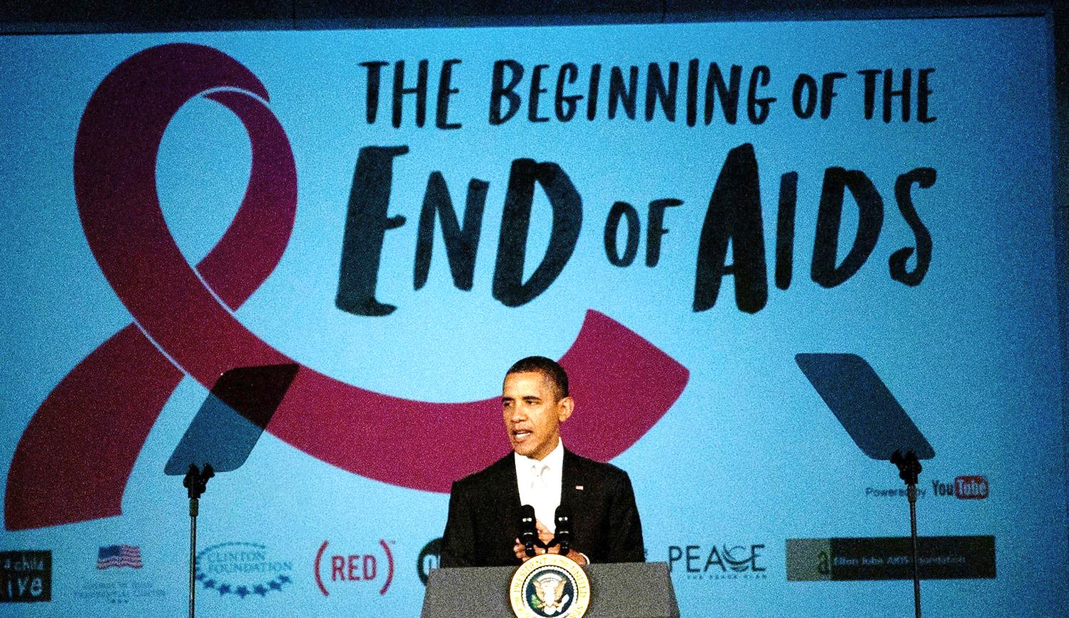
An AIDS-free Generation
Notes:
“An AIDS-free generation would be one of the greatest gifts the United States could give to our collective future.” -- Secretary of State Hillary Rodham Clinton, November 8, 2011
An AIDS-free generation means that:
Virtually no children are born with the virus
As these children become teenagers and adults, they are at a far lower risk of becoming infected than they would be today
- They have access to treatment that helps prevent them from developing AIDS and passing the virus to others
Treatment: By the end of 2013, PEPFAR will directly support more than 6 million people on antiretroviral treatment – two million more than our previous goal
Over the next two years:
Voluntary medical male circumcision (VMMC): PEPFAR will support more than 4.7 million VMMCs in Eastern and Southern Africa.
Condoms: PEPFAR will distribute more than 1 billion condoms.
PMTCT: PEPFAR will reach more than 1.5 million HIV-positive pregnant women with antiretroviral drugs to prevent them from passing the virus to their children.

Slide 49
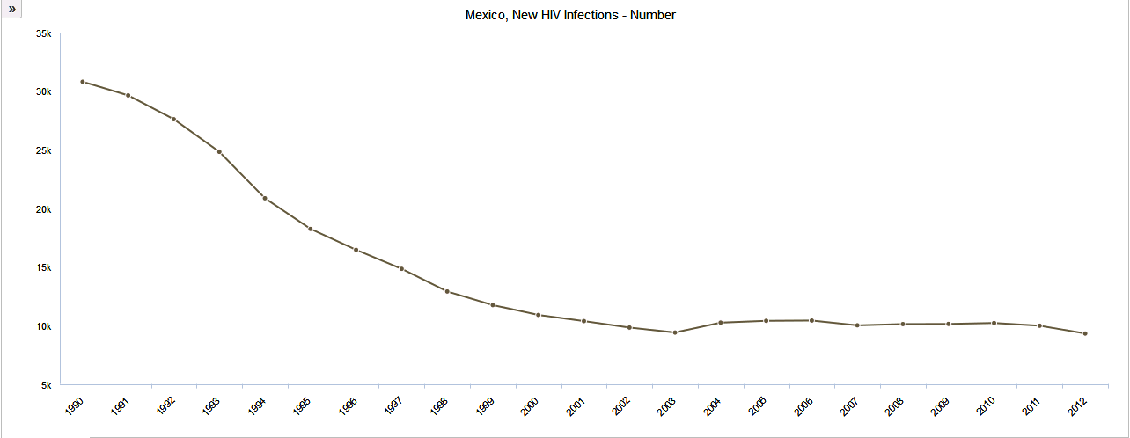
Mexico: New HIV Infections,1990-2012
Source: UNAIDS Spectrum Estimates
Notes:
http://www.aidsinfoonline.org/devinfo/libraries/aspx/home.aspx

Slide 50
South & SE Asia: New HIV infections and Annual AIDS Deaths

Slide 51
Ending Preventable Child Death in a Generation

Slide 52
Mexico’s U5M, 1960-2012
Notes:
Child Mortality Estimates (CME)
http://www.childmortality.org/index.php?r=site/graph#ID=MEX_Mexico
The primary source for MMR estimations is WHO, Unicef, Unfpa, World Bank (2012), Trends in maternal mortality: 1990 to 2010. WHO, Unicef, Unfpa and The World Bank Estimates. (it is available online).
New estimates will be coming out soon
For Mexico, the MMR estimate for 2010 is 50 (CI 44 to 56), with 1100 deaths/year and lifetime risk of 1 mat death/790 women RA. (page 34). On Page 42, they give the following estimates of MMR since 1990:
1990 92
1995 85
2000 82
2005 54
2010 50
% change in MMR between 1990-2010 is 45%, and annual rate of reduction (ARR) 3%/ year.

Slide 53
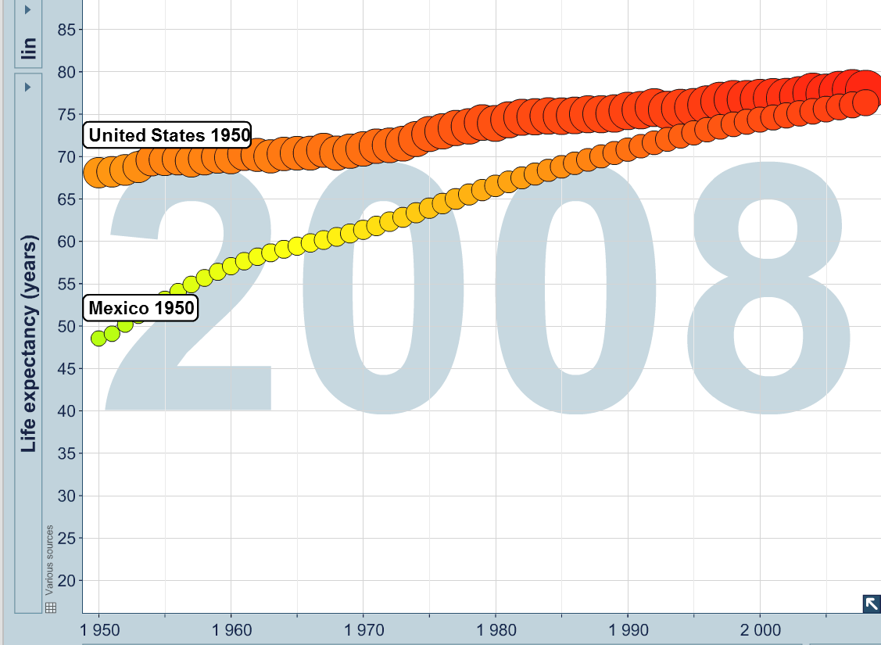
Grand Convergence in Mexico, 1950-2012

Slide 54
Implications of the ETH for USAID
Celebrate accomplishment and move on to bold end games for a Grand Convergence in GH
Engage L-MICs in new ways & towards UHC
New ways of working at USAID
GHI principles (country ownership, HSS)
Greater value of GHD & local advocacy
Planning for “The Ultimate Day…”
…to achieve a decisive turn-around in the fate of the less-developed world, looking toward the ultimate day when all nations can be self-reliant and when foreign aid will no longer be needed. President Kennedy, 1961.

Slide 55
THANK YOU !

Slide 56
Universal Health Coverage: Progressive Pathways to Achieving Convergence
Professor K Srinath Reddy
President, Public Health Foundation of India

Slide 57
Global Health 2035: Emphasizes Financial Risk Protection
Health systems have two main goals:
Since publication of WDR 1993, growing evidence on burden of such impoverishment
150 million people/y suffer financial catastrophe because of medical spending
Public spending should achieve health gains and FRP
Providing financial risk protection (FRP)—preventing households from medical impoverishment
Improving health status

Slide 58
Introduction of UHC provides FRP
UHC is end state of coverage to everyone with comprehensive set of interventions and no out of pocket expenses for this package
Involves pre-payment and pooling of funds to extend publicly financed insurance
It has a positive effect on FRP
Households in Mexico and Thailand enrolled in UHC schemes saw reduced incidence of catastrophic health expenses

Slide 59
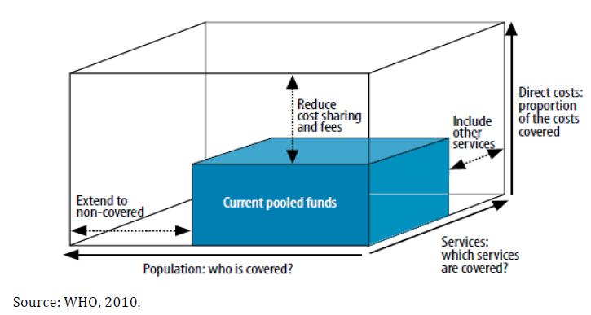
Three Dimensions of the UHC Cube

Slide 60
How to Move Through the Cube?
What works best depends on country’s starting point, nature/capacity of its institutions, national values, etc.
Global Health 2035 argues for initial focus on financing interventions towards grand convergence + essential interventions for NCD/injury to maximize health status and FRP
Progressive universalism: “a determination to include people who are poor from the beginning” (Gwatkin & Ergo)
Builds on Gro Brundtland’s new universalism: “if services are to be provided for all, then not all services can be provided. The most cost-effective services should be provided first.”

Slide 61
Progressive Universalism
Insurance covers whole population
Targets poor by insuring highly cost-effective health interventions for diseases disproportionately affecting poor
Interventions are funded through tax revenues, payroll taxes, or combination
No user fees for the defined benefit package of publicly financed services
As resource envelope grows, so does package (as seen in Mexico), e.g. add wider range of interventions for NCDs

Slide 62
Blue Shading: Initial Trajectory of Progressive Universalism
+ NCDs

Slide 63
Advantages of Progressive Universalism
Government does not have to incur costly administrative expenses identifying who is poor (everyone is covered)
Universal package promotes broader support among population and health providers than schemes targeting poor alone—such support helps to sustain financing over time

Slide 64
A Variant of Progressive Universalism
Larger package to whole population with patient copayment but poor are exempted from copay (e.g. Rwanda)
Uses a wider variety of financing mechanisms (general taxation, payroll tax, mandatory insurance premiums, copayments)
Advantages: wider package, engages non-poor in prepaid mandatory scheme from day 1, transition may be more feasible
Major disadvantage: costly to identify poor, to organize and collect copays/premiums

Slide 65
Four Benefits to Countries of Adopting Progressive Universalism
1
2
3
4
Poor gain the most in terms of health and FRP
Approach yields high health gains per $ spent
Public money is used to address negative externalities of infectious disease transmission
Implementation success in many low- and middle-income countries has shown feasibility

Slide 66
Thank you
GlobalHealth2035.org

