Slide 1
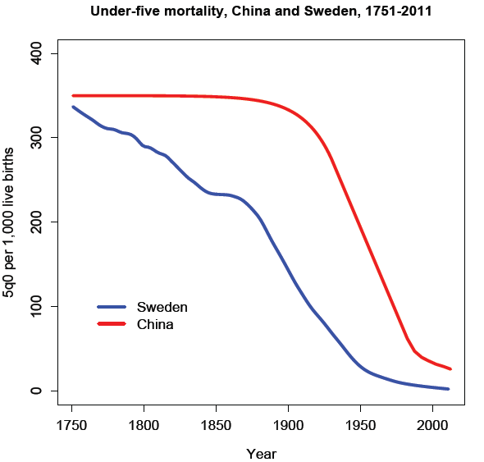
Two Centuries of Divergence; ‘4C Countries’ Then Converged

Slide 2
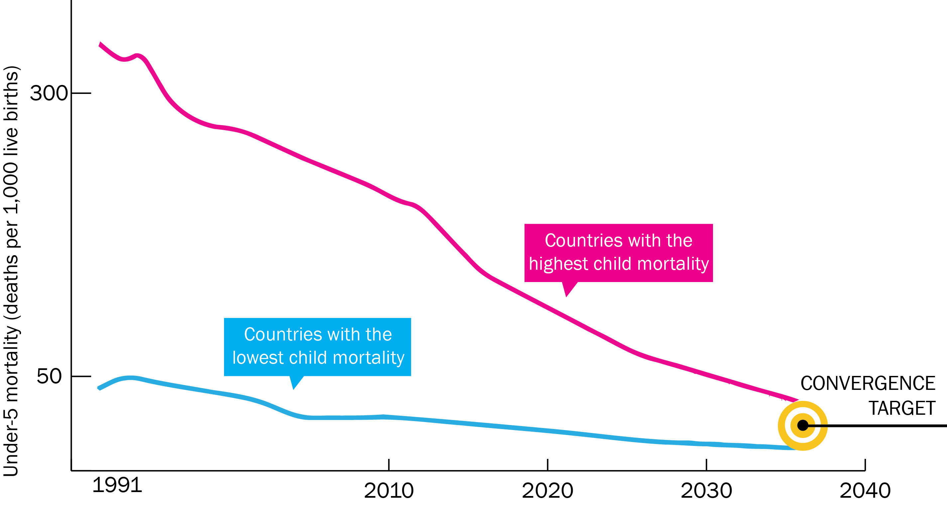
Now on Cusp of a Historical Achievement: Nearly All Countries Could Converge by 2035

Slide 3
Impact and Cost of Convergence
Low-income countries | Lower middle-income countries
Annual deaths averted from 2035 onwards
4.5 million | 5.8 million
Approximate incremental cost per year, 2016-2035
$25 billion (a doubling of current spending) | $45 billion (a 20% increase over current spending)
Proportion of costs devoted to structural investments in health system
60-70% | 30-40%
Proportion of health gap closed by existing tools (rest closed by R&D)
2/3 | 4/5

