Slide 1
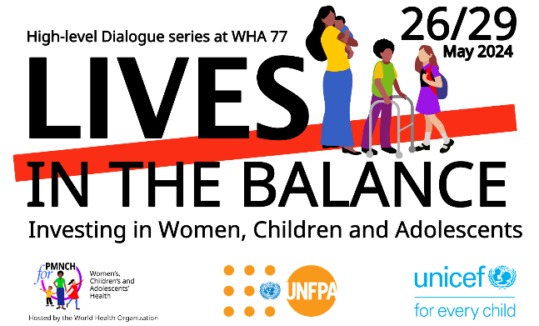
The Commission on Investing in Health 3.0
Gavin Yamey MD, MPH
Director, Center for Policy Impact in Global Health, Duke University
Chair, PMNCH Economics & Finance Workstream
Commissioner, Lancet Commission on Investing in Health

Slide 2
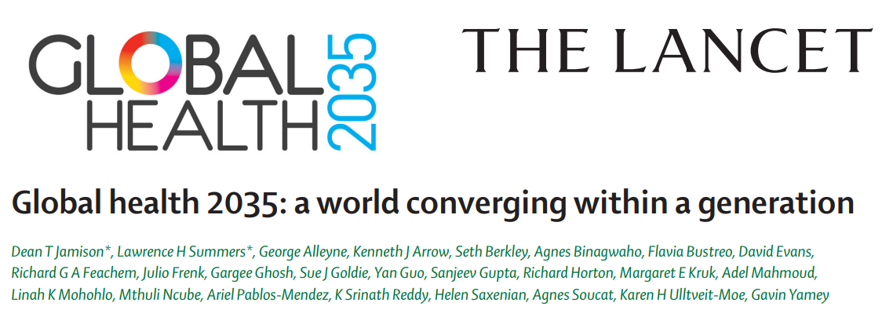
The Commission on Investing in Health 1.0 - 2013
Notes:
In 1993, the World Bank published its World Development Report, “Investing In Health.” Aimed at finance ministers and aid donors, the report’s central message was that targeted spending on cost-effective interventions for high-burden diseases could rapidly improve population-wide health outcomes, boost the economy, and improve human welfare. Twenty years later, in 2013, this message was echoed in the first report of the Lancet Commission on Investing in Health, CIH 1.0, called “Global health 2035: a world converging within a generation.”
The Commission worked closely with PMNCH on CIH 1.0. PMNCH convened the multi-stakeholder development of a landmark RMNCH investment case and related Lancet paper, which was a key underpinning of the broader Lancet CIH process, + PMNCH was in involved in key message development and dissemination of the CIH findings.

Slide 3
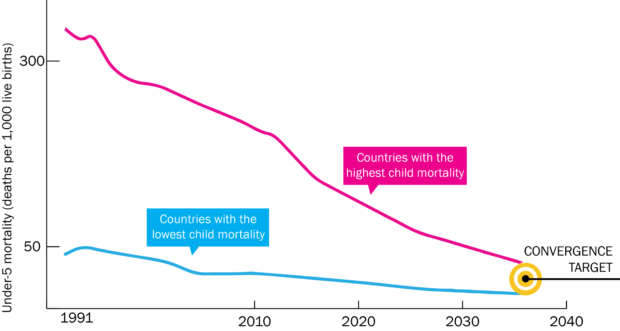
Technical & Financial Feasibility of Grand Convergence
Notes:
GH2035 concluded that aggressive scale-up of existing health technologies and development of new ones could lead to a “grand convergence”—a universal reduction in infectious disease, child, and maternal mortality down to rates seen in the best-performing middle-income countries

Slide 4
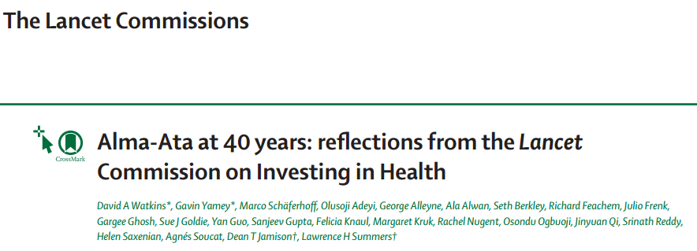
The Commission on Investing in Health 2.0 - 2018
Notes:
CIH 2.0 was published five years later, in 2018, to mark the 40 year anniversary of the influential Alma Ata Declaration on “health for all.” It gave us an opportunity to assess progress towards grand convergence and to reflect on the future of the global push for UHC.

Slide 5
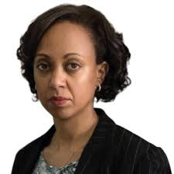

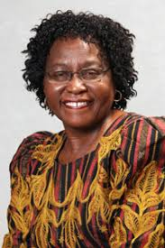
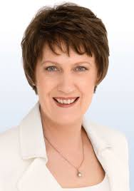
The Commission on Investing in Health 3.0 - 2024
Global Health 2050 identifies opportunities for investing in health in the post-COVID era that can succeed despite multiple headwinds:
  Rising geopolitical tensions, conflicts
  Increasingly manifest climate change
  Growth in nationalistic populism
  Slowed progress towards UHC
  Pandemic risk
6 emerging conclusions that I will share today for your responses and feedback
Report will be launched at the World Health Summit in Berlin, October 15, 2024
Lia Tadesse
Commissioner
Angela Chang
Commissioner
Olive Shisana
CIH 3.0 Adviser
Helen Clark
CIH 3.0 Adviser

Slide 6
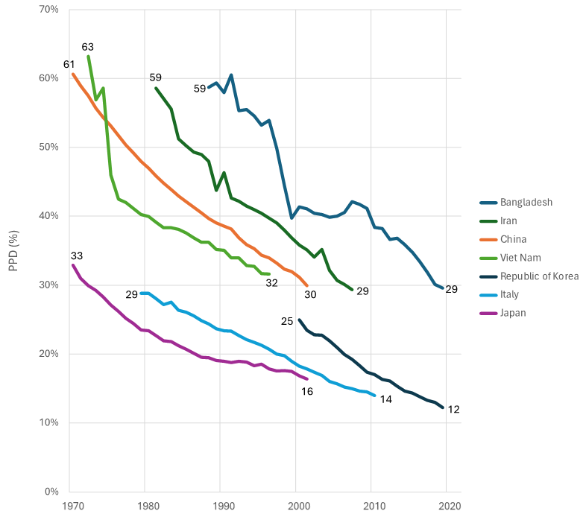
Conclusion 1: Dramatic Gains in Welfare Are Within Reach
50 by 50: Halving the probability of premature death (PPD)—death before age 70—by 2050, from a 2019 baseline (i.e., over 31 years)
Interim milestone of
30 by 35: Reducing PPD by 30% by 2035
7 high-population countries that achieved a halving of PPD in the last half century over 31 years or less
Notes:
In CIH 3.0, we advance the argument that reduction in the rate of premature mortality—the probability that members of a country’s population die before age 70—serves well as a single goal. We show that dramatic improvements in human welfare are achievable everywhere by 2050 with the right health investments. Countries that choose to do so can halve their probability of premature death, or PPD, by the middle of the century, achieving “50 by 50.’ A reasonable milestone on the way to the 2050 target would be to reduce this probability by 30% before 2035, or “30 by 35.” Historical experience and continued scientific advance indicate feasibility. The figure shows seven, diverse high-population nations that halved their chances of premature death in the last half century over 31 years or less. We know it can be done.
Achieving a halving of premature mortality by 2050 would mean a convergence toward mortality levels now experienced by the lowest mortality countries. Thus, in Global Health 2050, we are introducing a broader concept of grand convergence than we did in CIH 1.0, one that requires reducing deaths from NCDs and injuries as well as from infectious and maternal health conditions.

Slide 7
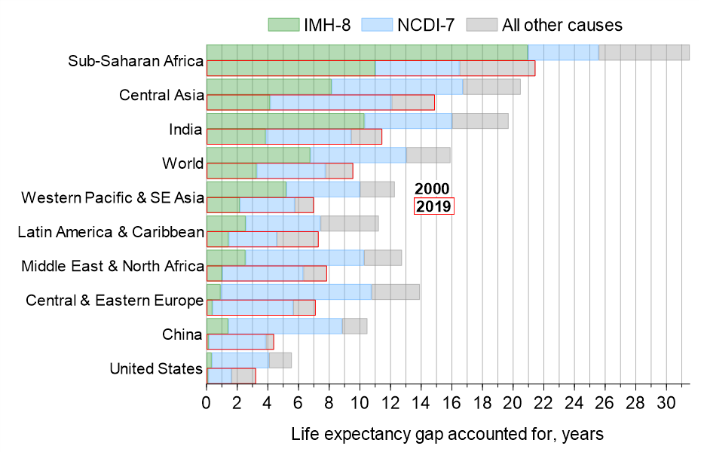
Conclusion 2: A Remarkably Narrow Set of Conditions Needs to be Targeted
Causes of the life expectancy gap compared to the “North Atlantic” in 2019
Notes:
The 2035 and 2050 mortality reduction targets described in the previous slide can be reached through tackling a remarkably narrow set of just 15 conditions. Eight are infections and maternal health conditions (the IMH-8): lower respiratory infections, neonatal conditions, diarrheal diseases, AIDS, tuberculosis, malaria, vaccine-preventable diseases, and maternal conditions. Seven are NCDs and injuries (the NCDI-7). The figure shows the life expectancy gap between different regions and what we call the North Atlantic (western European nations and Canada; we exclude the US, which performs much worse). Here, you can see that in the year 2000, the life expectancy gap between Sub-Saharan Africa and the North Atlantic was 32 years and the IMH-8 accounted for about two thirds of his gap. Even by 2019, the IMH-8 were the cause of half this life expectancy difference.
In countries that currently have high levels of premature mortality, a tight focus on tackling these eight causes will have an enormous payoff. Similarly, countries with currently low levels of premature mortality can progress rapidly toward halving premature mortality by carefully focusing on the NCDI-7.

Slide 8
Conclusion 3: Publicly Subsidize Critical Drugs & Other Commodities for the 15 Priority Conditions
  Governments struggle to fund interventions even for these 15 conditions:
    Aging populations, shrinking working age populations, macroeconomic distress
  Strong case for nations to choose finance mechanisms targeting these 15 conditions:
    Steers intervention efforts in priority directions, reduces the most common cause of catastrophic OOPs, uses pricing policy to slow the development of AMR
  We propose a public procurement & subsidy (“Arrow mechanism)
    Subsidize commodities, procure them more efficiently, procure adequate supplies to be inserted at the top of domestic supply chains both public and private

Slide 9
Conclusion 4: Accompany Focused Financing With Focused HSS (A “Modular” Approach)
IMH-8 module | High priority interventions in module | Primary outcome metric (secondary outcome metric) | Examples of essential medicines that could be targeted by the Arrow mechanism
Routine childhood immunization | All antigens recommend by WHO for all countries (n=11) | Child deaths averted (child height for age) | Pentavalent vaccine, measles vaccine, polio vaccine
Pregnancy and childbirth care | Antenatal care, safe delivery, management of labor complications, routine care for postpartum women, neonatal care | Maternal deaths averted (stillbirths and neonatal deaths averted) | tranexamic acid, oxytocin, chlorhexidine
Notes:
Global Health 2050 proposes a modular approach to health system strengthening that allows both for initial tight focus and gradual broadening of effort as the 15 priority conditions become more fully addressed. We introduce modular cost effectiveness, a tool that countries can use to support the choice of modules in developing health benefits packages.

Slide 10
Conclusion 5: Use Fiscal Policy to Control Use of Harmful Substances
  Increasing taxes on tobacco can do more to reduce premature mortality than any other single health policy
    Triple win: reduces illness and death, raises revenue, and taxation is pro-poor
  Taxation of SSBs and ultra-processed foods can curb consumption
  Sharply cut fossil fuel subsidies
    Triple win: improved population health, improved public finances, and a decreased rate of global warming

Slide 11
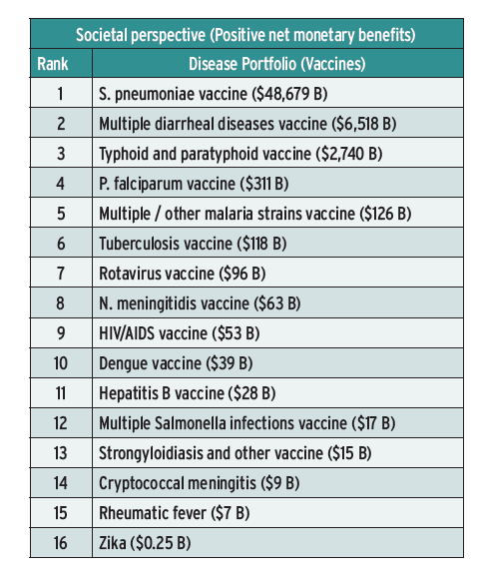
Conclusion 6: Scaled Up Investments In R&D for New Vaccines Generated Huge Health & Economic Returns
Notes:
When CIH 1.0 was published in 2013, there were no malaria vaccines and the only available TB vaccine was BCG, which had low efficacy. Today, 2 malaria vaccines have been approved—one in 2021 and one in 2023—and three promising TB vaccine candidates are now in late stage trials. These examples show the enormous value in funding development of needed medicines, vaccines, and diagnostics against priority diseases. A large body of research has shown the exceptionally high health and economic returns to investing in such R&D. Unfortunately, financing for the discovery and development of new health technologies is under threat, as is funding for widespread manufacture and deployment of vaccines that recently came to market.

Slide 12
Thank You
gavin.yamey@duke.edu
@gyamey

