Slide 1

Achieving UHC Through Primary Health Care
Reflections on Alma Ata at 40 from the Lancet Commission on Investing in Health
Moderator: Gavin Yamey
Director, Center for Policy Impact in Global Health, Duke University
CUGH Day 1: March 8, 2019

Slide 2
Global Health 2035: WDR 1993 @20 Years
The World Bank’s World Development Report 1993
Evidence-based health expenditures are an investment not only in health but in economic prosperity
The 2013 Lancet Commission on Investing in Health (chaired by Lawrence Summers and Dean Jamison)
Re-examined the case for investing in health
Additional resources should be spent on cost-effective interventions to address high-burden diseases
Provided a roadmap to achieving dramatic gains in global health by 2035
Proposed a health investment framework for low- and middle-income countries

Slide 3
2015-2035: Three Domains of Health Challenges
High rates of avertable infectious, child, and maternal deaths
Unfinished agenda
Global shift towards non-communicable diseases (NCDs) and injuries
Emerging agenda
Impoverishing medical expenses, unproductive cost increases
Cost agenda

Slide 4
Global Health 2035: 4 Key Findings
The returns from investing in health are extremely impressive
A grand convergence in health is achievable within our lifetime
Fiscal policies are a powerful, underused lever for curbing non-communicable diseases and injuries
Pro-poor pathways to universal health coverage are an efficient way to achieve health and financial protection

Slide 5
Global Health 2035: 4 Key Findings
The returns from investing in health are extremely impressive
A grand convergence in health is achievable within our lifetime
Pro-poor pathways to universal health coverage are an efficient way to achieve health and financial protection
Fiscal policies are a powerful, underused lever for curbing non-communicable diseases and injuries

Slide 6
Two Centuries of Divergence; ‘4C Countries’ Then Converged

Slide 7
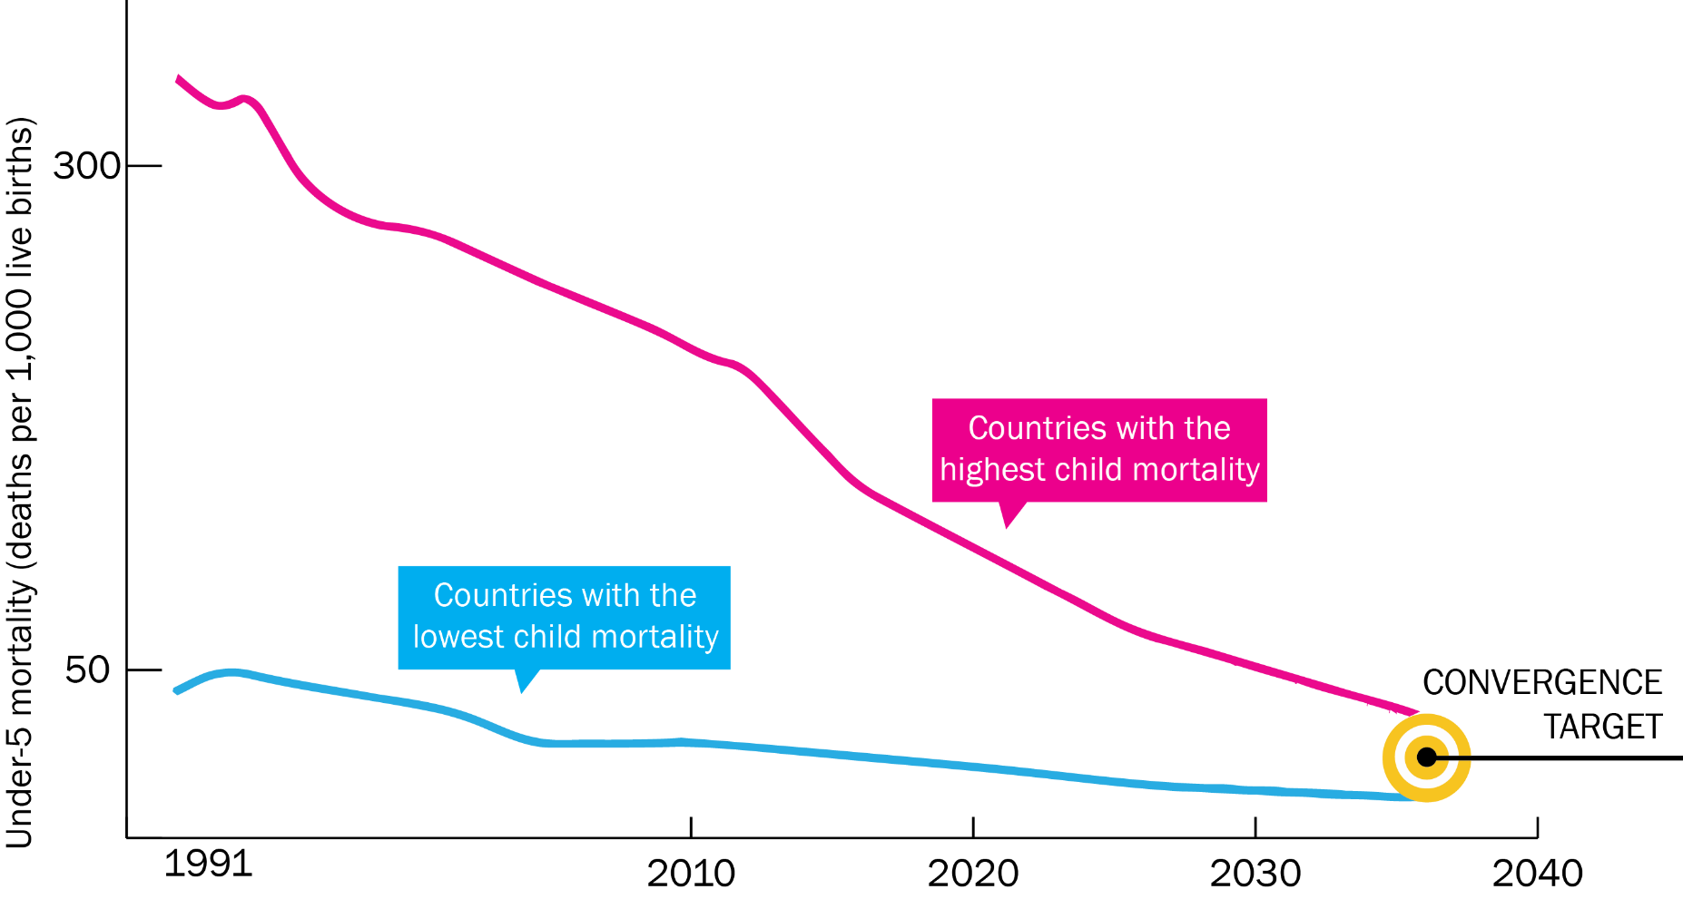
Now on Cusp of a Historical Achievement:
Nearly All Countries Could Converge by 2035

Slide 8
Impact and Cost of Convergence
Low-income countries | Lower middle-income countries
Annual deaths averted from 2035 onwards
4.5 million | 5.8 million
Approximate incremental cost per year, 2016-2035
$25 billion | $45 billion
Proportion of costs devoted to structural investments in health system
60-70% | 30-40%
Proportion of health gap closed by existing tools (rest closed by new tools)
2/3 | 4/5

Slide 9
Global Health 2035: 4 Key Findings
The returns from investing in health are extremely impressive
A grand convergence in health is achievable within our lifetime
Fiscal policies are a powerful, underused lever for curbing non-communicable diseases and injuries
Pro-poor pathways to universal health coverage are an efficient way to achieve health and financial protection

Slide 10
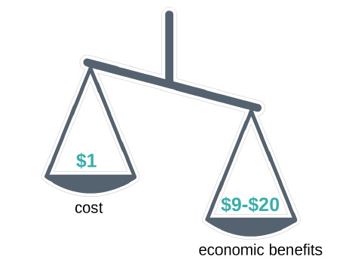
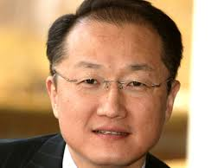
Convergence Has Impressive Benefit: Cost Ratio
“Further proof that improvements in human survival have economic value well beyond their direct links to GDP”
Jim Kim
World Bank President

Slide 11
Global Health 2035: 4 Key Findings
The returns from investing in health are extremely impressive
A grand convergence in health is achievable within our lifetime
Fiscal policies are a powerful, underused lever for curbing non-communicable diseases and injuries
Pro-poor pathways to universal health coverage are an efficient way to achieve health and financial protection

Slide 12

Single Greatest Opportunity To Curb NCDs is Tobacco Taxation
50% rise in tobacco price from tax increases in China
  prevents 20 million deaths + generates extra $20 billion/y in next 50 y
  additional tax revenue would fall over time but would be higher than current levels even after 50 y
  largest share of life-years gained is in bottom income quintile

Slide 13
Global Health 2035: 4 Key Findings
The returns from investing in health are extremely impressive
A grand convergence in health is achievable within our lifetime
Fiscal policies are a powerful, underused lever for curbing non-communicable diseases and injuries
Pro-poor pathways to universal health coverage are an efficient way to achieve health and financial protection

Slide 14
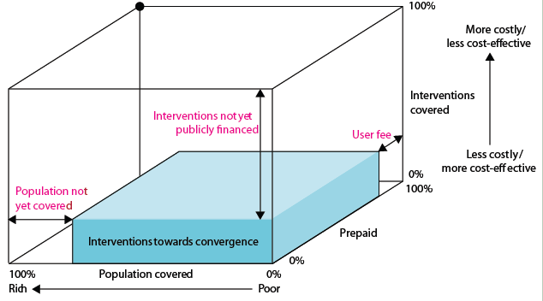
Our Recommendation on UHC:
Pro-Poor Pathway (Blue Shading)
+ essential package for NCDIs

Slide 15
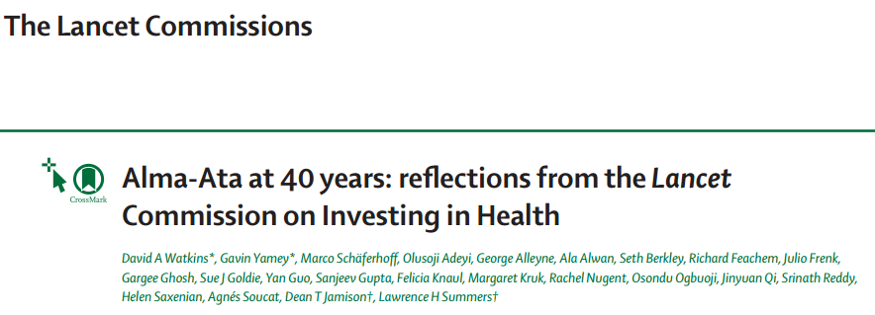

Slide 16
The World has Changed Since 2013
New and worsened health threats
Continued demographic shifts
Geopolitical shifts (e.g., health ODA)
MDG to SDG transition
Challenges to UHC and health finance
Environmental threats

Slide 17
Scope of the New Report
On track for grand convergence?
The future of PHC in the context of the modern UHC movement
The future of official development assistance (ODA) for health and its role in achieving grand convergence, UHC, and the health-related SDGs

Slide 18
Speakers
Sue J. Goldie, Roger Irving Lee Professor of Public Health, Harvard University, USA
Osondu Ogbuoji, Deputy Director, Center for Policy Impact in Global Health, Duke University, USA
David Watkins, Assistant Professor, Division of General Internal Medicine, University of Washington, USA
Agnes Soucat, Director of Health Systems Governance and Financing, WHO, Switzerland

